Slide 1
2024 New Officers Training
Jurisdictional Directors Presentation

Slide 2
Jurisdictional Disputes and Grievances
Overview of Policies and Procedures
for
Filing Grievances and Jurisdictional Disputes

Slide 3
I serve on the NMAPC Committee NABTU Boards Committee Department of Labor Davis Bacon Committee General Presidents Grievance and Jurisdictional Disputes Committee here to help!
Notes:
I recently participated in a hearing grievance and was selected to serve as a voting member it was three labor three management and one impartial hearing judge. 4 hours for late paychecks on a GPPMA project in 7 or 8 different. 80 k in back wages. Second time it happened payday was on Thursday, because of Columbus day the offsite payroll company had off and didn’t process on time which made all those paycheck late. The fine is 4 hours of wages and benefits for every day late.

Slide 4
We Will Cover
Pre-Job Briefs Jurisdictional Disputes / Grievance
NMA NCA GPPMA PLA Preparation What you will need / Where to find it What to document moving forward

Slide 5
There is an incredible amount of work that is started and is coming our way in the next few years
These Projects have incentive funding by the federal Government
Must be completed under a Project Labor Agreement.
( NCA / PLA / NMA / GPPMA )
President Bidens Infrastructure Act & Chips and Science Act

Slide 6
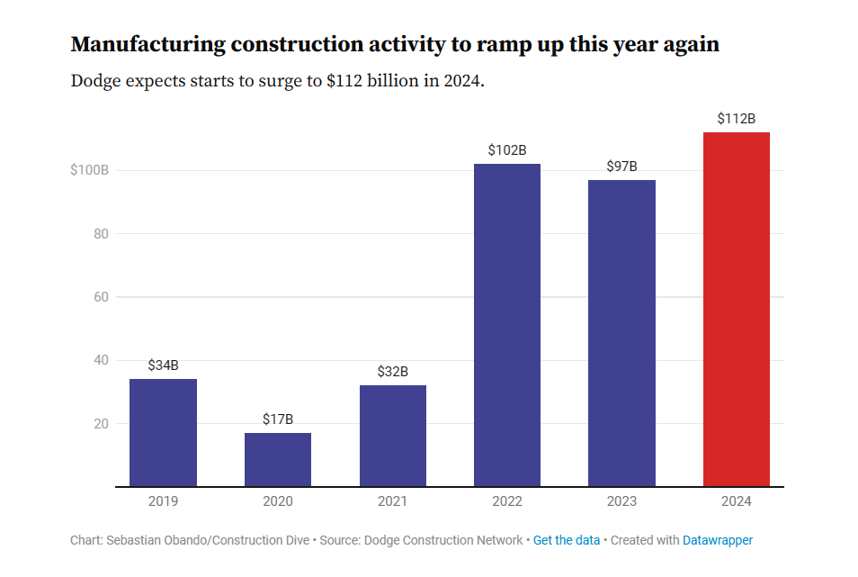

Slide 7
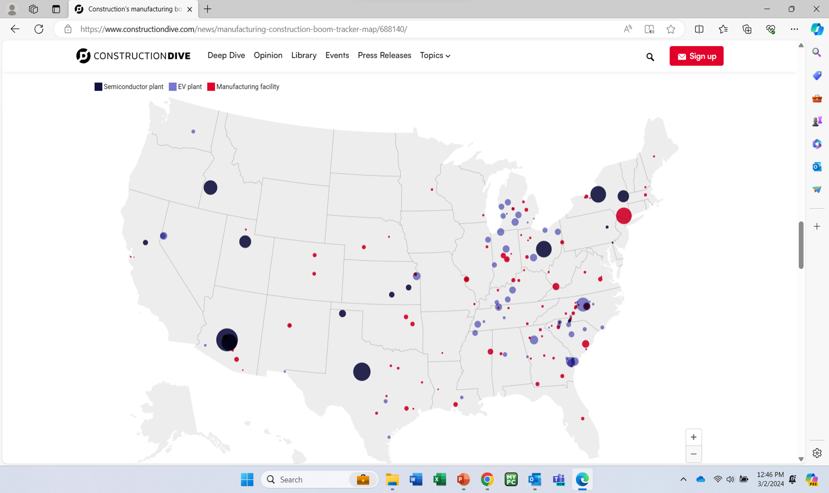

Slide 9
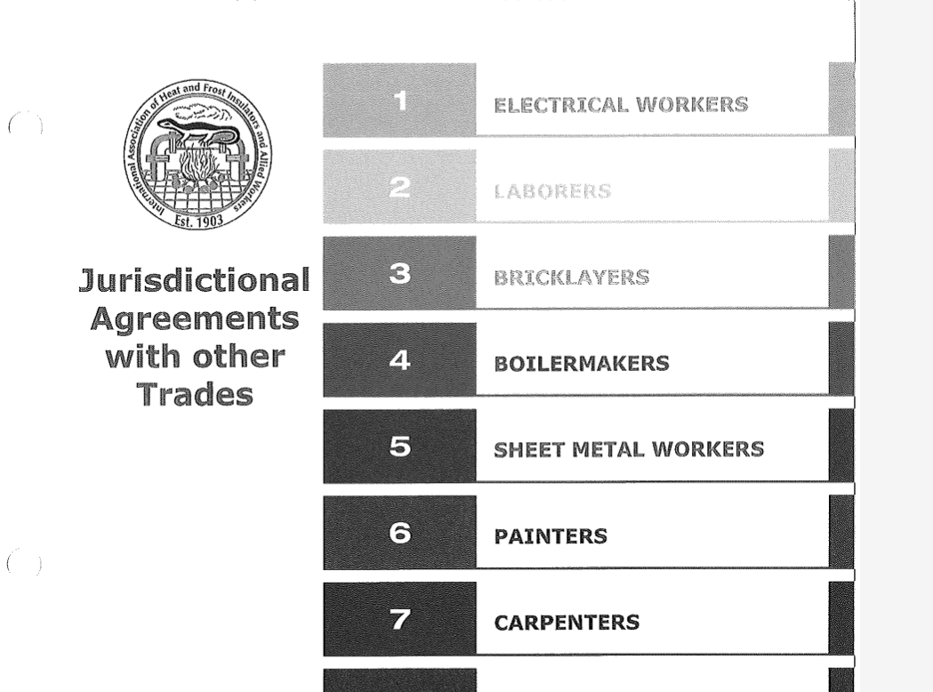
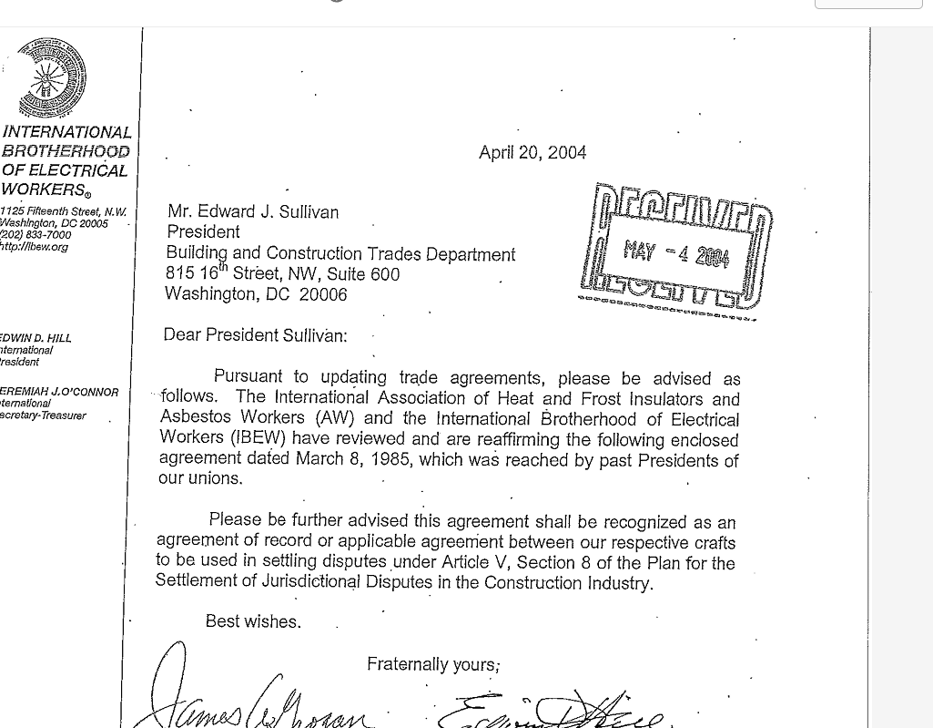

Slide 10
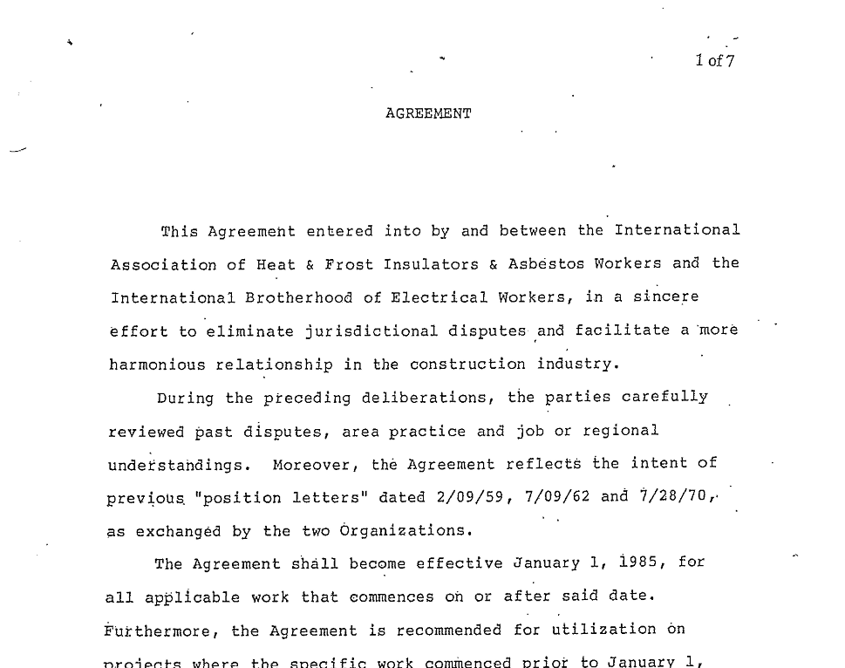

Slide 11
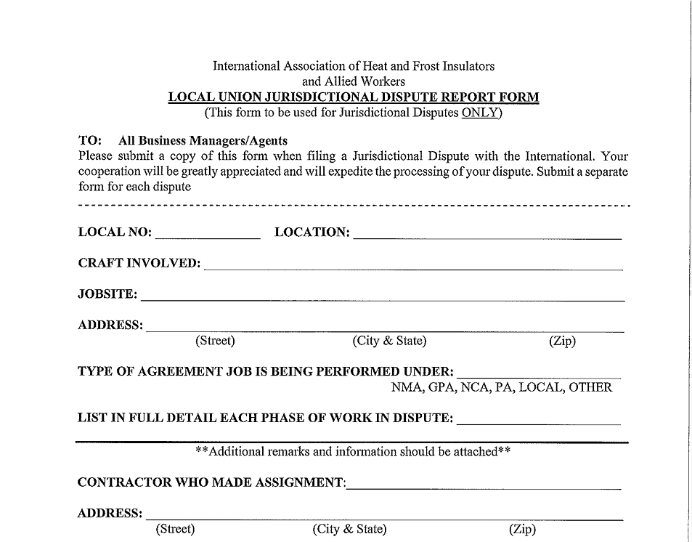

Slide 13
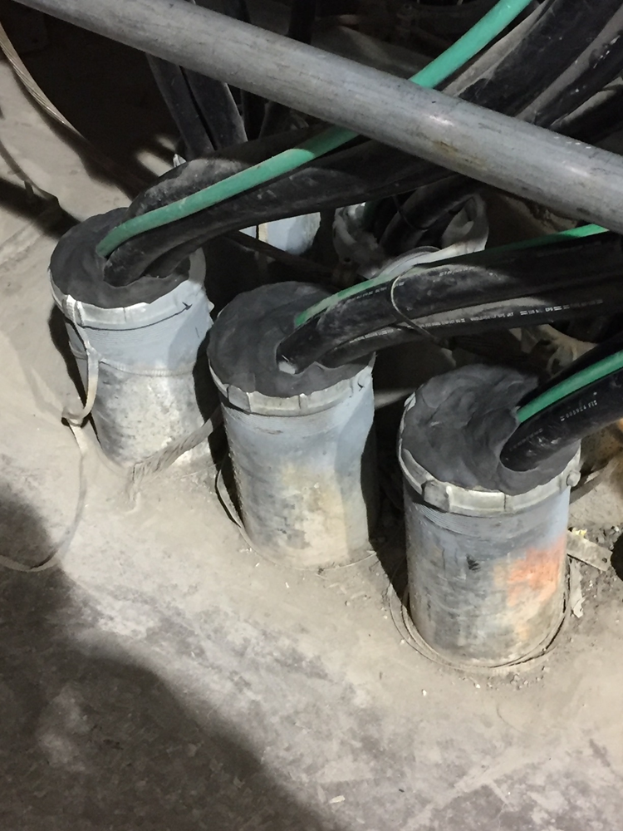

Slide 14
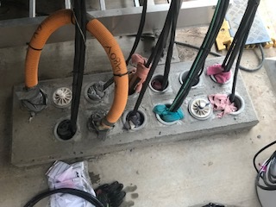

Slide 15
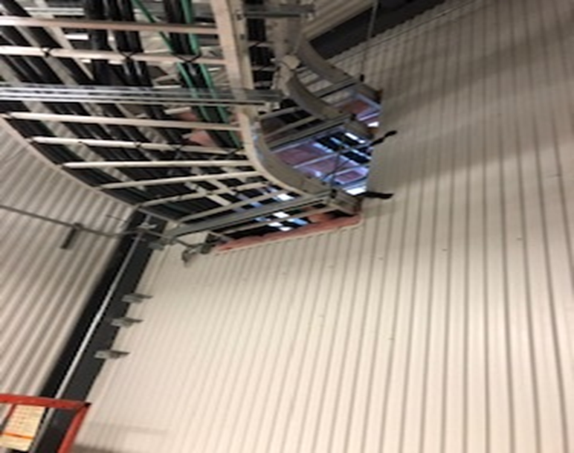

Slide 16
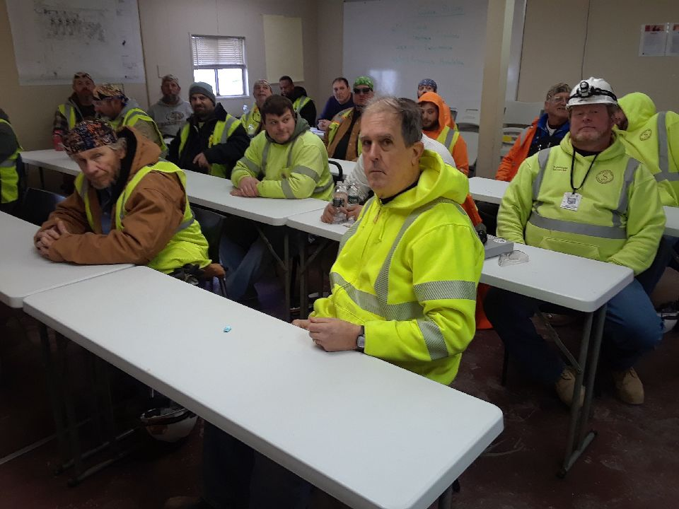

Slide 17
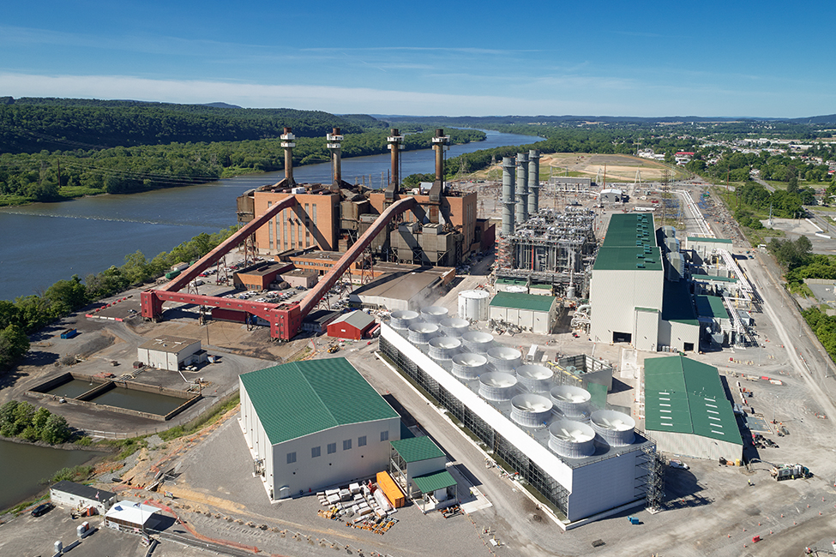

Slide 18
Plan for the Settlement of Jurisdictional Disputes
- PLAN -
Governed by the National Building
and Construction Trades
Agreements and Decisions Rendered Affecting The Building Industry
Notes:
Show a copy of the Plan “Explain” The Plan covers the procedural rules for settling jurisdictional disputes (for US and Canada) It also contains the decisions of records between trades that will be one of the things considered by the arbitrator when hearing the case. You can download a copy of the Plan at NABTU’s website under field services.

Slide 20
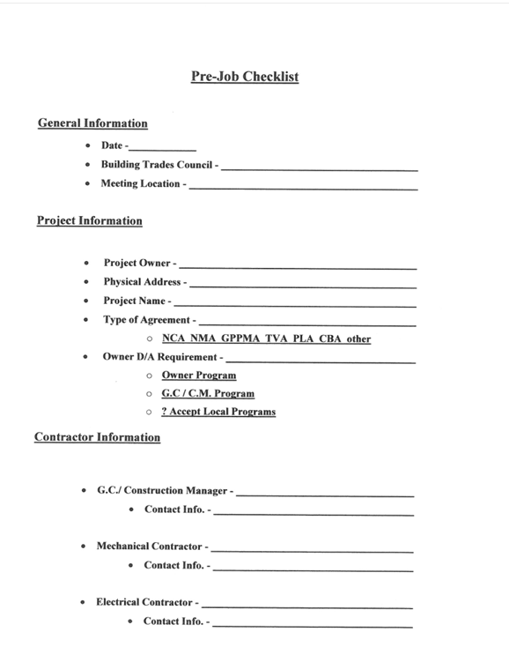

Slide 21
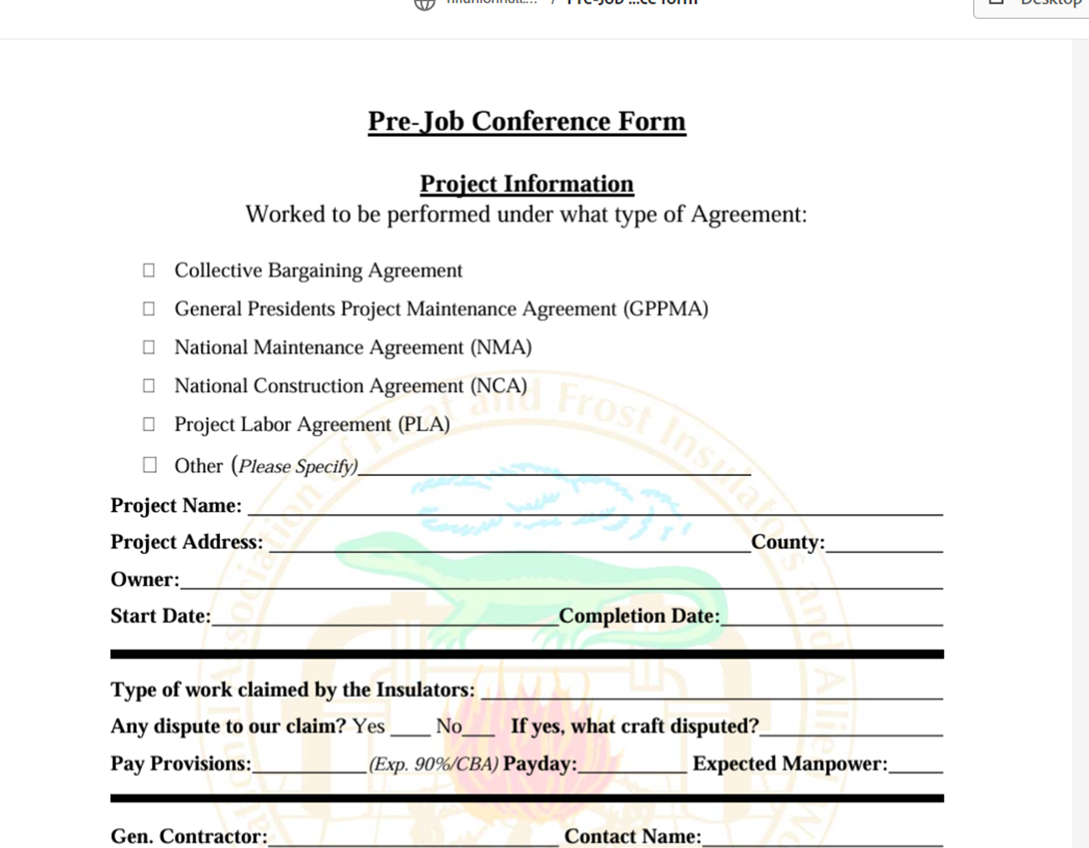

Slide 22
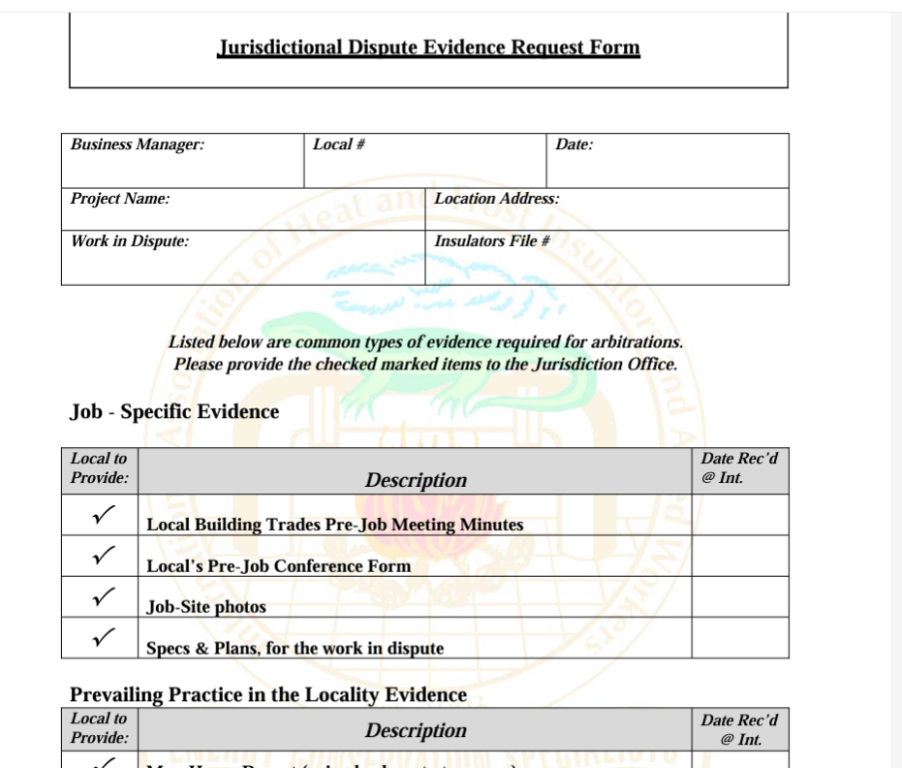
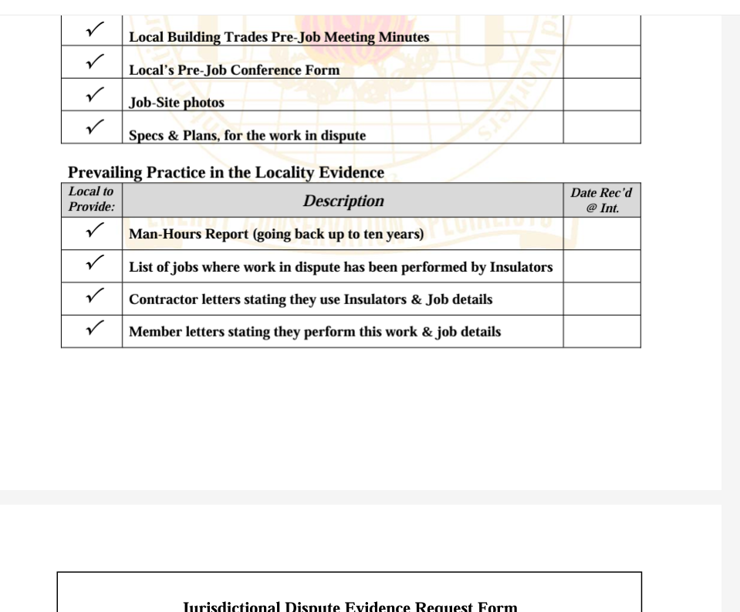

Slide 23
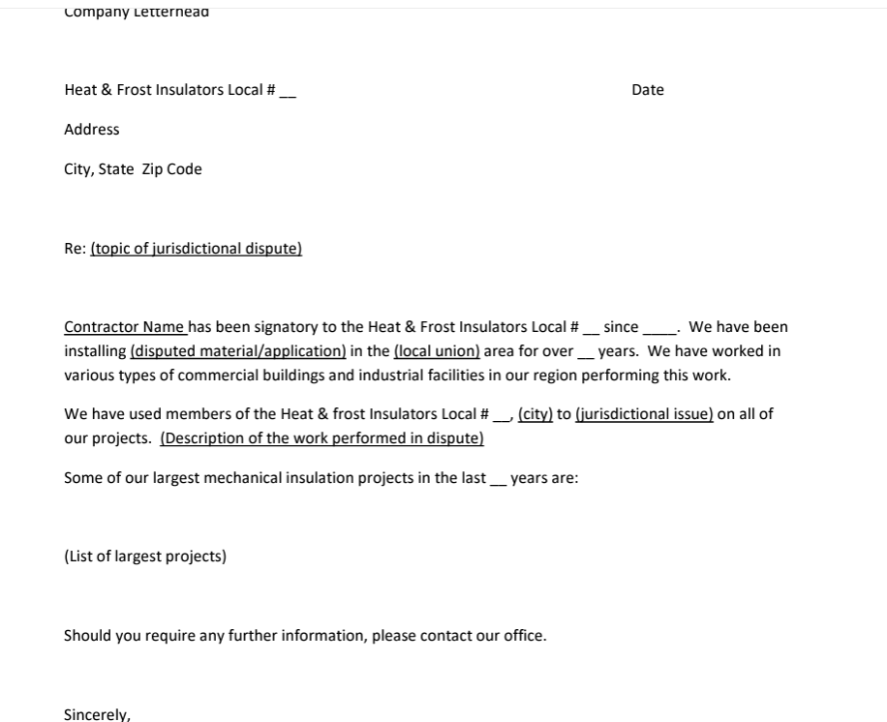
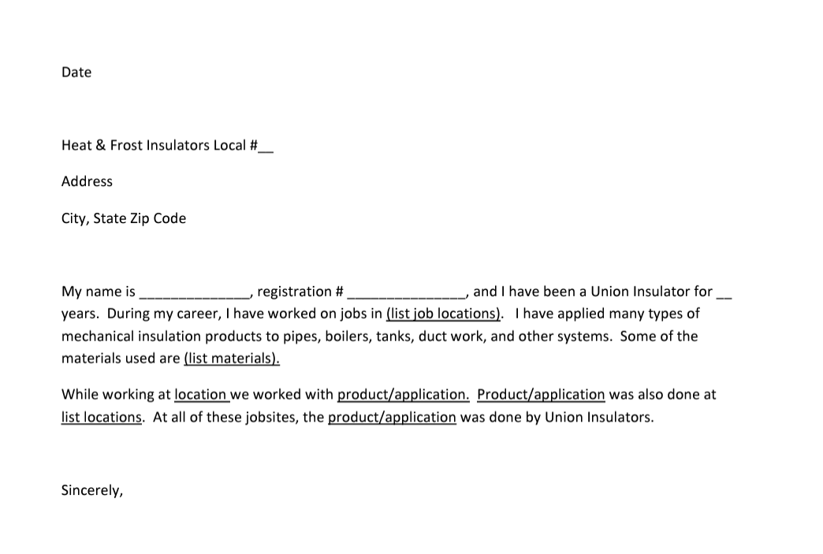

Slide 24
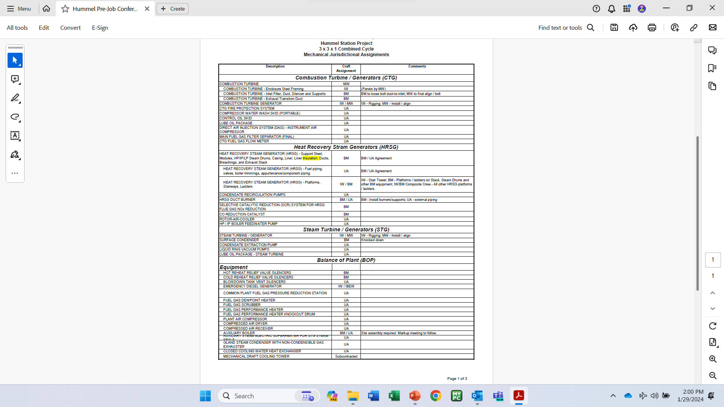
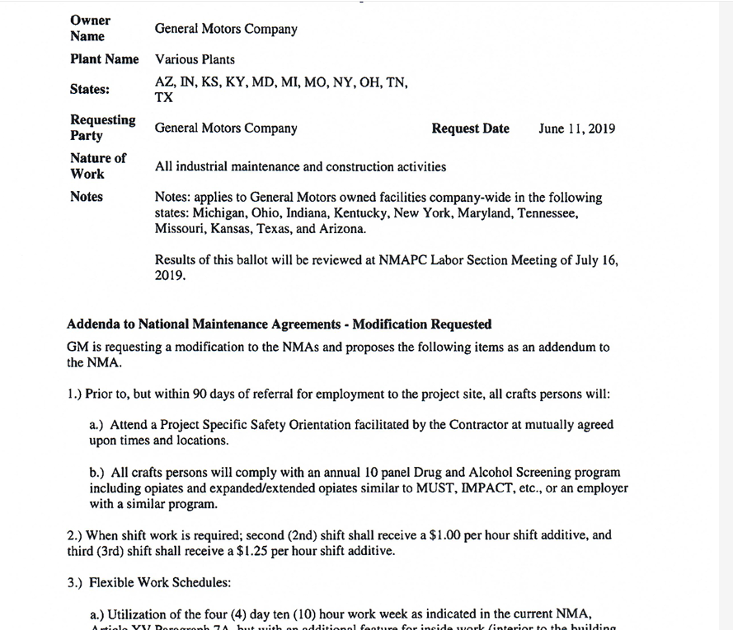
Addenda

Slide 27
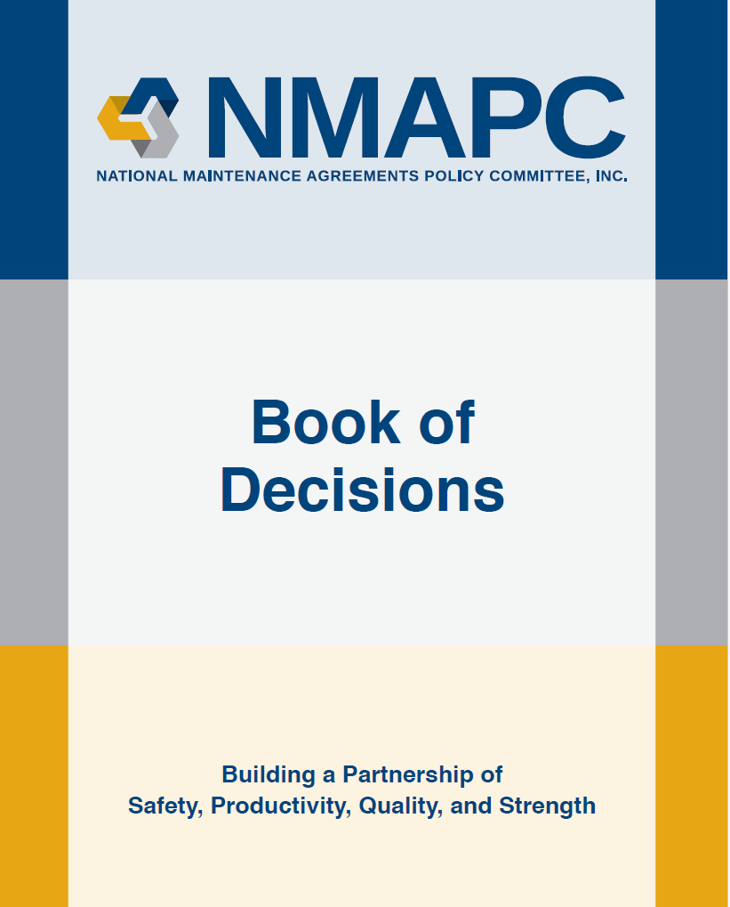

Slide 28
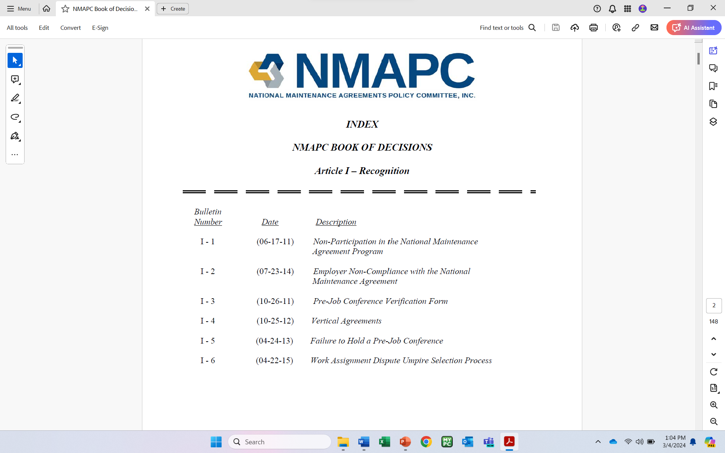

Slide 29
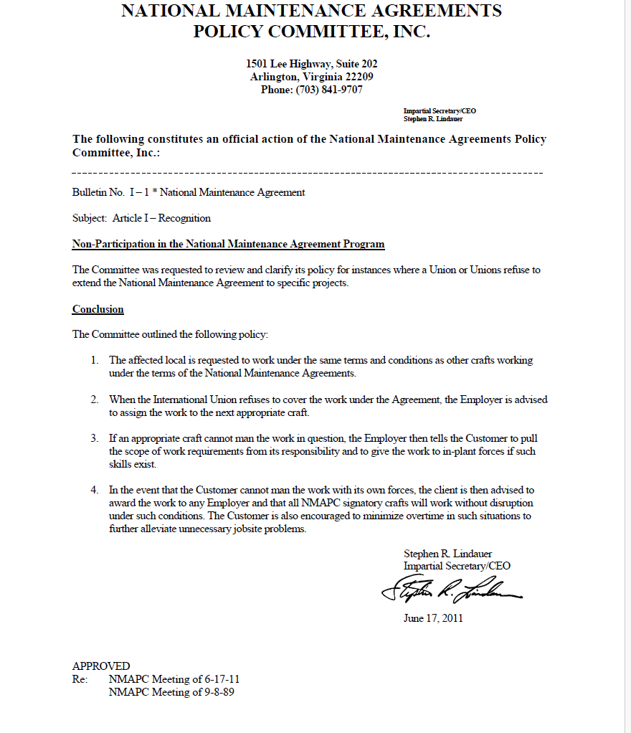

Slide 31
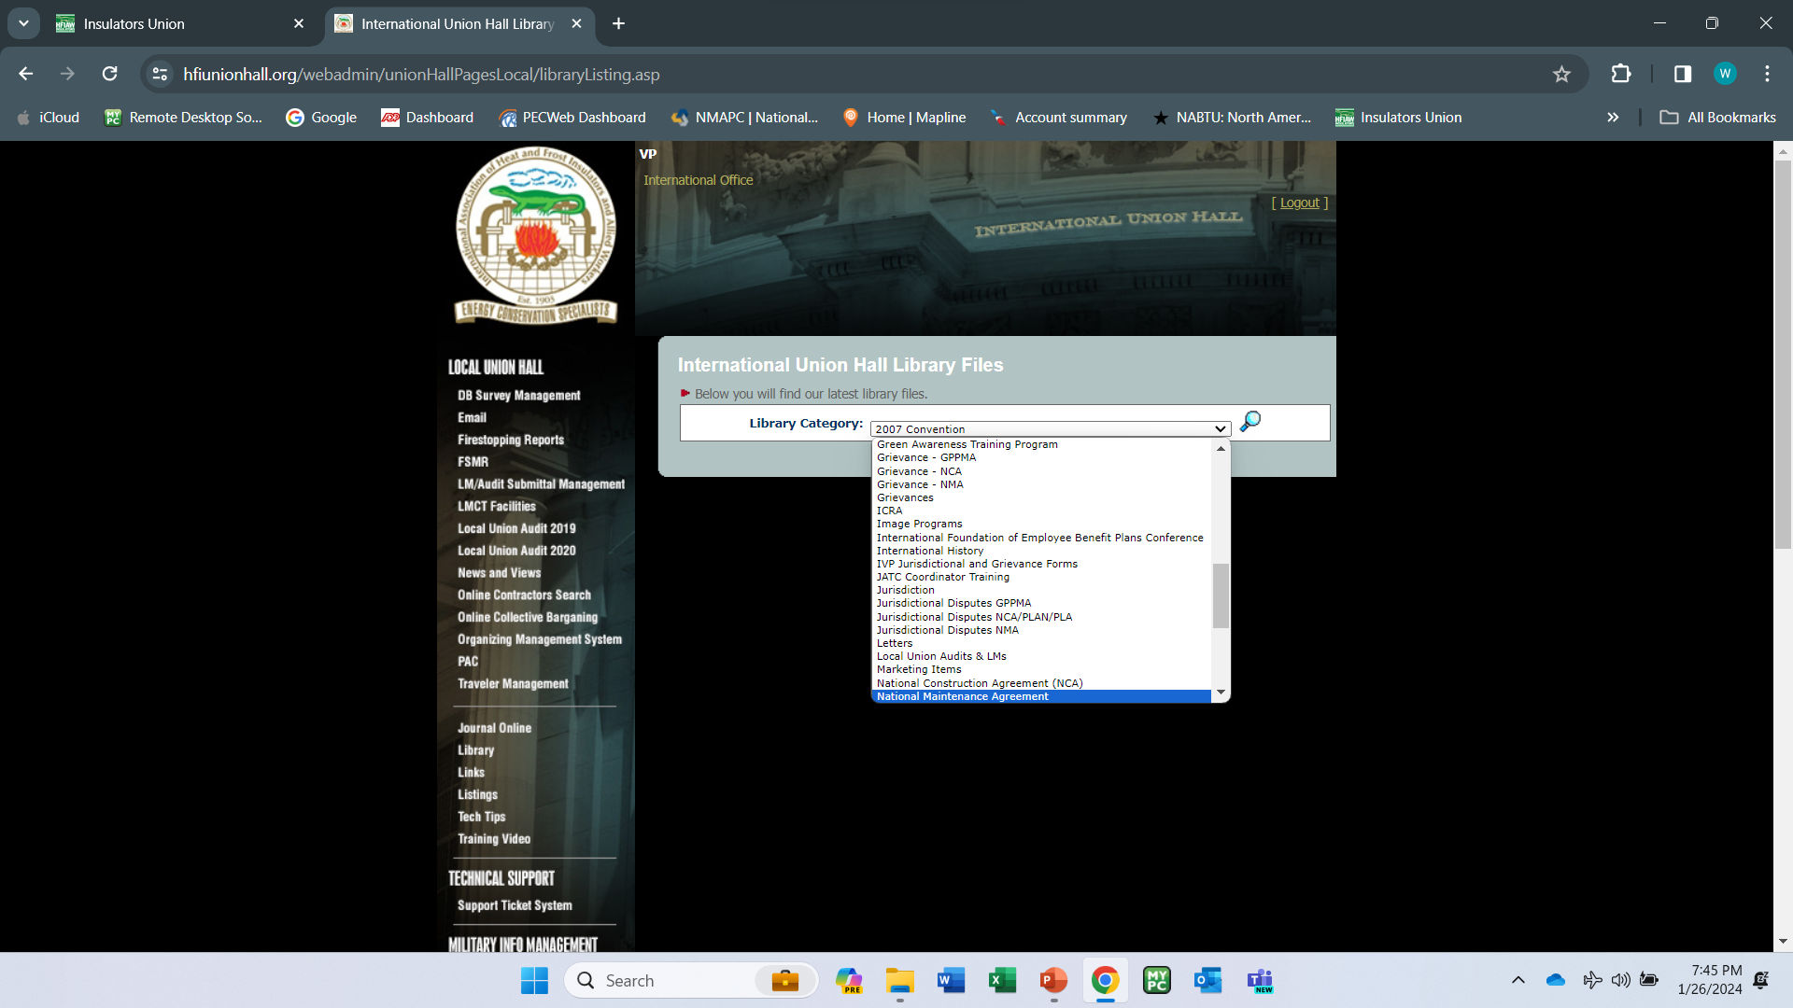

Slide 32
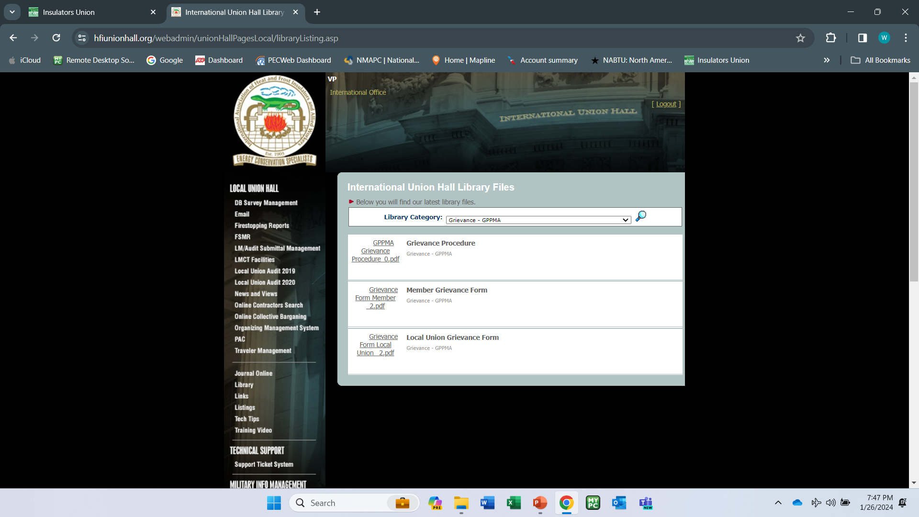

Slide 33
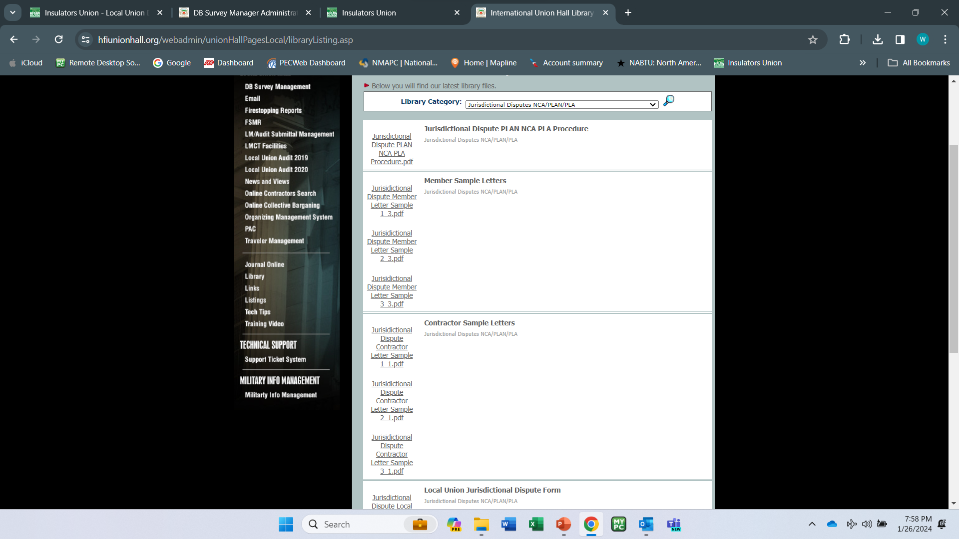

Slide 34
Agreements that Require the USE OF THE PLAn
Project Labor Agreements
PLA
NCA
National Construction Agreement
Project Maintenance and Modification Agreement
PMMA
TVA Work
Tennessee Valley Authority
CBA
work
No Local or National Agreement exist

Slide 35
Who is Stipulated to
the Plan
PLAN
International Unions
All International Unions in the National Building Trades.
Unions not affiliated
PLAN
All Unions not affiliated with the National Building Trades when working under the mentioned Agreements.
(exception is private CBA work)
PLAN
contractors
All Contractors working under the mentioned Agreements
(exception is private CBA work)

Slide 36
WHAT CONSTITUTES A
JURISDICTIONAL DISPUTE
When another craft is doing or claiming your work.
Work does not have to be started prior to filing Dispute.

Slide 37
Jurisdictional Dispute Procedures
- Try to resolve it at the Local Level -
Speak to the Contractor who was awarded the work.
Speak to the other Craft Representative.
Document all Communication with date, time, location, and who you spoke with.
These steps need to be done as soon as you are aware of the dispute.

Slide 38
Procedures
- If NO resolve is achieved -
1
3
2
5
contact
4
Dispute Form
Contact International Jurisdictional Director and provide all of the info to date.
Notify
action
Notify your Int. Vice President of the dispute.
consult
Int. J.D. will then provide a course of action.
Fill out Jurisdictional Dispute Form and send it to the International Jurisdictional Director.
Int. J.D. will then consult with the Manager/ Agent and the and
the Int. V.P. to go
over the dispute, as well as past practice.

Slide 39
Procedures
- If Dispute has Merit -
01
02
03
assign
Notification
resolve
International Jurisdictional Director will assign a International Vice President to the case in an attempt to resolve it at an International Level.
Notification sent to the other International notifying them of the dispute and who we have assigned to the dispute.
In turn the other International assigns a Rep. to work with our V.P. to come to a resolve.

Slide 40
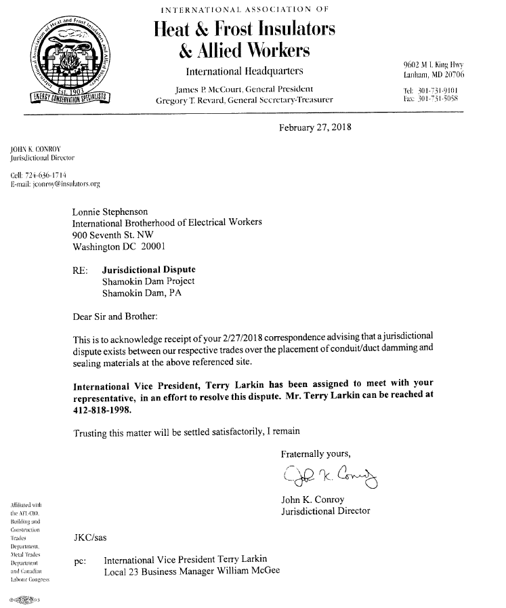
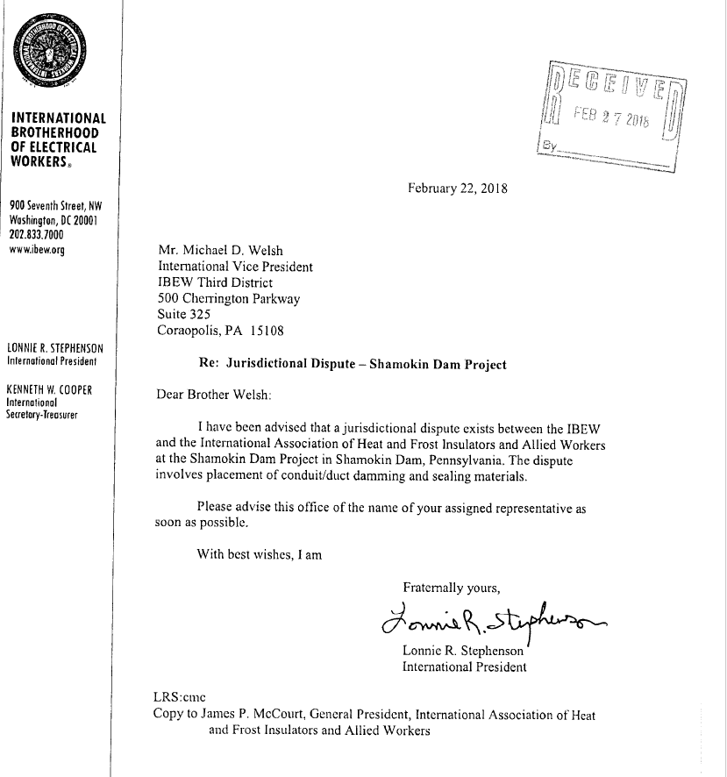

Slide 41
Procedures
Manager/Agent to provide all documentation
pertaining to the case to the J.D.
Letters from members
Letters from Contractors
Pre-Job minutes
Any and all documentation
Top priority
Minutes from any meeting.
Pictures showing past practices
Time is of the essence

Slide 42
Procedures
- If NO resolve at this level -
1
3
2
5
report
4
5 Days
Int. V.P. to fill out J.D. report and send to Jurisdictional Director.
files
3 Days
J.D. then files dispute with PLAN Administrator
7 Days
Arbitrator will have decision within three days.
We have five days from the time it is filed to decide to go to arbitration.
Arbitrator is chosen and a hearing set within seven days.

Slide 43
Arbitrator
An arbitrator considers and analyzes the evidence that both parties to a dispute present at a hearing.
The arbitrator draws on knowledge of relevant laws, precedents and policies to thoughtfully weigh the merits of each side's perspective and then determine judgement.

Slide 44
Arbitrator
What the Arbitrator looks at when rendering a decision
Existing agreements of records between the crafts involved.
Previous decisions of records.
Established Trade practices in the industry.
Comprehensive and professional presentation.
Prevailing practice in the locality.
Documentation of past practice.

Slide 45
Arbitrator
What is needed for a successful Arbitration
DOCUMENTATION

Slide 46
Jurisdictional Disputes National Maintenance Agreement
N.M.A.
Who is stipulated to the N.M.A.
Any and all Contractors and Unions working under this agreement.

Slide 47
Jurisdictional Disputes National Maintenance Agreement N.M.A.
- Try to resolve it at the Local Level -
Speak to the Contractor who was awarded the work.
Speak to the other Craft Representative.
Document all Communication with date, time, location, and who you spoke with.
These steps need to be done as soon as you are aware of the dispute.

Slide 48
Jurisdictional Disputes National Maintenance Agreement - N.M.A. -
01
02
03
Notification
assign
documentation
A party challenging the assignment shall notify all affected parties / Unions – Int. J. D. & Int. V.P. / Employer.
Int. V.P. will be assigned to the dispute.
Provide any and all documentation to the J.D.

Slide 49
Jurisdictional Disputes National Maintenance Agreement - N.M.A. -
1
3
2
5
resolve
4
7 Days
At this step the V.P. has five days to come to a resolve.
5 Days
3 Days
Present
Arbitrator/ Umpire shall hold a hearing within seven days.
If after five days there is no resolve the J.D. can refer it to the N.M.A.P.C. for Arbitration.
Arbitrator shall issue a decision within three days.
J.D. will present the case.

Slide 50
Jurisdictional Disputes General Presidents Project Maintenance Agreement G.P.P.M.A.
Who is stipulated to the G.P.P.M.A.
Any and all Contractors and Unions working under this agreement.

Slide 51
Jurisdictional Disputes General Presidents Project Maintenance Agreement G.P.P.M.A.
- Try to resolve it at the Local Level -
Speak to the Contractor who was awarded the work.
Speak to the other Craft Representative.
Document all Communication with date, time, location, and who you spoke with.
These steps need to be done as soon as you are aware of the dispute.

Slide 52
Jurisdictional Disputes General Presidents Project Maintenance Agreement G.P.P.M.A.
01
02
03
04
Report
assign
Meet
resolve
If no resolve the J.D. will submit a statement of facts and a request to the General Presidents Committee for assistance in resolving the
said dispute.
Provide any and all documentation to the J.D
J.D.will notify the other International Union of the dispute and assign a IVP to the case. Other Int. Union will do the same.
The two Int. Reps shall meet and try to come to a resolve.

Slide 53
Jurisdictional Dispute Overview
Claim our work, but have proof to back it up.
Different Agreements / Different procedures and timelines
Know what to ask if not brought up.
Ongoing documentation of area and past practice.
Get it in the minutes of the pre-job.
Attended the pre-jobs
Understand your timelines.

Slide 54
Grievance Procedures National Maintenance Agreement N.M.A.
What constitutes a Grievance
A dispute arising from non-compliance with this agreement or any other agreement that is incorporated into this agreement by reference.
Note: All Grievances shall be filed within 10 calendar days after the issue has occurred.

Slide 55
Grievance Procedures National Maintenance Agreement N.M.A.
step one
Local Union Steward and Contractor Supervisor try to remedy the issue.

Slide 56
Grievance Procedures National Maintenance Agreement N.M.A.
Step one
Step two
Local Union Manager/ Agent meet with Contractor Supervisor to try to remedy the issue.
If no resolve notify Int. J.D. and Int. V.P. of the situation.
Fill out Grievance report and send to Int. J.D.

Slide 57
Grievance Procedures National Maintenance Agreement N.M.A.
step one
Step three
Int. V.P. to meet with contractor Labor relations Manager to try to remedy the issue.
step two

Slide 58
Grievance Procedures National Maintenance Agreement N.M.A.
Step four
Hearing date will be set in front of the Grievance review subcommittee (5 management / 5 Labor / 1 NMAPC).
Jurisdictional Director formally submits grievance to the N.M.A.P.C. for processing.
Opposing party then has ten days to submit their position and supporting documentation to the N.M.A.P.C.
Jurisdictional Director will present the case to the Subcommittee.
Subcommittee ruling is final and binding.
Step three
Step one
Step two

Slide 59
Grievance Procedures National Construction Agreement N.C.A.
step one
Dispute will be referred to the Business Manager / Agent and Project Superintendent at the site to try to resolve.
If no resolve , notify Int. J.D. and Int. V.P. of the issue.
Fill out Grievance report and send to Int. J.D.

Slide 60
Grievance Procedures National Construction Agreement N.C.A.
Step one
Step two
After five days of no resolve in step one the matter will be referred to the Int. V.P. and the Labor Relations Manager for the Contractor.
Note: Moving to steps 2 & 3 shall be within 10 calendar days of the meeting held in step one.

Slide 61
Grievance Procedures National Construction Agreement N.C.A.
Step three
step one
After ten days of no resolve in step two the Jurisdictional Director shall refer the issue to the General President and to the home office Representative of the Employer.
If not resolved it shall be submitted to a review committee (Equal number of Management/ Labor)
step two
J.D. Presents the Grievance

Slide 62
Grievance Procedures National Construction Agreement N.C.A.
Step four
After ten days of no resolve in step three/ or a disagreement with the ruling of the review committee, an Arbitrator will be selected.
Arbitrators ruling shall be final and binding.
Step three
Step one
Step two

Slide 63
Grievance Procedures General Presidents Project Maintenance Agreement G.P.M.A.
step one
Note: No Grievance shall be recognized unless called to the attention of the Employer by the Union or to the Union by the Employer within five working days after the alleged violation
Meeting between the Business Manager and the Employer

Slide 64
Grievance Procedures General Presidents Project Maintenance Agreement G.P.M.A.
Step one
Step two
International VP to meet with Employer to try to resolve the issue
(within ten working days after the meeting in step one).
Fill out Grievance report and send to the Int. J.D.

Slide 65
Grievance Procedures General Presidents Project Maintenance Agreement G.P.M.A.
step one
Step three
If no resolve Jurisdictional Director will submit Grievance to the GPPMA Grievance Committee for resolution. ( 10 working day time limit from step one)
step two

Slide 66
Grievance Procedures General Presidents Project Maintenance Agreement G.P.M.A.
Decision rendered by committee is final and binding.
Step three
Step one
Step two

Slide 67
Grievance Procedures General Presidents Project Maintenance Agreement G.P.M.A.
Step three
Step four
Step two
If no decision made by Grievance Committee, the case can be submitted to GPPMA standing Arbitrator for a decision no later than 30 days after the failure of the Grievance committee to make a decision. Ruling shall be final and binding.
Step one

Slide 68
Glossary
The Plan – Procedural Rules and Regulations for the settlement of jurisdictional disputed in the construction industry.
SER-Site Extension Request from the National Maintenance Association.
NCA-National Construction Agreement
GPPMA-General President Project Maintenance Agreement
PLA-Project Labor Agreement
Letter of Assent-Binds the contractor to the terms of the agreement.
Trust Agreement- Is a legal binding document that serves as the governing document for a trust
Pre Job-Briefs-Mandatory, identify the craft with the scope
Industry Advancement Funds-Labor Management Cooperative Trusts
Addendum-Additional material added to the agreement to clarify or supplement.
Tripartite-Owner , Contractors, and Building Trades
Yellow Card /Project- Only work within the project scope is covered by NMA
Yellow Card / Site- Only requested by owners only all work will be preformed by the Building Trades
NMA-National Maintenance Agreement

Slide 69
questions & comments

