Slide 1

The Duty of Fair Representation
International Association of Heat and Frost Insulators and Allied Workers
New Officers’ Training

Slide 2
Created by the Courts
If you do not represent employees fairly, no one else will or even can

Slide 3

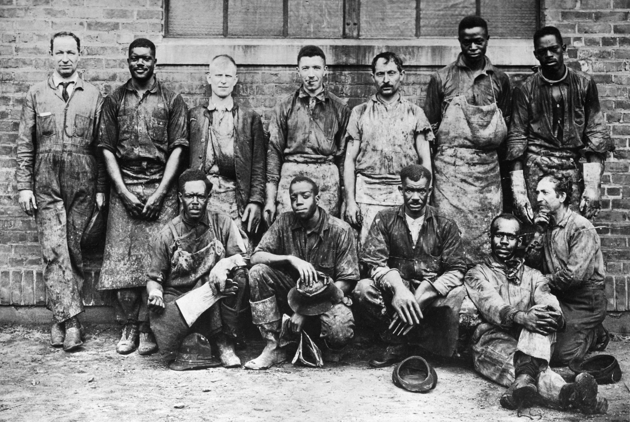
Steele v. Louisville and Nashville Railroad (1944)

Slide 4
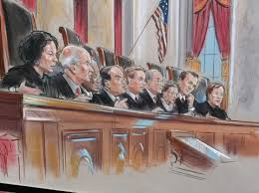
If the law gives unions the right to represent everyone, it also requires them to represent everyone fairly.

Slide 5
?
To what activities does the duty apply?
  Negotiations?
  Grievance handling?
  Arbitration hearings?
  Admission to membership?
  Job referrals?
  Union discipline?

Slide 6
?
Who owes a duty of fair representation?
  Local Union?
  You?
  Job Stewards?
  Grievance Committee?

Slide 7
?
What type of conduct breaches
the duty of fair representation?

Slide 8
“Arbitrary, Discriminatory, or Bad Faith”

Slide 9
My grievance was meritorious and my union dropped it!

Slide 10
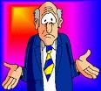
Negligence does not breach the duty of fair representation
I thought that Joe was next on the out-of-work list and called him without checking the list.

Slide 11
Arbitrary Conduct
Conduct that is “so far outside a wide range of reasonableness . . . That it is wholly irrational.” Airline Pilots Association v. O’Neill
Refusing to investigate a grievance
Handling an arbitration hearing in a perfunctory manner
Accepting the employer’s version of events without investigating

Slide 12

Discriminatory Conduct
Conduct based on irrelevant or impermissible classifications
Refusing to process
grievances filed by
non-members
Refusing to process grievances based on sexual harassment

Slide 13

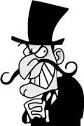
Conduct that is fraudulent,
deceitful or dishonest
Conspiring with the employer against the employee
Refusing to process a grievance on behalf of a critic or political opponent

Slide 14
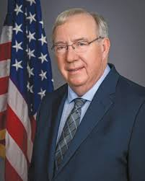
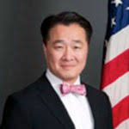
Trump vs. Biden Administration
Trump-appointed GC
  Issued memo expanding union liability for DFR
  Limiting use of negligence defense
  Requiring unions to have grievance tracking systems
  Making unions liable for failing to communicate with grievants
Biden-appointed GC
  Withdrew Robb memo on DFR
  Restored Pre-Trump DFR law

Slide 15
Reasons to Drop a Grievance
It is not meritorious
It is not winnable
It does not justify the time and expense
It may harm the interests of the overall unit

Slide 16
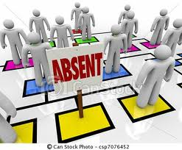
Example # 1
An employee misses two days of work without calling in and is discharged.
He claims that he tried to call
in, but he has no record of
the call.

Slide 17

Example # 2
Employer has a past practice of ignoring the fact that employees sometimes return from lunch a few minutes late.
The employer announces that it will dock the pay of anyone returning late.
It is apparent that the issue is important to the employer.

Slide 18

Example # 3
A female employee complains
about sexual harassment by a
fellow employee also
represented by the local union.
Pursuing a grievance might
result in that other employee’s discharge
or discipline.

Slide 19
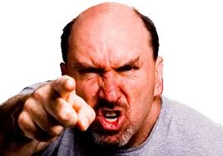
You didn’t call the key witness!
You didn’t talk to my witnesses!
You didn’t talk to me!
You didn’t make an important argument!
Unhappy Grievant

Slide 20

Suggestions on Grievances
Know the deadlines. Create a system that prevents missing them
Create a paper trail.
Explain your decisions
Communicate with the
grievant.
Respond to inquiries

Slide 21

Things to Avoid
Intemperate language
Participating in employer decisions on discipline
Making decisions without recording what you did and why

Slide 22
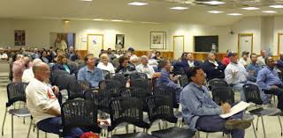
DFR and Contract Negotiations
Contract ratification
  No legal duty to ratify
  Constitution does not
  require it
  May be required by bylaws
  or past practice
  Concealing information may breach DFR

Slide 23
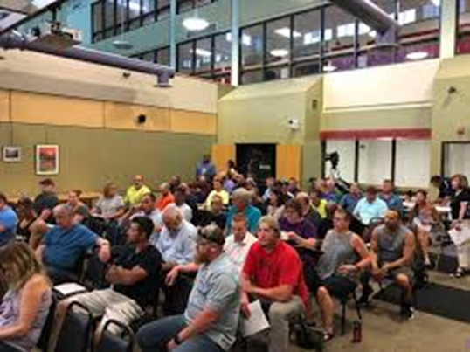
Suggestions on Contract Negotiation and Ratification
Be able to explain your decisions
Follow your past practice on ratification
Do not conceal
information
Make the new
agreement available
Notes:
23

Slide 24
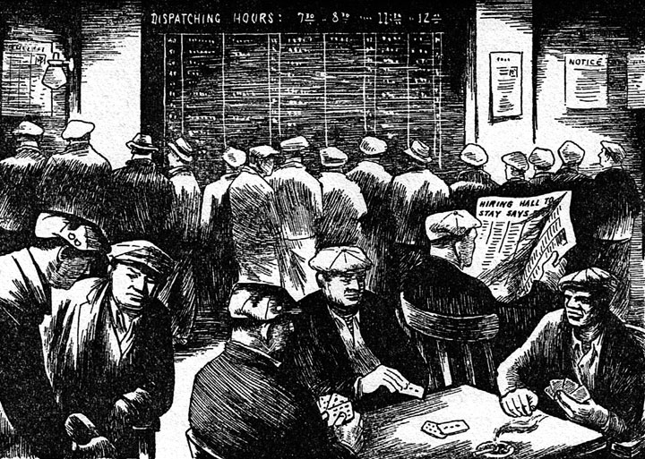
What is the difference between an exclusive and nonexclusive hiring hall?

Slide 25
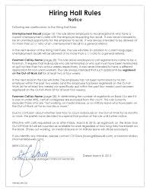
Rules for Exclusive Hiring Halls
Referrals must be based on objective criteria
All applicants must be notified of any change in procedure
Discrimination against nonmembers is prohibited
Intentional failure to follow hiring hall rules violates the DFR
Applicants are entitled to
review hiring hall records

Slide 26
Rules for Nonexclusive Hiring Halls
DFR does not apply
Hiring hall can operate for the benefit of local union members
Discrimination against nonmembers and travelers is permitted
Cannot refuse referrals because of union political activity

Slide 27
How can an employee file a
DFR claim?
Lawsuit
Unfair Labor Practice Charge
Notes:
27

Slide 28

Two Good Things About the DFR
Short statute of limitations
Preempts state law
Notes:
28

Slide 29
Six Months to File

Slide 30

Preempts State Law
Federal DFR
State Law

