Slide 1
DUTY OF FAIR REPRESENTATION
International Association of Heat and Frost Insulators and Allied Workers 2024 New Officers Training
Sherman Dunn, P.C.
900 7th Street, N.W., Suite 1000
Washington, D.C. 20001

Slide 2
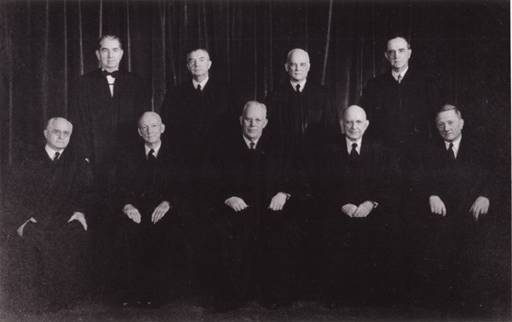
DFR Background
Duty of Fair Representation created by the Courts, not by federal or state statute.

Slide 3
DFR Background
Steele v. Louisville and Nashville Railroad (1944) – Railway Labor Act Case
Brotherhood of Locomotive Firemen represented unit of firemen. Brotherhood did not admit African-American employees as members.
Union proposed a CBA provision stating that only white employees would be promoted to Firemen.
Supreme Court: If law gives unions right to represent everyone in a unit, it implicitly imposes a duty to represent everyone fairly.

Slide 4
DFR Background
What activities are covered?
Grievance Handling
Arbitration
Negotiations
Any other activity over which the union has exclusive authority as the employees’ representative.

Slide 5
DFR Background
What conduct breaches the Duty?
Conduct that is:
Arbitrary
Discriminatory
Bad Faith
Other conduct, though misguided or wrong, will not breach the DFR.

Slide 6
DFR Background
Arbitrary?
Wholly irrational or perfunctory
Refusing to file an obviously meritorious grievance because union did not feel like it;
Refusing to investigate a reasonable complaint;
Taking a grievance to arbitration, but not conducting any investigation or preparation.
Conduct that is “so far outside a ‘wide range of reasonableness’ as to be irrational.”

Slide 7
DFR Background
Discriminatory?
Conduct based on factors “unrelated to legitimate union objectives”
Refusing to file a grievance for a non-member;
Refusing to investigate claims by women or people of color.
Union may consider seniority, skill level, or other employment-related criteria.
BUT NOT: Race, Gender, Political Alliances, Union Membership, etc.

Slide 8
DFR Background
Bad Faith?
Fraud
Deceitful Action
Deceitful Conduct
Examples:
Secret side letters negotiated with employers;
Withholding relevant facts from unit prior to strike or ratification votes;
Refusing to investigate or process a grievance because you don’t like grievant.

Slide 9
DFR Background
DFR applies to how the Union responds to member complaints and grievances.
BUT: Not every grievance must go to arbitration.

Slide 10
DFR Background
After receiving a complaint from an employee:
Investigate
Talk to steward
Talk to witnesses
Talk to the grievant before meeting with employer.
Make a decision about how to proceed that is based on investigation and merits of the complaint and best interest of the bargaining unit.

Slide 11
DFR Background
Union may drop a grievance if:
Not meritorious;
May be meritorious, but you don’t think you’ll win the grievance (missing witnesses, evidence);
Doesn’t justify the expense; or
Grievance will benefit one or two employees, but will harm overall unit.
BUT: Decision can’t be arbitrary, discriminatory, or in bad faith.

Slide 12
DFR and Grievances
Mistakes made without animosity do not violate the DFR.

Slide 13
DFR and Grievances
Trump-appointed GC
Issued memo expanding union liability for DFR
Limiting use of negligence defense
Requiring unions to have grievance tracking systems
Making unions liable for failing to communicate with grievants
Biden-appointed GC
Withdrew Robb memo on DFR
Restored Pre-Trump DFR law

Slide 14
DFR and Grievances
Do
Know grievance deadlines.
Communicate decisions to grievant.
Record those decisions.
Explain those decisions.
Respond to grievant’s inquiries.
Don’t
Participate in employer termination or disciplinary decisions.
Make decisions without recording reasons.
Ignore or blow off grievants.

Slide 15
DFR and Contract Ratification
DFR Applies to Contract Ratification
Law does not require ratification.
Insulators Constitution does not require ratification.

Slide 16
DFR and Contract Ratification
BUT
Local union bylaws or past practice may require ratification.
Many unions have past practice of ratifying agreements.

Slide 17
DFR and Contract Ratification
Ratification Tips
Explain difficult or troublesome provisions in the proposed agreement.
Do not mislead members about provisions they may not like.
Don’t conceal the agreement – make it available to membership prior to vote.
Follow past practice on ratification.
If want to change past practice, do so with bylaw amendment or resolution at separate union meeting.

Slide 18
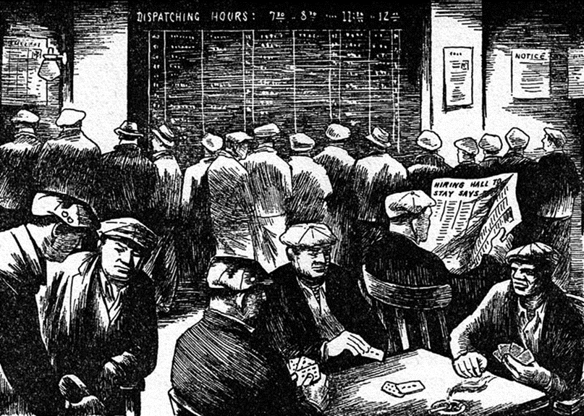
Hiring Halls and the DFR
What’s the difference between exclusive and nonexclusive hiring halls?

Slide 19
Hiring Halls
Exclusive if the hall is the employer’s initial sole source of employees
“Exclusive” even if employer can:
Reject applicants
Call by name
Hire off the street if job can’t be filled
Non-exclusive if employer is permitted to hire outside of referral system

Slide 20
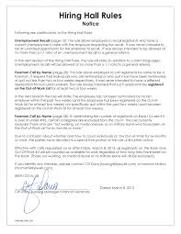
DFR and Exclusive Hiring Halls
Union breaches DFR if ARBITRARY, DISCRIMINATORY or BAD FAITH administration of exclusive hiring hall:
Must be based on objective criteria
Must notify all applicants of procedural changes
Applicants are entitled to review hiring hall records
Can’t discriminate against nonmembers
Can’t discriminate based on protected activity
Intentional failure to follow hiring hall rules violates DFR

Slide 21
DFR and Exclusive Hiring Halls
Lawful objective criteria:
First-in/first-out
Experience in trade
Seniority with employer or in unit
Qualifications
Training
Residency in area
Passing grade on test
Journeyman status
Any combination of these
NOT UNION MEMBERSHIP

Slide 22
DFR and Exclusive Hiring Halls
Intentional departure from rules violates DFR – even if
Doesn’t discriminate based on membership
Not related to protected activity
Unintentional mistake does not violate DFR
Once aware of mistake, failure to correct can be a breach

Slide 23
DFR and Exclusive Hiring Halls
NOTIFICATION OF CHANGES
Breach of DFR to fail to inform applicants of significant rule changes
Must give timely notice
Use usual notice method:
Post
Newsletter
Other communication

Slide 24
DFR and Exclusive Hiring Halls
Must allow applicants access to job referral records –
Permits applicants to determine whether treated fairly
Must permit applicant to photocopy records (not just make notes)
Includes names, addresses, phone numbers
Not SS#
Can establish agreed-upon time
Don’t have to interrupt dispatching

Slide 25
DFR and Exclusive Hiring Halls
Cost of Violation:
Backpay for discriminatees
May seek backpay for entire class of discriminatees

Slide 26
DFR and Nonexclusive Hiring Halls
DFR does not apply to non-exclusive referral procedure.
Hiring hall can operate for the benefit of LU members
Can discriminate against nonmembers and travelers
BUT: Cannot refuse referrals because of union political activity

Slide 27
DFR
QUESTIONS?

