Slide 1

Fiduciary Duties of Local Union Officers
International Association of Heat and
Frost Insulators and Allied Workers
New Officers’ Training

Slide 2

Covering Three Subjects
NLRA Section 302
  Receiving something of value from an employer
LMRDA Section 501
  Taking something of value from your union
Federal Criminal Code Section 1954
  Receiving something of value because of role as trutee or administrator of benefit plan

Slide 3

Canada
Government imposed regulation of
internal union matters almost non-existent
Fiduciary duties governed by union constitution.
Enforced as contractual obligations
Most provinces an unfair labor practice for employer to contribute financial or other support to union.
No criminal penalties.

Slide 4
NLRA Section 302(a)
Employer cannot give money or
anything of value to:
  Any representative of its
  employees
  Any labor union or officer or employee of a union which seeks to represent or would admit to membership its employees
  Any employee or group of employees in excess of normal compensation to influence how they exercise their right to organize or bargain
  Any officer or employee of a union to influence his or her decisions as a union officer or employee

Slide 5

NLRA Section 302(b)
It is unlawful for any person to request, demand, demand, receive or accept a payment
prohibited by section 302(a)

Slide 6
Criminal Penalties
$1,000 or less – a misdemeanor
More than $1,000 – a felony

Slide 7
Exceptions – Section 302(c)
Payments to employees because of their service as employees
Payments to resolve lawsuits or arbitration cases
Payments of union dues deducted at the request of employees
Payments to joint trust funds to pay employee benefits
Payments to LMCC’s

Slide 8
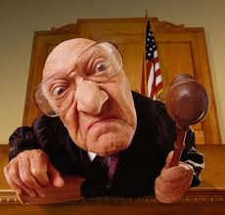
You be the Judge

Slide 9
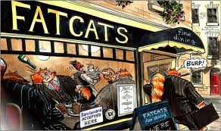
Union official accepts meals or entertainment paid for by the employer

Slide 10
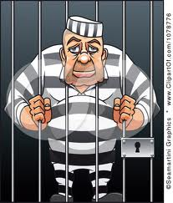
It is unlawful under section 302(a) for an employer to give
anything of value to any representative of any of its
employees and for any person to receive or accept anything prohibited by section 302(a).

Slide 11

Employer accepts meal paid for by the union

Slide 12

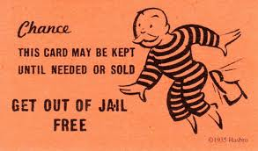

Slide 13
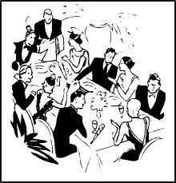
Union has a testimonial dinner to
honor a union official
Employer purchases tickets
and buys an ad in the
testimonial booklet
Union official receives
gifts purchased with
proceeds from the
dinner.

Slide 14
I should have listened to my lawyer.

Slide 15

Employer delivers a holiday basket to the local union’s office. The local union president places the basket in the office for the clerical staff to share.

Slide 16

I should have paid attention in class
Section 302 prohibits
Employers from giving
something of value, not
only to union officials, but also to union employees
and prohibits both officials and employees from
accepting employer gifts.

Slide 17
Grievance Chairman
Grievance chairman spends all week preparing for an
arbitration case. He is placed on union leave and
continues to be paid by the employer.

Slide 18

The exceptions to section 302 include payments
to an employee “by reason of” his service as an
employee.
The compensation received by the grievance
chairman is by reason of his service. He would
not have received it but for his status as an
employee.

Slide 19
Can section 302 be used offensively against a nonunion employer that you are trying to organize?
It is unlawful for any employer to pay its employees anything in excess of normal compensation to influence how they exercise their rights to organize or bargain.

Slide 20

Section 501(a) Imposes 5 Duties
To hold union money and property for the benefit of the members
To manage union property in accordance with the Constitution and bylaws
To refrain from dealing with
the union as an adverse party
To avoid conflicts of interest, and
To account to the union for any personal profit gained in transacting business for the union

Slide 21

Two Issues in section 501 Cases
Has the expenditure been authorized by the membership?
Is the expenditure
unreasonable?

Slide 22
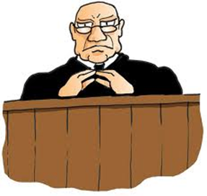
You be the Judge

Slide 23


Union members vote to purchase an automobile
for a union official whose duties include traveling.

Slide 24



Slide 25

Local union paid expenses when presented with
vouchers and receipts.
Executive board voted to pay officers a per diem
amount in lieu of expenses.
Officers continued to receive expense reimbursements.
Bylaws were not amended.

Slide 26

Inconsistent with the union Constitution
Inconsistent with local union bylaws
Nothing more than a salary increase that
members had not approved.

Slide 27
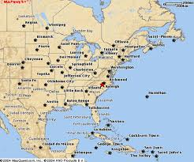
Members of a local union
in NYC voted ot pay the
commuting expenses of
their officers.
Local union president lived in Florida.

Slide 28

Can a Local Union Pay an
Officer’s Legal Expenses?
Depends on whether there is a conflict of interest between the officer and the local
If officer prevails, local union can reimburse him or her for legal fees.

Slide 29
Sec. 501 Civil Lawsuits
Plaintiff must first ask the local union to sue to recover amounts improperly paid or received.
Plaintiff must convince a court that he or she has good cause to sue.
Plaintiff must seek damages
only for the benefit of the
union and not for himself.

Slide 30
Sec. 501 Criminal Actions
  Any officer or employee of a union who embezzles or converts to his own use money or assets of a union is guilty of a felony.

Slide 31

Example #1
Local union secretary-treasurer was elected as
a general organizer of the international union.
He retained his position and salary as a
local union officer.
He spent 80% of his time working for the
international as an organizer.
He was convicted of embezzlement because he retained his full-time salary from the local union without membership approval

Slide 32
Example #2
Local union officer caused his local
union to sell the union’s car to a used
car dealership at below market
value with the understanding that
the dealer would sell the car to
the union officer for less than
market value.

Slide 33
Example #3
Local union paid the travel
expenses of an officer
scheduled to attend a union
conference.
The officer traveled to the
conference location but did not
attend any part of the conference.

Slide 34

Example #4
A local union officer attends a union
convention as an elected delegate.
He receives a payment from his
international for travel and living expenses.
After the convention, he submits expense
vouchers to his local union for all actual
expenses and receives payment.

Slide 35
Avoiding Sec. 501 Liability
Make sure that actual practice is consistent with Constitution and Bylaws and local union bylaws.
When in doubt, get membership approval.
Discourage use of union property and union credit cards for personal reasons or expenses.

Slide 36

Federal Criminal Code Section 1954
It is a crime for:
  Any administrator, or trustee or agent of an employee benefit plan, or
  Any officer, agent, or employee of a union whose members are covered by an employee benefit plan
  To receive or solicit any kickback, money, or thing of value because of actions, decisions, or duties with respect to the plan.

Slide 37

You are the trustee of a pension plan.
Investment manager pays for your golf outing.

Slide 38


You are a plan administrator.
You open a bank account for the plan.
The bank gives you a free TV set.

