Slide 1
Orange is NOT the new Black Union Fiduciary Obligations
Insulators new officers training
March 6, 2024
Jon newman
Sherman Dunn, P.C.

Slide 2
Overview
Using Union money or property
Section 501 of the LMRDA
Taking Employer money or other things of value
Section 302 of the Taft-Hartley Act
Taking benefit fund service providers’ money
18 USC § 1954

Slide 3
LMRDA – Section 501 Fiduciary Responsibilities
Section 501(a) and (b) of the LMRDA: civil enforcement
Sets out fiduciary responsibilities and covers officers, agents, shop stewards and other representatives
What other representatives are covered?
Courts look to the role of individual – do they handle union funds? Are they responsible for approving expenditures?
Can cover clerical employee if they handle union funds

Slide 4
LMRDA – Section 501
Section 501(a) of the LMRDA
Defines fiduciary duties:
To hold union’s money and property for sole benefit of the union and its members
To manage, invest, and spend union money in accordance with its constitution and bylaws and any resolutions of the governing body adopted thereunder
Refrain from dealing with the union as an adverse party
Account to union for any profit received in connection with union transactions

Slide 5
Section 501: Importance of Union’s Own Standards
Section 501(a) requires that covered officials:
Manage, invest, and spend union money in accordance with its constitution and bylaws
Intentionally leaves it to unions to impose their own restrictions on use of union funds
Therefore, scope of fiduciary responsibilities under Section 501 is set largely by the union’s constitution and bylaws
For the most part, with some exceptions, any expenditure that is authorized by or in accordance with governing documents will not violate Section 501(a)
Any expenditure that is not in accordance with union’s governing documents violates Section 501(a)

Slide 6
LMRDA Section 501 – 501(a)
Was the use of union money or property authorized by the membership in accordance with the constitution, bylaws, or resolution?
No? Violation of 501(a)
Yes? Did the officer or their family personally benefit from the expenditure?
If so, was the expenditure “manifestly unreasonable?”

Slide 7
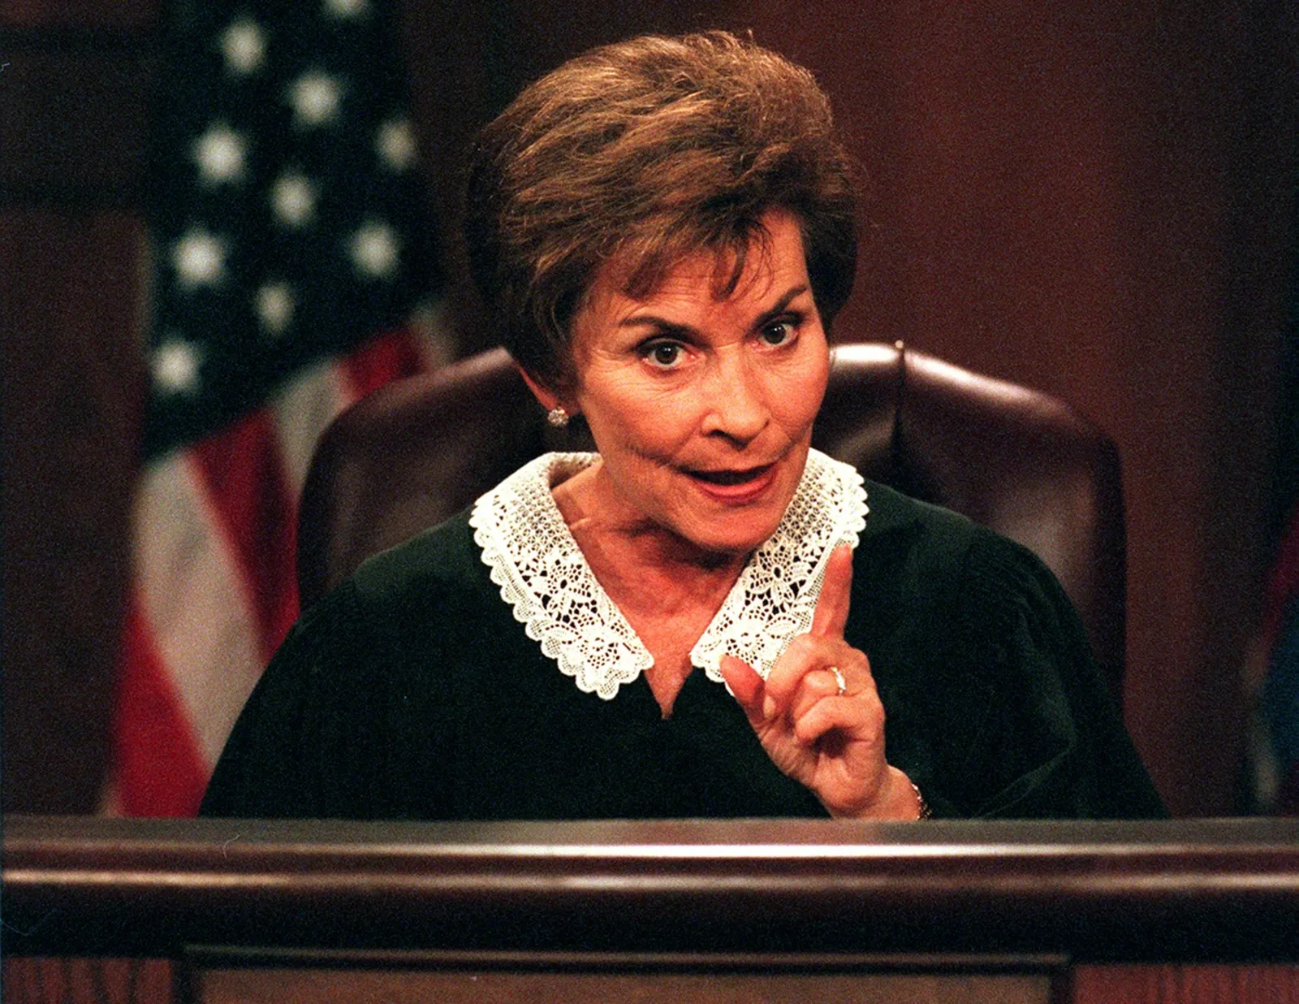
You be the Judge

Slide 8
Membership votes to purchase an automobile for the union president
Authorized?
Personal use?
Reasonable?

Slide 9
What about this?
Lambourgini Revuelto: V-12, starts at $608,358.
0-60 mph in 2.3 seconds

Slide 10
Per Diem and Expenses
Bylaws provide for reimbursement of expenses associated with union business, with receipts
E-Board approves a flat $50 per day per diem for meal expenses with or without receipts
Inconsistent with bylaws, and therefore, violation of 501

Slide 11
LMRDA – Section 501 – Criminal Provision
Section 501(c) of the LMRDA: criminal enforcement
“Any person who embezzles, steals, or unlawfully and willfully abstracts or converts to his own use, or the use of another, any of the moneys, funds, securities, property, or other assets of a labor organization of which he is an officer, or by which he is employed, directly or indirectly, shall be fined not more than $10,000 or imprisoned for not more than five years, or both.”
Coverage is broad: “any person” who is employed “directly or indirectly”
Covers virtually any kind of theft
Authorization is not a defense if money is taken with fraudulent intent

Slide 12
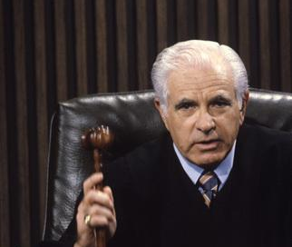
You be the Judge

Slide 13
LMRDA Section 501(c)
Delegate to convention
International union pays for travel and hotel, plus $125 per day for expenses for delegates
The $125 in fact covers all expenses, including meals
Delegate returns and claims, and accepts, reimbursement of meal expenses from their local union
E-Board and membership approve

Slide 14
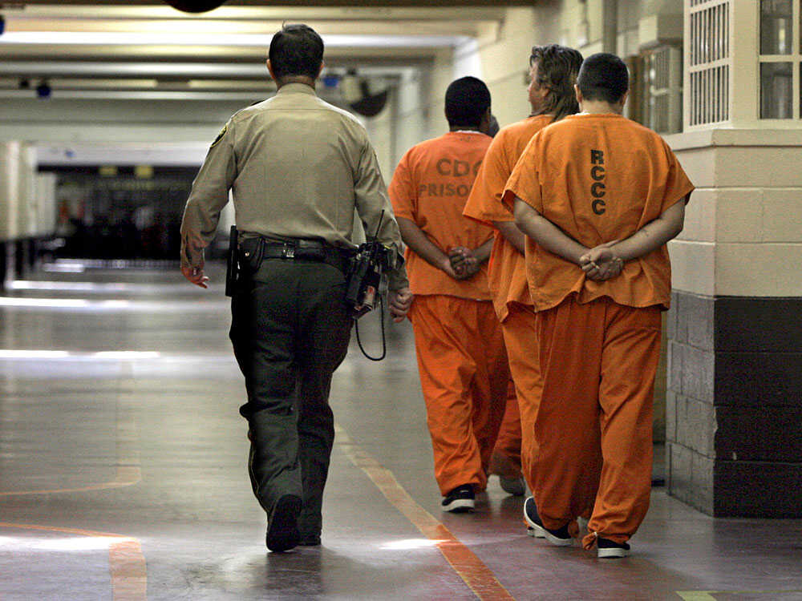
Double dipping has been found to violate 501(c)

Slide 15
You be the Judge

Slide 16
LMRDA Section 501(c)
Union officer sells union-owned vehicle to used car dealership below market value, with understanding that dealership will sell it back to the officer at a certain price.

Slide 17
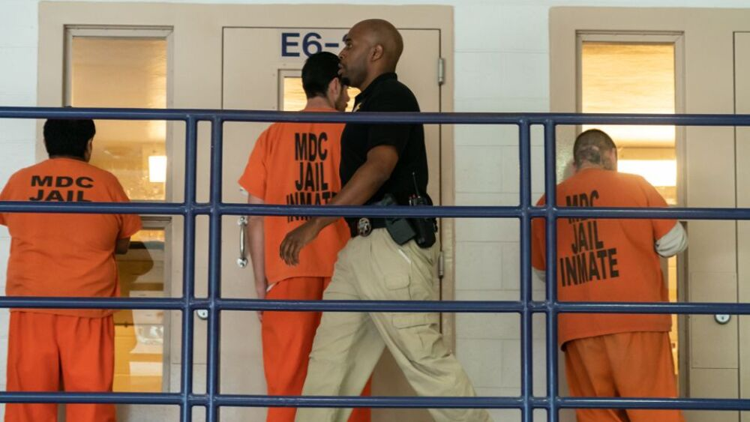

Slide 18
Section 501 – Analysis
Review International Constitution, Local Union Bylaws, Policy Documents
How are expenses to be authorized?
Ensure expenditures are authorized – spot audit and interview staff
How are salaries authorized?
Benefits?
Auto policy?
Bylaws, and/or minutes should reflect authorization if necessary

Slide 19
Section 302 of the LMRA: Employer $ to Union
Payment prohibition:
Section 302 prohibits the payment of any “money or other thing of value” by an employer or anyone acting in the employer’s interests to:
Any representative of any of its employees
A union that represents or seeks to represent, or would admit to membership, the employer’s employees
An officer, representative, or employee of such a union

Slide 20
Section 302 of the LMRA: Employer $ to Union
Payment prohibition:
Section 302 prohibits the payment of any “money or other thing of value” by an employer to the union or union officials, and also
Prohibits the receipt of such money by the union or union officials
It’s a crime both for the employer to pay it and the union, union official, representative, or union employee to receive it

Slide 21
Section 302 of the LMRA: Employer $ to Union
Bribery prohibition:
Section 302 prohibits the payment of any “money or other thing of value” by an employer to a union officer or employee:
With “the intent to influence” that individual’s actions
Crime for the employer to pay it and union officer or employee to receive it
Doesn’t require that union represent, seek to represent, or admit to membership, the employer’s workforce

Slide 22
Section 302 of the LMRA: Employer $ to Union
Exceptions: 302(c)
Payments to employees as compensation for their service
Payments to settle legal claims
Payments for sale or purchase of article or commodity at prevailing market price
Payment of dues if checkoff is signed
Payments to various benefit funds if set up correctly (jointly trusteed)
Payments to LMCCs

Slide 23
Section 302 of the LMRA: Employer $ to Union
Criminal Statute
If money or thing of value is $1000 or less:
Misdemeanor
Prison of not more than a year
Fine of not more than $10,000
If more than $1,000:
Felony
Prison of not more than 5 years
Fine of not more than $15,000
Conviction triggers bar from holding union office or serving as representative or employee of union

Slide 24
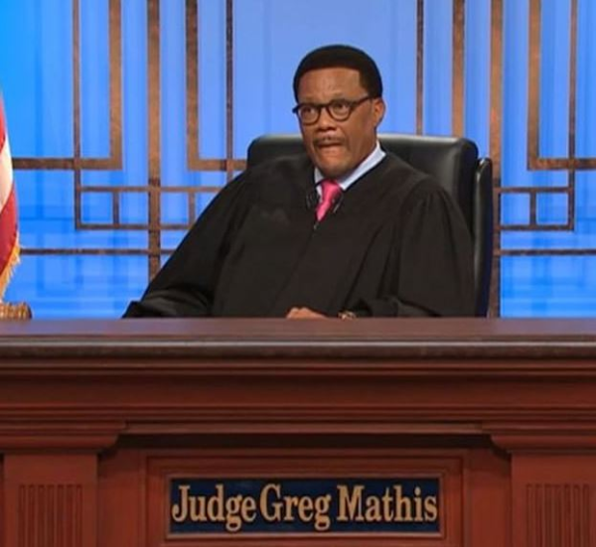
Section 302 of the LMRA: Employer $ to Union
You be the judge:

Slide 25
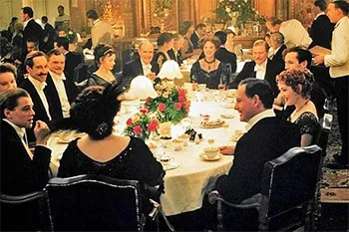
Employer and union representative meet over lunch to discuss various labor-relations issues, and employer pays:

Slide 26
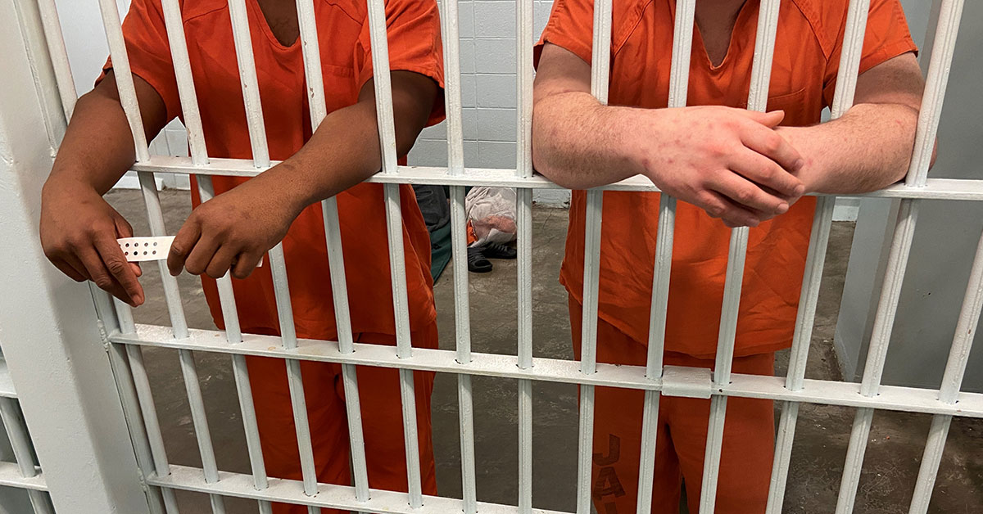
“Unlawful for any person to request, demand, receive, or accept . . . any money or other thing of value prohibited by” Section 302

Slide 27
Union pays for the meal of the employer:

Slide 29
Section 302 of the LMRA: Employer $ to Union
You be the judge:

Slide 30
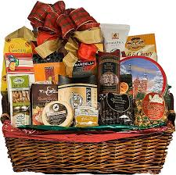
Employer sends holiday basket to the office
Business Manager places it in the office for the clerical staff and all employees to share

Slide 31
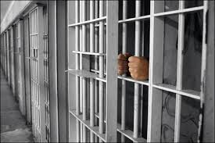
302 applies to “any labor organizer, or any officer or employee thereof” which represents the employer’s workforce

Slide 32
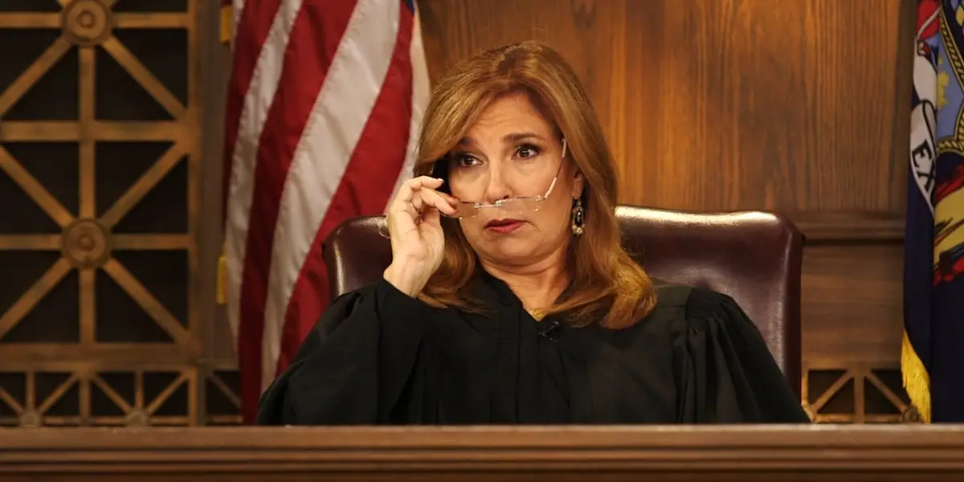
Section 302 of the LMRA: Employer $ to Union
You be the judge:

Slide 33
Signatory contractor hired to insulate officer’s house
Contractor performs work at less than market rate

Slide 34
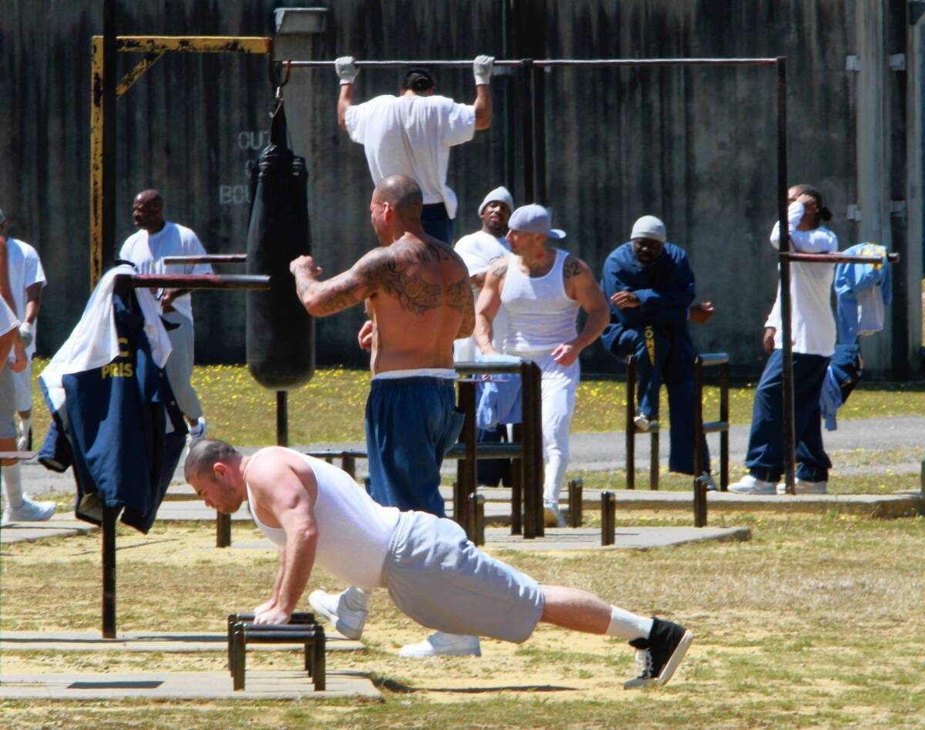

Slide 35
18 USC 1954: Benefit Funds
Whoever being—
an administrator, officer, trustee, custodian, counsel, agent, or employee of any employee welfare benefit or pension plan; or
. . . an officer, counsel, agent, or employee of an employee organization any of whose members are covered by such plan; . . .
and who . . .

Slide 36
18 USC 1954: Benefit Funds
receives or agrees to receive or solicits any fee, kickback, commission, gift, loan, money, or thing of value,
because of or with intent to be influenced with respect to, any of the actions, decisions, or other duties relating to any question or matter concerning such plan . . .
shall be fined under this title or imprisoned not more than three years, or both
this section shall not prohibit the payment to or acceptance by any person of bona fide salary or compensation

Slide 37
18 USC 1954
You be the judge:

Slide 38
You’re a trustee to your health fund
Service provider seeking to do business with the fund takes you golfing and pays for the round

Slide 39
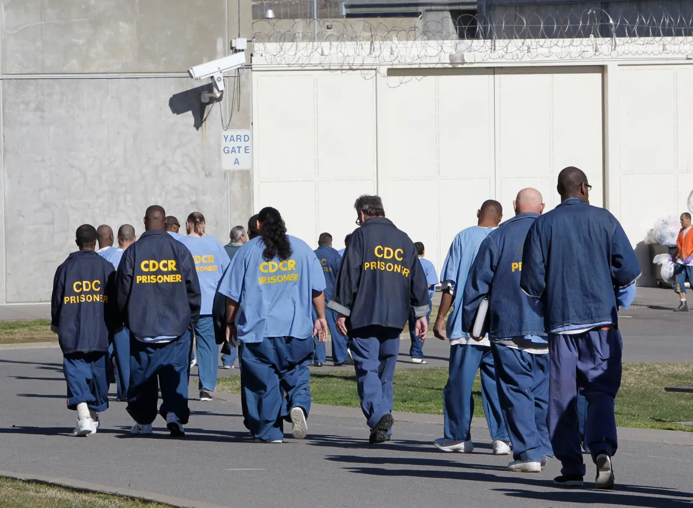

Slide 40
Takeaways
Don’t take their money, gift, meals or drinks
Don’t take their tickets to games or concerts
If it doesn’t feel right, it isn’t right

Slide 41
QUESTIONS?
Insulators new officers training
March 6, 2024
Jon newman
Sherman Dunn, P.C.

