Slide 1


HELMETS TO HARDHATS
SERVE YOUR COUNTRY, SECURE YOUR FUTURE, BUILDING NORTH AMERICA

Slide 2


OUR MISSION
WHO WE SERVE
HOW WE'RE FUNDED
Active-Duty military
National Guard
Reservists
Veterans
While H2H supports trades and employers on the local level, most of our funding comes from international union office donations, private donations, and grant funding we apply for.
ABOUT US
Helmets to Hardhats is a 501c3 non-profit assisting our men and women in uniform as they transition from military life to civilian life by guiding the way to career opportunities within the organized building trades.
WHERE WE SERVE
All 50 states and Canada

Slide 3







Post apprenticeship/career opportunities
Create a Helmets to Hardhats account
HOW H2H WORKS
STEPS 1-2 ARE
MISSION CRITICAL
Get applicants organically, via job board, or Regional Manager outreach
Search for Career Seekers while they search for you
Indenture/Hire Veterans!
Report KST
Success back to H2H!

Slide 4

IN 2023, OVER 15,000 CAREER SEEKERS CREATED NEW PROFILES WITH H2H. OVER 400 OF THOSE CAREER SEEKERS WERE INTERESTED IN INSULATORS IN 2023.
LESS THAN
15%
SUCCESS RATE
LESS THAN 3,000 HAVE BEEN REPORTED AS KSTS INDUSTRY WIDE.

Slide 5


JOB BOARD FOR YOU
  Learn about MOS codes using our “Occupation Search” tool.
  Connect directly with servicemembers looking for careers in the construction industry.
  Advertise your opportunities to servicemembers in the H2H database.
Notes:
This is an example. We aren't highlighting the Elevator Constructors because they're any better than the rest.

Slide 6
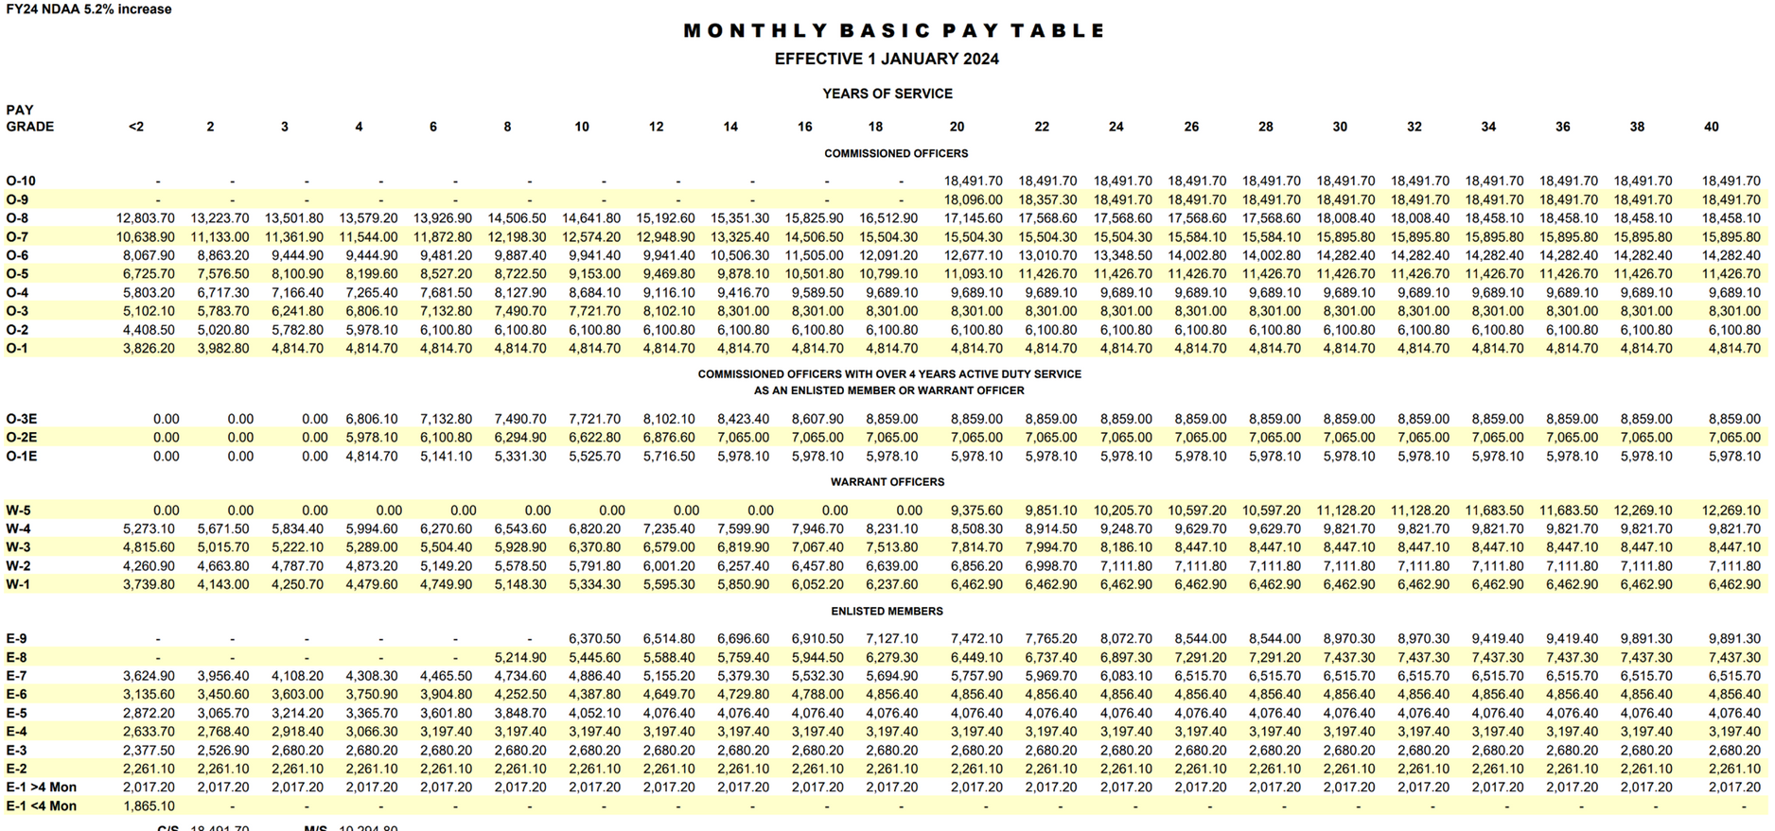
US ARMY SPECIALIST (E-4)
ANNUAL
BAS EACH MONTH
$36,796 ($17.69/hr.)
$460.25 (Tax-Free)
WITH DEPENDENTS 4 YEARS SERVICE
MONTHLY HOUSING ALLOWANCE
TOTAL ANNUAL GROSS PAY
Fort Campbell, Kentucky
$62,008 ($29.81/hr.)
$1,641 (Tax-Free)
  Special Pay (Jump Pay, Hazard Pay, Hardship Pay, etc.
  Health Care (No Cost)
  Blended Retirement System/Pension
  30 Days Paid Leave

Slide 7
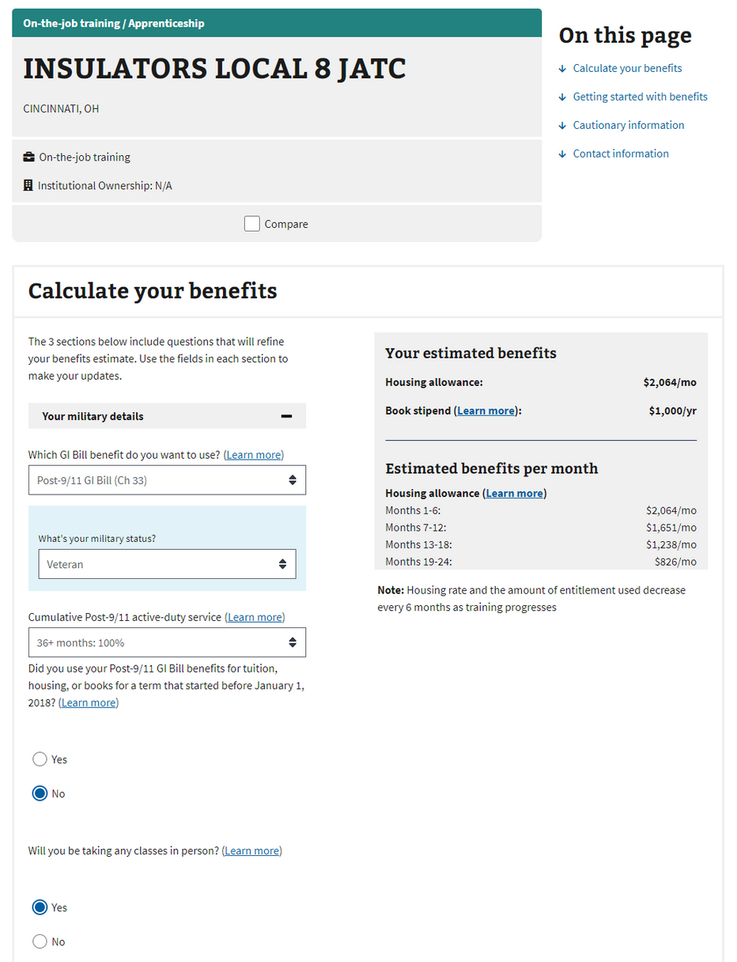
GI BILL COMPARISON TOOL
LINK THE COMPARISON TOOL ON JATC WEBSITE
https://www.va.gov/education/gi-bill-comparison-tool/
DON'T GUESS - USE THE TOOL!
Have your staff trained and ready to use this tool when assisting veterans so you have the right numbers all the time.
Example reflects veteran that is 100% eligible for full GI Bill benefit. National Guard/Reserve members could receive less than half of amount reflected, hence the importance of accurate use of this tool.

Slide 8


TEAM
FIGHT

Slide 9
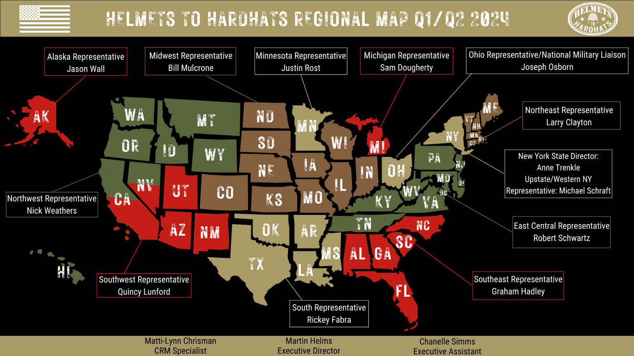




THANK YOU!
@HelmetstoHardhats
@helmetstohardhats
@HelmetsHardhats
helmetstohardhats.org
*Use our website's chat bot feature to connect to H2H when needed

