Slide 1
OSHA Documents
2024 JAC Conference

Slide 2
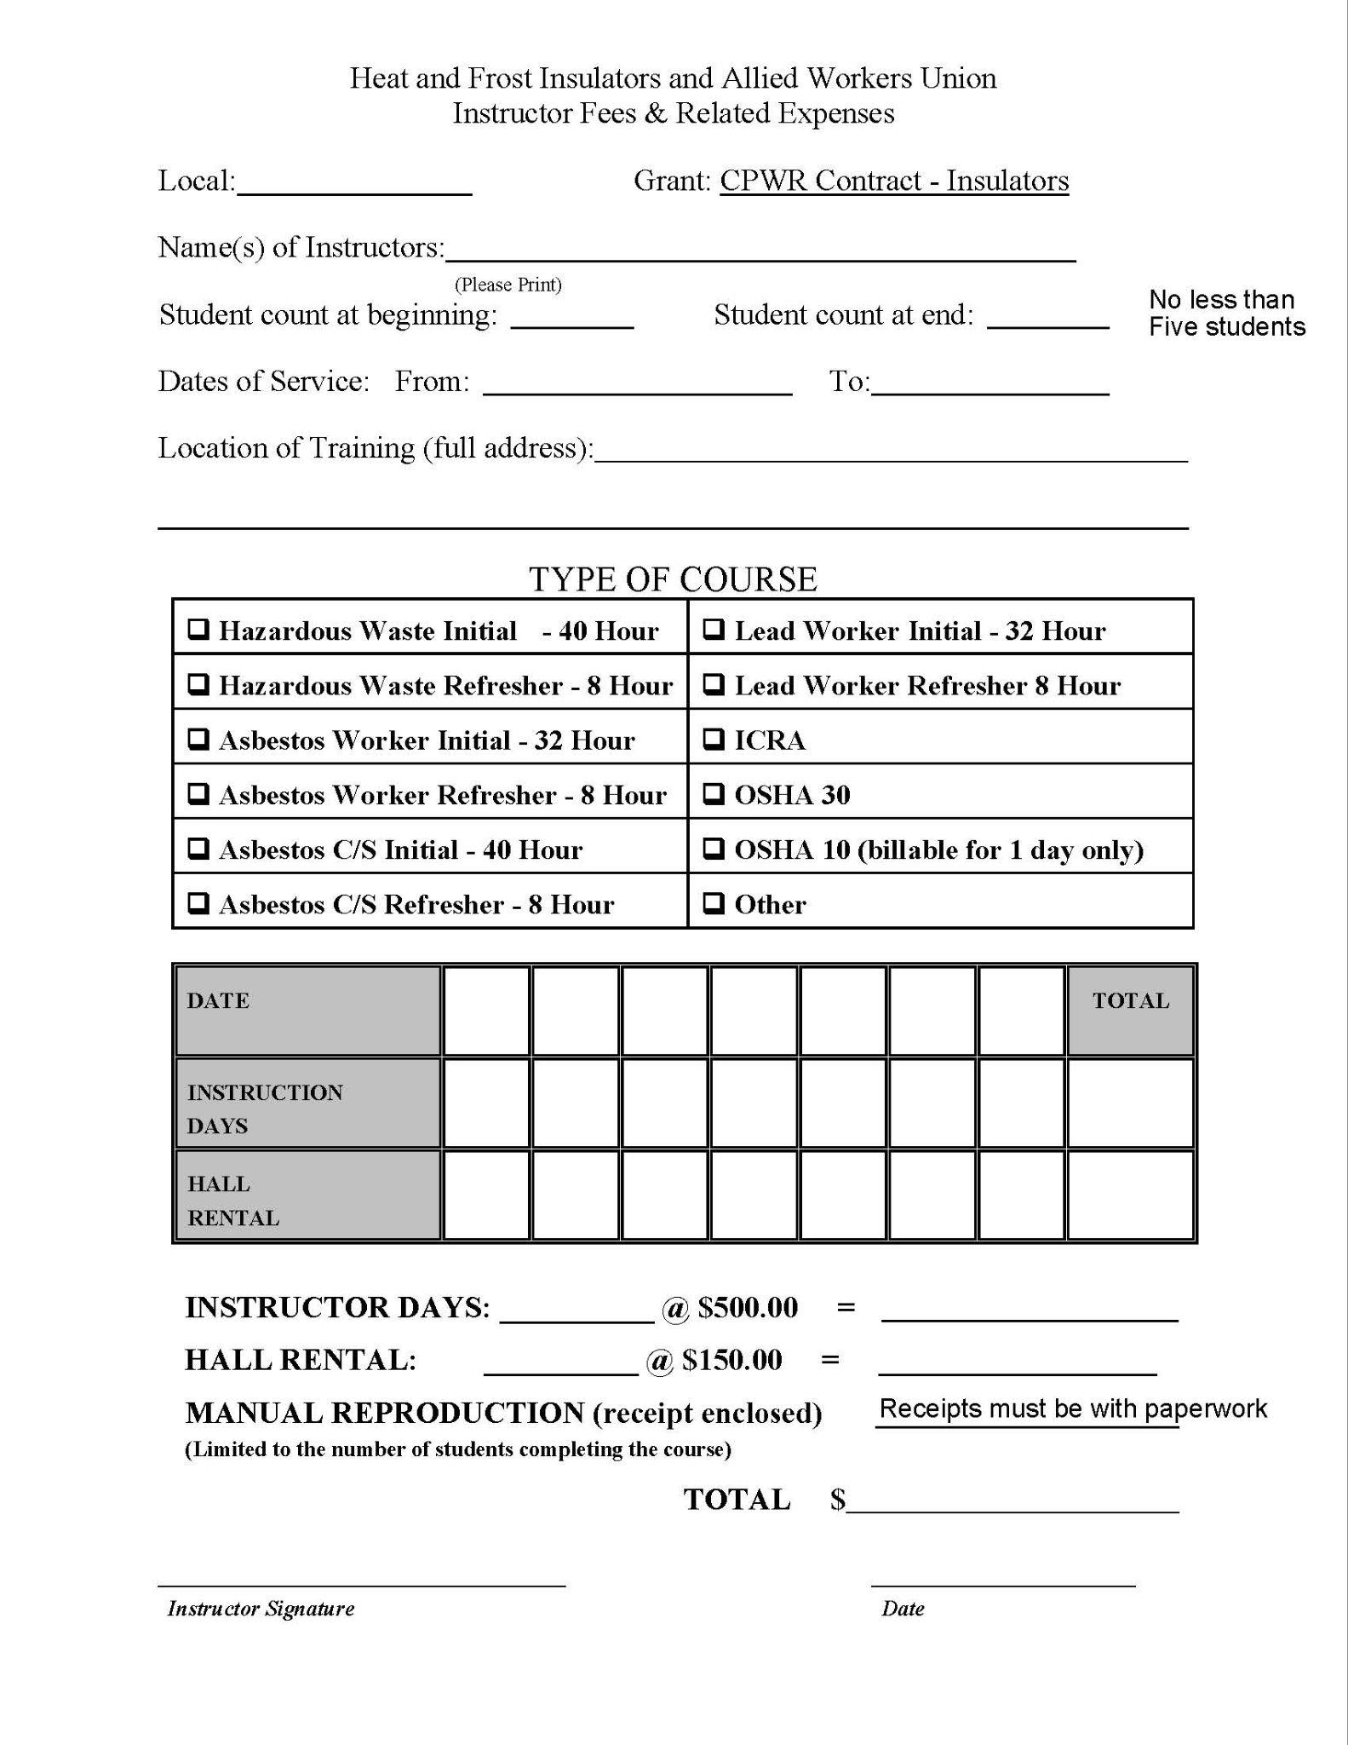
Instructor Fees and Related Expenses
This page MUST be fully filled out
MUST include manual receipts
Sign-in sheets MUST be included for each class

Slide 3
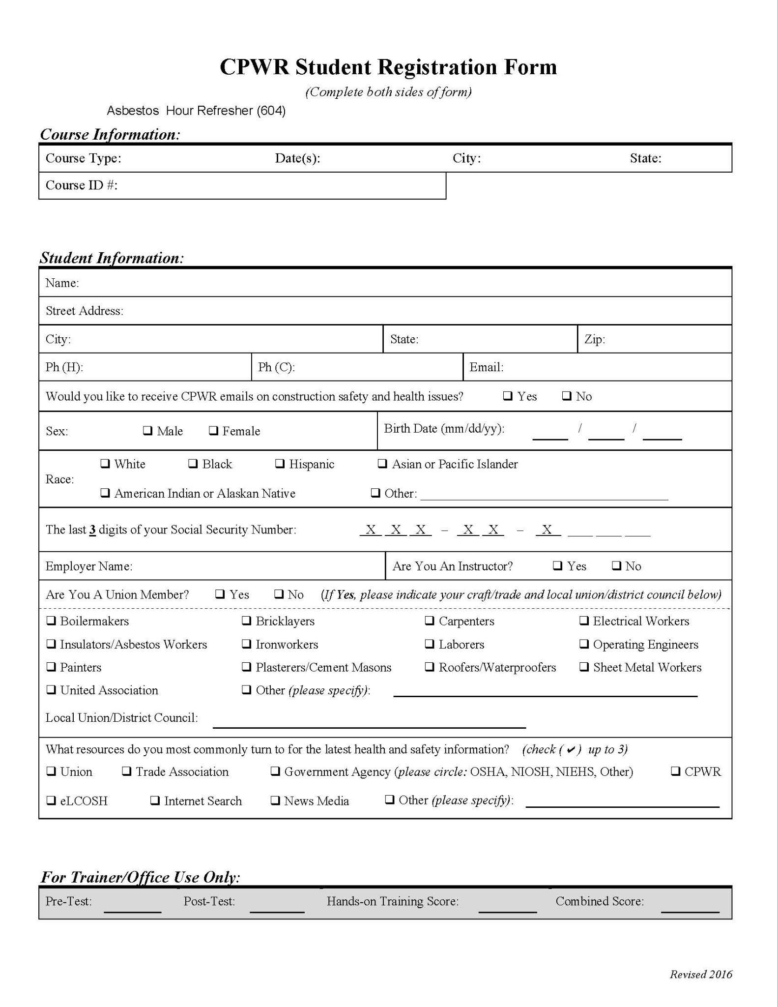
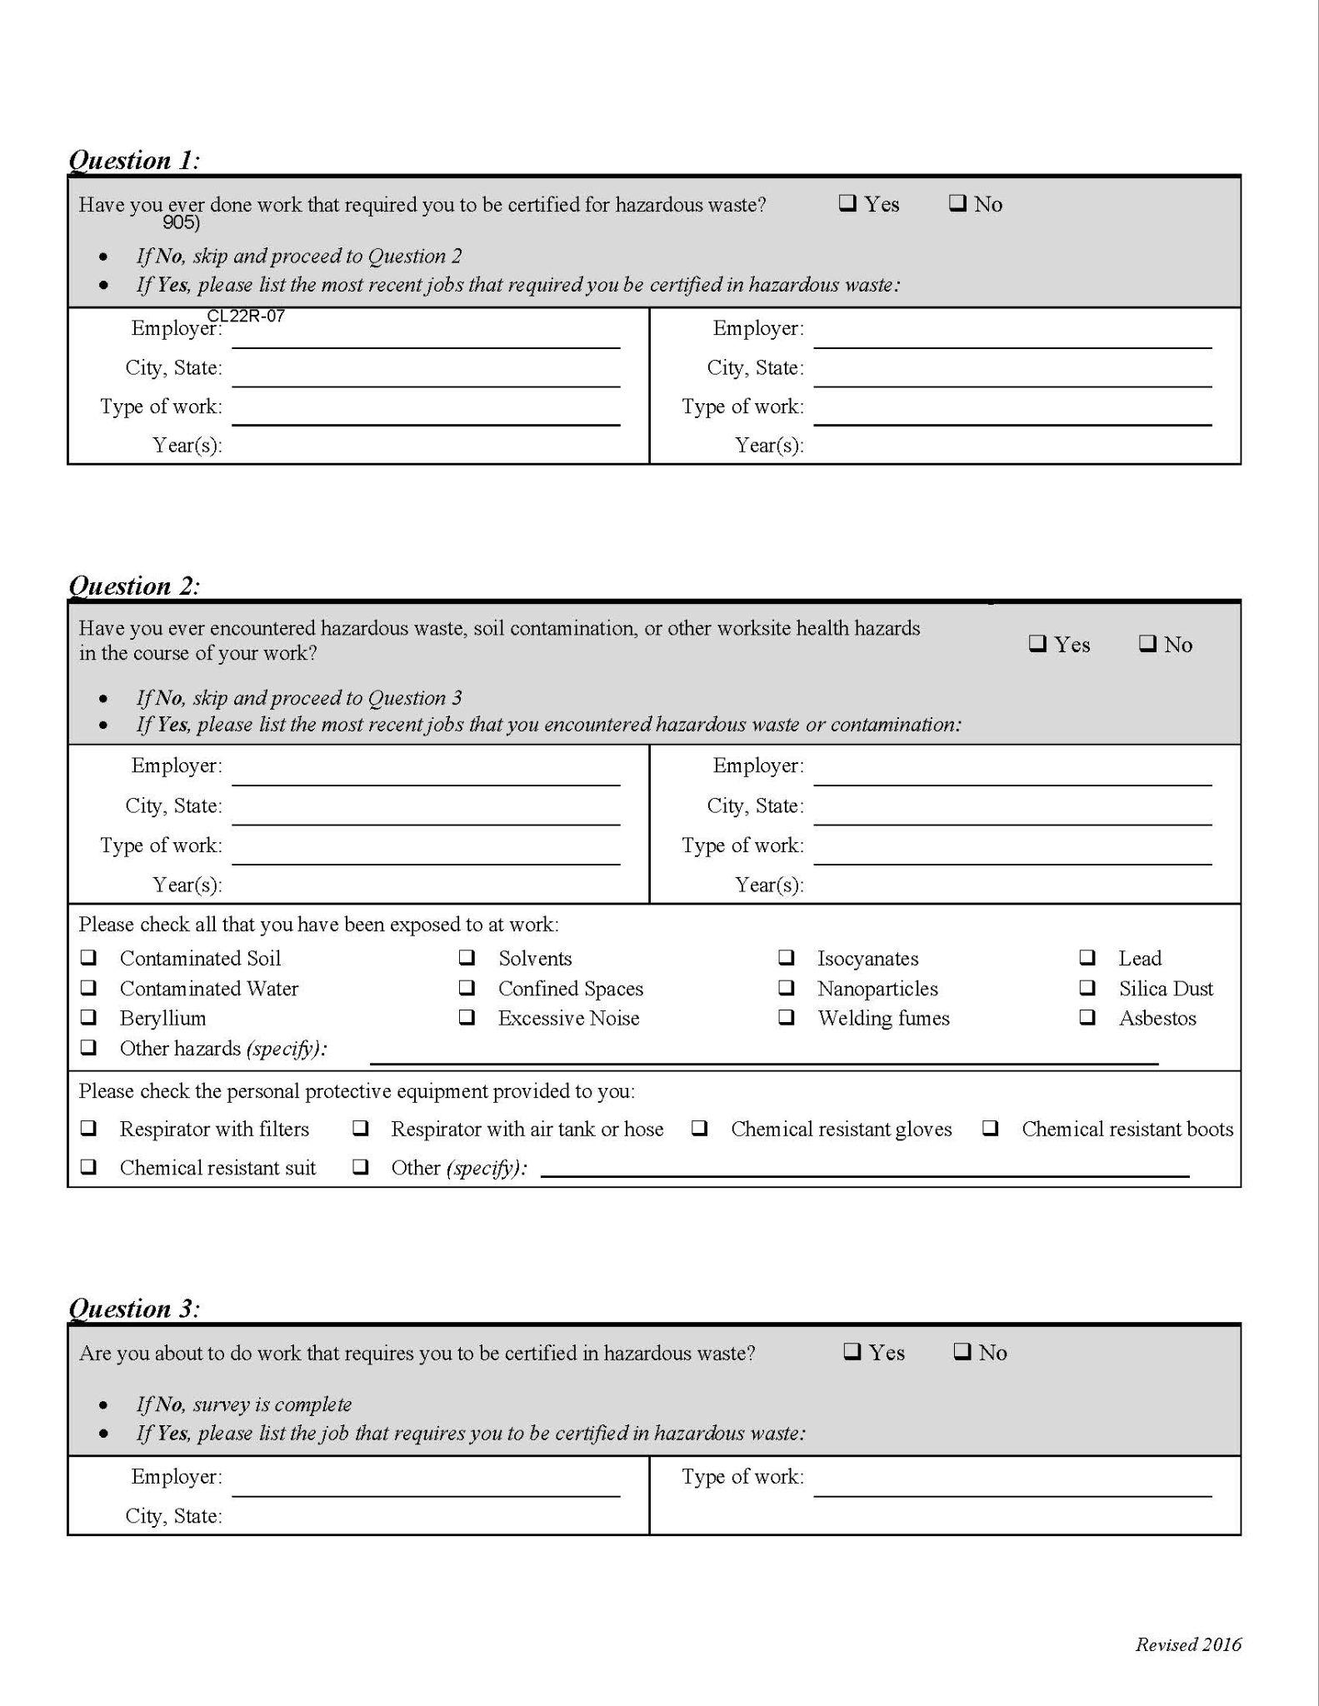
Each Class Attendee Must Complete
Student Registration Form

Slide 4
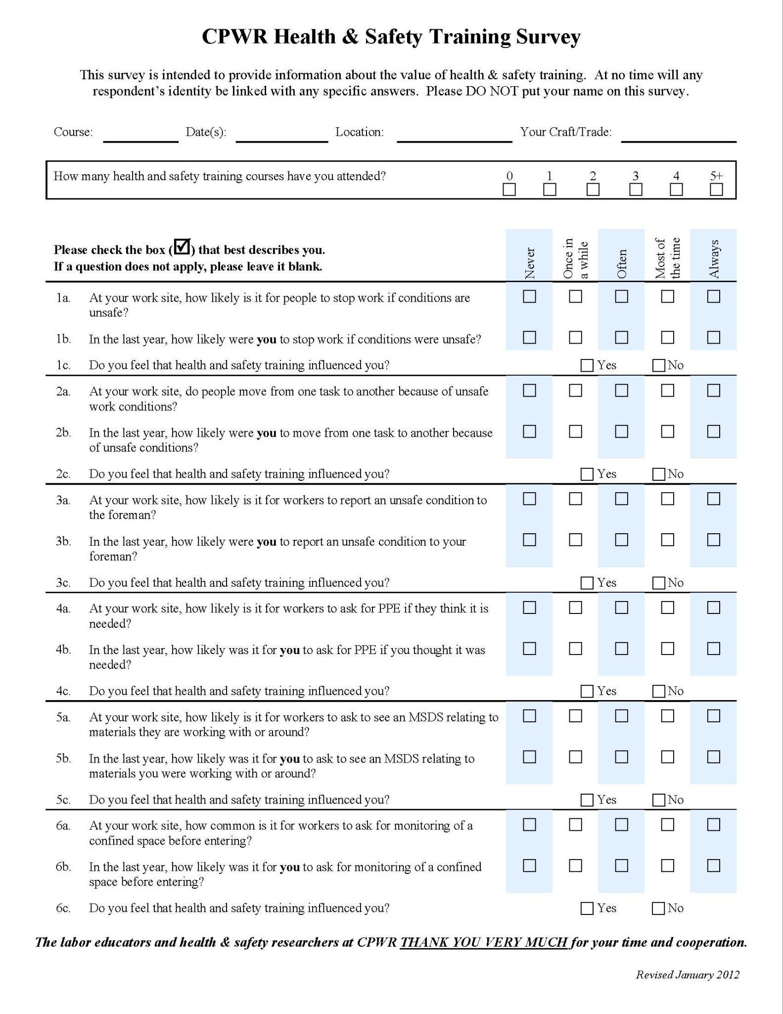
Each Class Attendee Must Complete
Survey

Slide 5
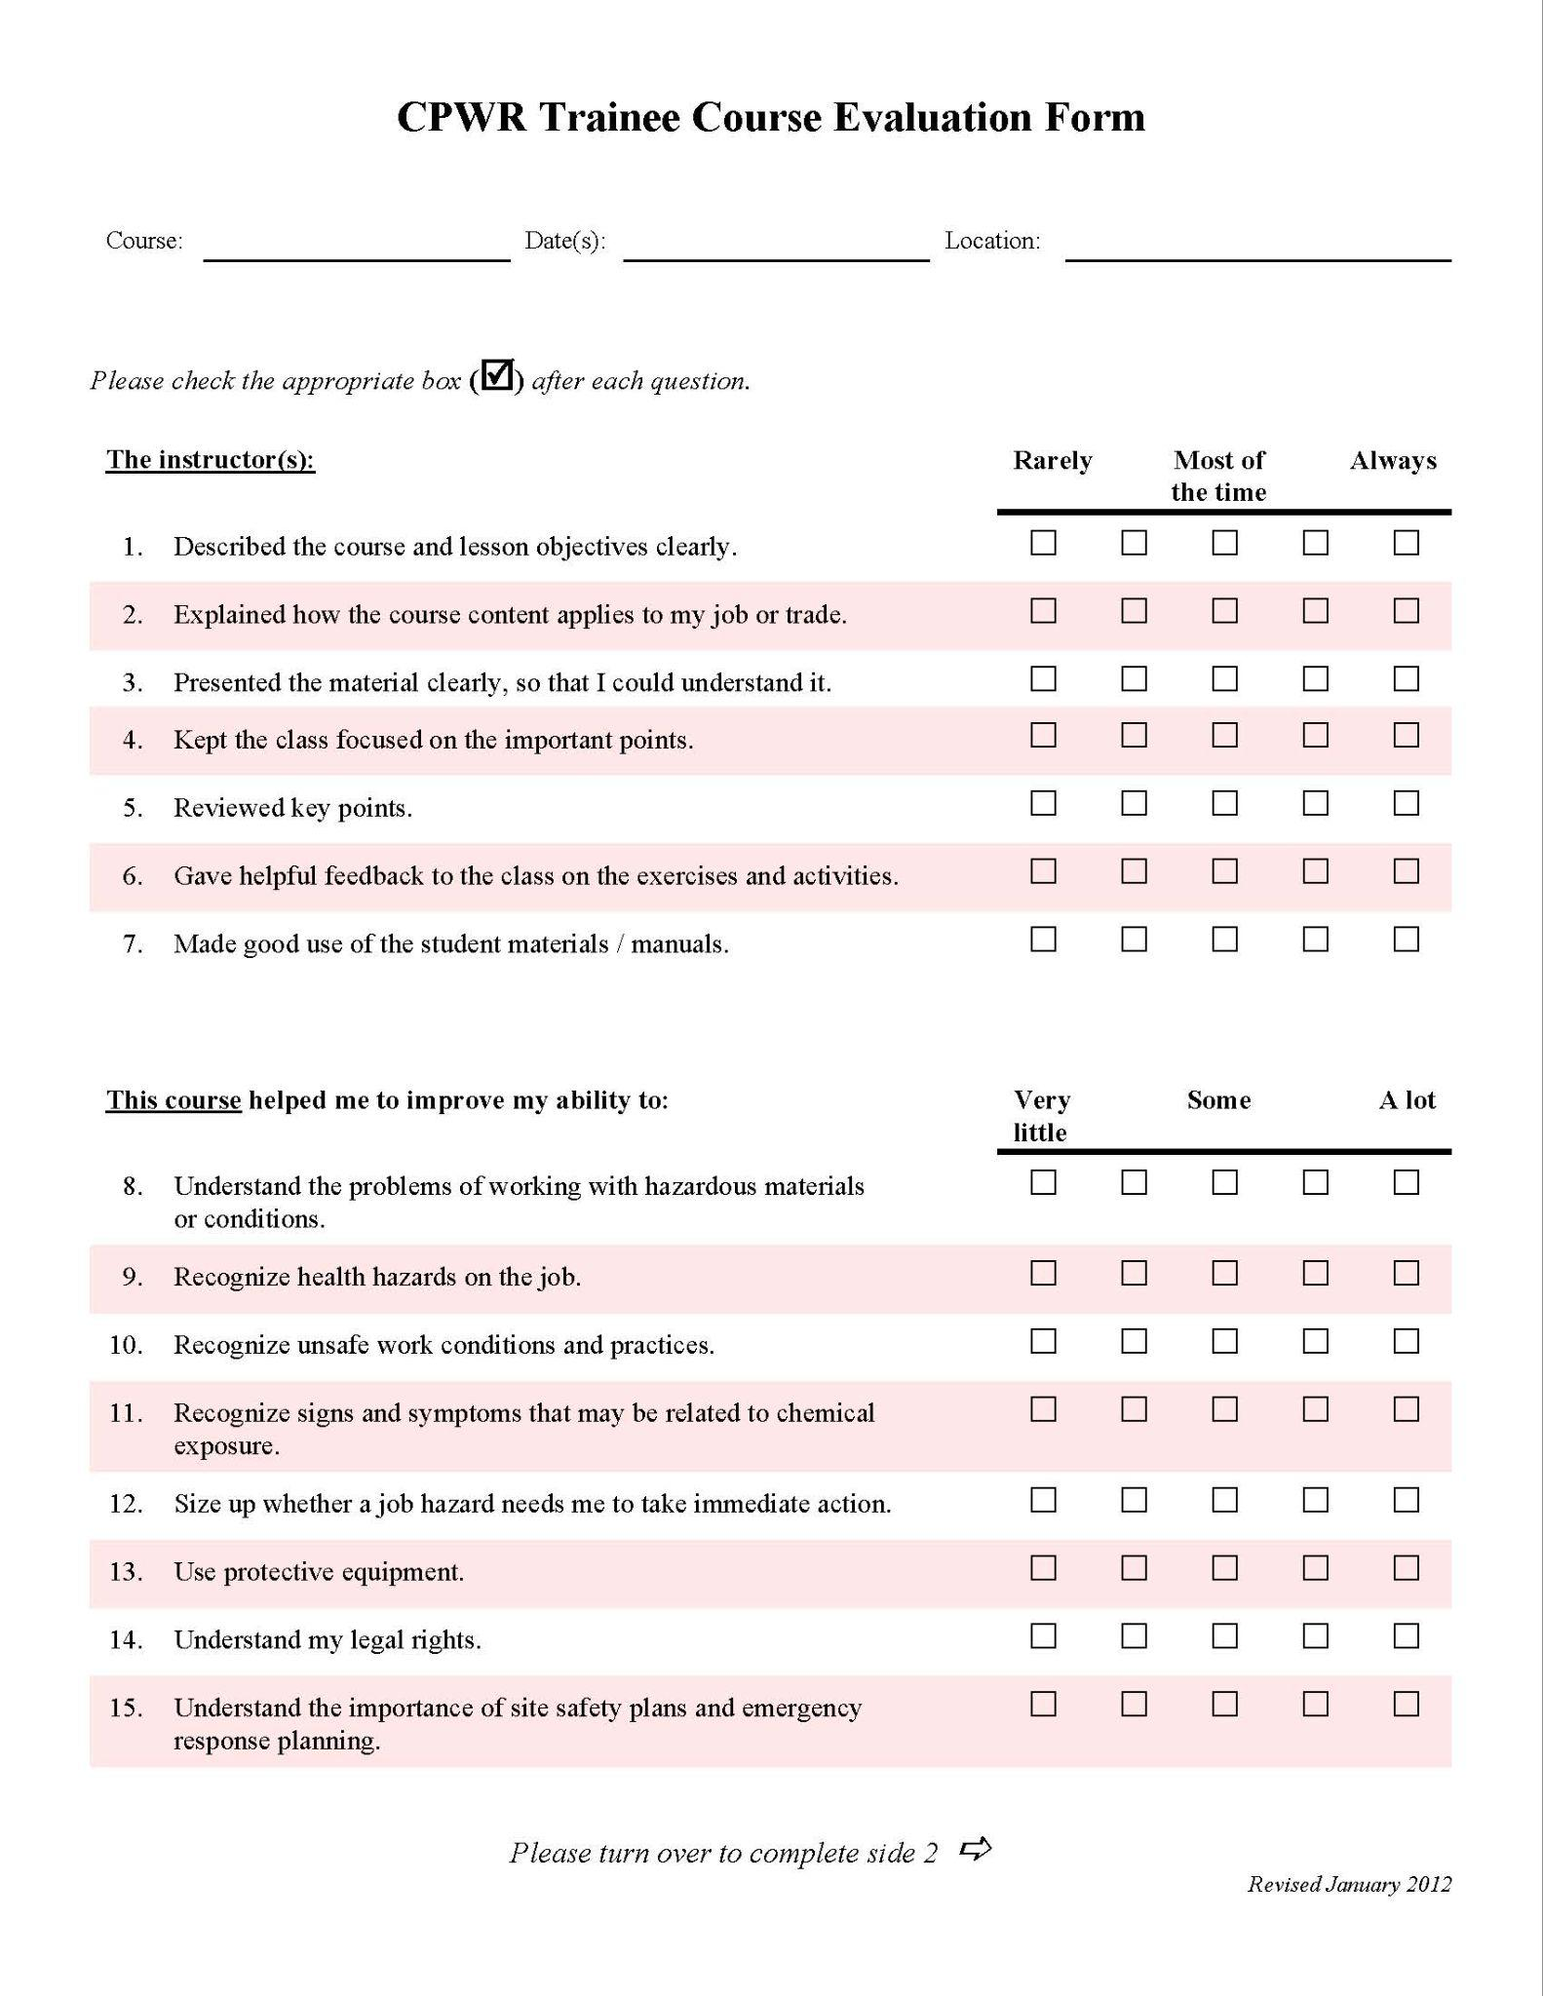
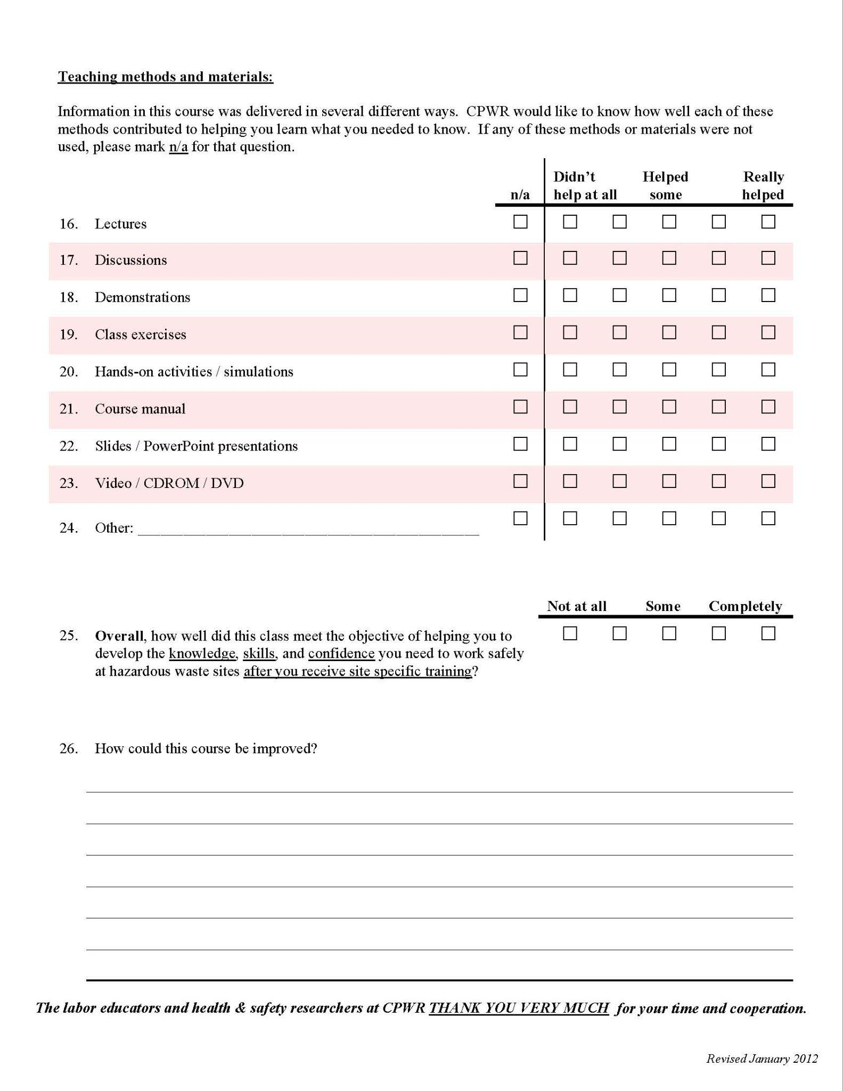
Each Class Attendee Must Complete
Course Evaluation

Slide 6
What Karen Scott Needs From You
Send all forms to the IIIATF directly
Electronic is best
kscott@insulators.org
MUST BE IN THIS ORDER
The first page is Instructors fees and related wages
All student registration forms
All surveys
All evaulations

Slide 7
What Karen Scott Needs From You
DO NOT STAPLE THEM IF TURNING THEM IN HARD COPY
THANK YOU!

Slide 8
Contact
Contact Information: KAREN SCOTT
EMAIL: KSCOTT@INSULATORS.ORG
PHONE: 410-671-8974

