Slide 1
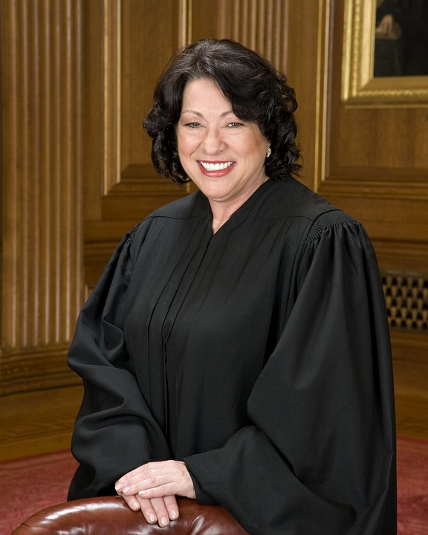
OFFENSES AND CHARGES

Slide 2
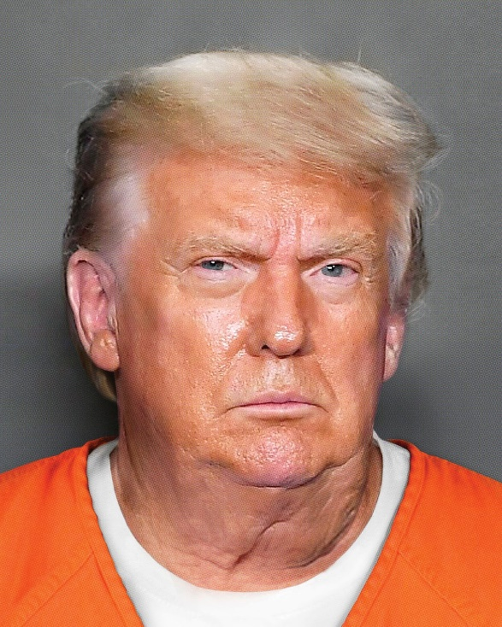
WHO CAN BE CHARGED?

Slide 3
ANY MEMBER, INCLUDING THOSE ON WITHDRAWAL CARD, SHALL BE SUBJECT TO CHARGES AND TRIAL.

Slide 4
WHAT ARE THE DIFFERENT TYPES OF CHARGES ???
CHARGES AGAINST MEMBERS OF THE SAME LOCAL UNION
CHARGES AGAINST MEMBERS OF ANOTHER LOCAL UNION (INTER-LOCAL NATURE)
CHARGES AGAINST OFFICERS

Slide 5
OFFENSES AND CHARGES
ARTICLE XXIV
(A). Violation of any provision of the Constitution and Bylaws of the International Association, and the rules there-under, or of the bylaws, trade agreements or rules of a local union.
(B). Embezzlement, or the improper receipt or misappropriation, or any unauthorized use of any funds or property of a local union or the International Association.
(C). Obtaining or attempting to obtain membership in the International Association or credentials for delegates to the International convention, through fraudulent means or misrepresentation, either on the part of the member himself or others.

Slide 6
OFFENSES AND CHARGES
(D). Engaging in activities designed to bring about a secession or withdrawal from the International Association of any member or group of members or a local union.
(E). Wronging a member of the International Association by any act or acts (other than the expression of views or opinions) causing him physical or economic harm.
(F). Working for or in the interests of, or in any way assisting any person, firm or corporation whose employees are locked out or lawfully on strike, in accordance with this Constitution, or which is otherwise declared to be in labor difficulty with the International Association or a local union. This subsection shall not apply in the case of withdrawal card members, performing their normal duties as owners, salesmen or superintendents.

Slide 7
OFFENSES AND CHARGES
(G). Working for, or on behalf of, any employer, employer-supported organization or other union or organization, or the representatives of any of the foregoing, whose position is adverse or detrimental to the International Association.
(H). Filing charges under this Constitution in bad faith or out of malice, or knowing or having reason to know such charges to be false or without foundation.
(I). Making known the business of the International Association or any of its local unions to any employer, employer-supported organization, or other union or organizations, or to the representatives of any of the foregoing.

Slide 8
OFFENSES AND CHARGES
(J). Causing or participating in a stoppage of work because of any alleged grievance or dispute without having the approval of the local union, or its duly authorized officers, which shall result in a minimum fine of one thousand dollars ($1,000.00), no portion of which shall be held in abeyance.
(K). The failure or refusal of any member or officer to turn over or relinquish any money, books, records or other property of the International Association or any of its local unions when directed to do so by authorized officials of the International Association or a local union, in accordance with this Constitution or the local union bylaws.
(L). Causing or engaging in unauthorized work stoppages or strikes or other violation of the laws and rules of the International Association or its local unions.

Slide 9
OFFENSES AND CHARGES
(M). Interfering or refusing to cooperate with any inquiry or investigation which is being conducted by, or pursuant to the authority of any international officer.
(N). Engaging in any act or acts which are contrary to the member’s responsibility toward the International Association or any of its local unions as an institution, or which interfere with the performance by the International Association or a local union of its legal or contractual obligations.

Slide 10
OFFENSES AND CHARGES
(o). Interfering with the rights of members of the International Association under this Constitution and Bylaws or working agreements, or interfering or threatening to interfere with any officer of a local union or the International Association in the performance of his duties.
(p). Refusing, without good cause, to participate in COMET, or other similar training programs offered by the International Association or a local union.

Slide 11
PROPER PROCEEDURES THAT MUST FOLLOWED
SUBMISSION OF CHARGES
Charges against members must be signed and submitted in duplicate not more than one hundred and eighty days after person preferring charges has knowledge of the act or acts which form the basis for the charges
INVESTIGATION
The Business Manager (or designated representative) shall investigate all charges brought forth
IF CHARGE HAS MERIT
When the BM (or designated Rep) believes that charge has merit he notifies/advises the President

Slide 12
PROCEDURES TO FOLLOW
NOTIFICATION OF CHARGES
When charge has merit the Charges must be read at the next regular meeting of the local union and hearing date to be scheduled.
CORRESPONDING SECRETARY
After charges have been read out the Corresponding Secretary of the local union shall serve the member charged, by registered or certified mail, to his last given home address, with a written copy of charges and notice of time and place of trial.

Slide 13
SCHEDULING A TRIAL
TRIALS SHALL NOT BE HELD LESS THAN TEN (10) DAYS FROM THE TIME THE CHARGES ARE SERVED UPON THE ACCUSED.

Slide 14
TRIALS
All charges to be heard and tried by the Local Union Executive Board
The Local Union President shall sit as Trial Judge***
The Business Manager shall act as Trial Prosecutor***
Three members of the Board shall constitute a quorum

Slide 15
TRIAL BOARD EXCEPTIONS
BUSINESS MANAGER
MAY DESIGNATE REP TO ACT AS PROSECUTOR
PRESIDENT
IF PRESIDENT IS PREFERRING CHARGE OR IS A WITNESS TO EVENTS IN QUESTION OR ANY WAY INTERESTED IN THE OUTCOME OF THE TRIAL, THE LOCAL UNION VICE PRESIDENT SHALL REPLACE HIM.
VICE PRESIDENT
IF THE VICE PRESIDENT IS DISQUALIFIED FOR THE SAME REASONS AS THE PRESIDENT, THE TRIAL BOARD SHALL SELECT ONE OF ITS MEMBERS AS PRESIDING OFFICER.
EXECUTIVE BOARD
IF MEMBER PREFERRING CHARGES IS MEMBER OF THE EXECUTIVE BOARD, OR IS DISQUALIFIED FOR SAME REASONS AS PRESIDENT AND VICE PRESIDENT, THE PRESIDING OFFICER SHALL DISQUALIFY HIM FROM HEARING CASE AND MAY APPOINT A DISINTERESTED MEMBER AS SUBSTITUTE.

Slide 16
CHARGED MEMBER
CHARGED MEMBER SHALL APPEAR FOR TRIAL ON DATE AND TIME SET BY PRESIDENT.
CHARGED MEMBER MAY SELECT A MEMBER IN GOOD STANDING TO REPRESENT/ASSIST HIM IN THE PRESENTATION OF HIS DEFENSE.
IF CHARGED MEMBER FAILS TO APPEAR, OR ATTEMPTS TO EVADE TRIAL, THE TRIAL BOARD SHALL PROCEED TO HEAR AND DETERMINE CASE.

Slide 17
CHARGED MEMBER
EXCEPTION
CHARGED MEMBER REQUEST DELAY ON TRIAL
IF A CHARGED MEMBER MAKES A REQUEST FOR A DELAY ON THE TRIAL THE PRESIDENT MAY GRANT A REASONABLE DELAY TO THE ACCUSED WHEN HE BELIEVIES THE FACTS AND CIRCUMSTANCES WARRANT A DELAY

Slide 18
TRIAL BOARD DECISIONS
AFTER HEARING ALL OF THE EVIDENCE PRESENTED, THE TRIAL BOARD SHALL REACH A DECISION ON EACH CHARGE BEFORE IT.
ALL DECISIONS SHALL BE MADE BY MAJORITY VOTE OF THE MEMBERS OF THE TRIAL BOARD
IF CHARGES, OR ANY PORTION THEREOF, ARE SUSTAINED, THE ACCUSED SHALL BE FOUND NOT GUILTY
ON ANY PORTION OF CHARGES NOT SUSTAINED, THE ACCUSED SHALL BE FOUND NOT GUILTY AND THOSE CHARGES SHALL BE DISMISSED.

Slide 19
SENTENCING
THE PRECIDING OFFICER SHALL IMPOSE SENTENCE WITHIN THREE BUSINESS DAYS.
SENTENCE MAY INCLUDE EXPULSION, SUSPENSION, LAPSING, AND FINE.

Slide 20
$$$ FINES $$$
$100.00 OR LESS
SHALL BE DUE AND PAYABLE WHEN IMPOSED
***UNLESS LONGER PERIOD PROVIDED BY TRIAL BOARD
$100.00 OR MORE
50% OF FINE PAYABLE WHEN IMPOSED, AND BALANCE WITHIN 3 MONTHS

Slide 21
$$$ FINES $$$
$500.00 OR MORE
*****LONGER PERIODS OF PAYMENT MAY BE GRANTED/PROVIDED BY TRIAL BOARD*****
WHEN FINE IS $500.00 OR MORE AND THE MEMBER APPEALS TO THE GENERAL EXECUTIVE BOARD THE GENERAL PRESIDENT SHALL STAY ANY PORTION OF THE FINE IN EXCESS OF $250.00 UNTIL G.E.B. HAS ISSUED ITS DECISION

Slide 22
MANDATORY LANGUAGE
“FAILURE TO PAY FINE, OR ANY REQUIRED PORTION THEREOF, WITHIN 30 DAYS AFTER ITS DUE DATE SHALL RESULT IN AUTOMATIC LAPSING WHICH WILL NOT RELIEVE THE RESPONSIBILITY OF PAYING ANY FINANCIAL OBLIGATION INCURRED WHILE A MEMBER, INCLUDING BUT NOT LIMITED TO DUES, ASSESSMENTS, AND FINES.”

Slide 23
APPEALS
ANY MEMBER WHO IS DISCIPLINED BY A LOCAL UNION TRIAL BOARD MAY APPEAL TO THE GENERAL EXECUTIVE BOARD.
MUST BE IN WRITING TO GENERAL SECRETARY TREASURER WITHIN 30 DAYS OF DECISION APPEALED FROM
PAYMENT OF FINE MUST HAVE BEEN MADE IN ACCORDANCE TO ARTICLE XXV SECTION 5.

Slide 24
ARTICLE XXV SECTION 5
IN ANY CASE WHERE THE FINE IS $500.00 OR MORE AND THE MEMBER APPEALS TO THE GENERAL EXECUTIVE BOARD, THE GENERAL PRESIDENT SHALL STAY ANY PORTION OF THE FINE IN EXCESS OF $250.00 UNTILL THE GENERAL EXECUTIVE BOARD HAS ISSUED ITS DECISION, PROVIDED THAT SUCH MEMBER REQUESTS SUCH A STAY AT THE TIME THAT HIS NOTICE OF APPEAL IS FILED WITH THE GENERAL SECRETARY TREASURER.

Slide 25
APPEALS
NOTICE SHALL CLEARLY STATE THAT APPEAL IS BEING MADE FROM DECISION RENDERED
DATE OF TRIAL
STATUS OF ANY FINE IMPOSED
BASIS OF THE APPEAL

Slide 26
PENDING APPEAL
THE DECISION APPEALED FROM AND THE PENALTY IMPOSED SHALL REMAIN IN FULL FORCE AND EFFECT

Slide 27
APPEAL OF GENERAL EXECUTIVE BOARD DECISION
ANY PARTY TO A TRIAL OR APPEAL BEFORE THE GENERAL EXECUTIVE BOARD MAY APPEAL ITS DECISION TO THE FOLLOWING CONVENTION, WHOSE ACTION, IF ANY BE TAKEN, SHALL BE FINAL.

Slide 28
APPEAL TO CONVENTION
NOTICE OF APPEAL FROM A DECISION OF THE GENERAL EXECUTIVE BOARD SHALL BE FILED WITH THE GENERAL SECRETARY-TREASURER.
NOTICE MUST BE MADE NOT MORE THAN THIRTY (30) DAYS AFTER THE GENERAL EXECUTIVE BOARD ISSUES ITS DECISION AND TRANSMITS ITS DECISION TO THAT PARTY.

Slide 29
INTER-LOCAL CHARGES
CHARGES OF AN INTER-LOCAL NATURE SHALL BE DISPOSED OF IN ACCORDANCE WITH ARTICLE X SECTIONS 1,2 AND 3 OF THE CONSTITUTION AND BYLAWS.
CHARGES MUST BE FILED NO LATER THAN 90 DAYS AFTER THOSE PREFERRING THEM HAD KNOWLEDGE OF THE FACTS ALLEGED.
THE EXCEPTION TO THIS IS IN THE CASE OF A MEMBER ON TRAVEL CARD. THE CHARGES AGAINST THIS MEMBER MAY BE HEARD BY THE EXECUTIVE BOARD OF THE LOCAL UNION IN WHOSE JURISDICTION THE ALLEGED OFFENCE TOOK PLACE. PURSUANT TO ARTICLE XXV, SECTIONS 1-6.

Slide 30
ARTICLE X
SECTION 1
THE GENERAL EXECUTIVE BOARD SHALL DECIDE ALL CASES AND APPEALS REFERRED TO IT IN ACCORDANCE WITH THE CONSTITUTION, ITS RULINGS OR DECISIONS SHALL STAND UNLESS REVERESED BY CONVENTION ON APPEAL

Slide 31
ARTICLE X
SECTION 2
THE GENERAL EXECUTIVE BOARD SHALL HOLD TRIAL OR APPEAL HEARINGS AT THE GENERAL OFFICE OR AT ANY OTHER PLACE THEY SHALL DESIGNATE, IN THE MANNER PROVIDED IN THE CONSTITUTION

Slide 32
ARTICLE X
SECTION 3
A CHARGED MEMBER OR APPELLANT WHO FAILS TO APPEAR AT THE DESIGNATED TIME AND PLACE OF HEARING SHALL BE DEEMED TO HAVE WAIVED HIS RIGHT TO APPEAR, AND THE PROCEEDING SHALL CONTINUE AS IF HE WERE PRESENT

Slide 33
INTER-LOCAL CHARGES
CHARGES MAY BE PREFERRED WHEN:
BUSINESS MANAGER/AGENT
1.VISITS JOB SITE
2. MAKES THOROUGH INVESTIGATION
3. REPORTS FINDINGS AT REGULAR MEETING OF THE LOCAL
4. MAKES RECOMMENDATION TO MEMBERS FOR VOTE (MAJORITY NEEDED) TO PREFER CHARGES AGAINST THE ACCUSED

Slide 34
INTER-LOCAL CHARGES
    CORRESPONDING SECRETARY
    THE CORRESPONDING SECRETARY SHALL DRAFT AND SUBMIT THE CHARGES AGAINST THE ACCUSED TO THE GENERAL OFFICE

Slide 35
INTER-LOCAL CHARGES
$$$ FINES $$$
WHEN MONETARY PENALTIES ARE IMPOSED THEY SHALL BE CREDITED TO THE COMPLAINANT LOCAL UNION.
MEMBER PENALIZED WILL MAKE PAYMENT IN FULL TO HIS LOCAL
LOCAL TO FORWARD PAYMENT TO GENERAL OFFICE
GENERAL OFFICE TO CREDIT THE ACCOUNT OF COMPLAINANT LOCAL UNION

Slide 36
CHARGES AGAINST OFFICERS
MUST BE SUBMITTED IN WRITING TO THE GENERAL PRESIDENT
MUST BE SUBMITTED NOT MORE THAN 90 DAYS AFTER PERSON PERFERRING CHARGES HAS KNOWLEDGE OF ACT OR ACTS WHICH FORM BASIS FOR THE CHARGES
MUST BE SIGNED BY MEMBER PREFERRING CHARGES
MUST BE READ BY THAT MEMBER AT REGULAR MEETING OF THE LOCAL UNION

Slide 37
CHARGES AGAINST OFFICERS
GENERAL PRESIDENT TO PROCEED IN ACCORDANCE WITH PROCEDURE SPECIFIED IN ARTICLE VII, SECTION 5(b) OF THE CONSTITUTION AND BYLAWS.
FOLLOWING THE DECISION OF THE GENERAL PRESIDENT, AS SPECIFIED IN THAT SECTION, THE CHARGED OFFICER SHALL HAVE APPEAL RIGHTS SET FORTH THEREIN.

Slide 38
ARTICLE VII
SECTION 5 (b)
THE GENERAL PRESIDENT SHALL HAVE THE AUTHORITY TO REMOVE OR SUSPEND ANY LOCAL UNION OFFICER, REPRESENTATIVE OR AGENT, OR IMPOSE ON SUCH OFFICER, REPRESENTATIVE OR AGENT ANY OTHER SANCTION OR REMEDY HE DEEMS APPROPRIATE, FOR FAILURE TO CARRY OUT PROVISIONS OF THE CONSTITUTION AND BYLAWS, OR FOR FAILURE TO OBSERVE OR CARRY OUT ALL LAWFUL DECISIONS OR INSTRUCTIONS OF THE GENERAL PRESIDENT, GENERAL SECRETARY-TREASURER OR GENERAL EXECUTIVE BOARD.

Slide 39
ARTICLE VII
SECTION 5 (b)
THE GENERAL PRESIDENT MAY FILL SUCH OFFICE OR POSITION BY APPOINTMENT OF A SUCCESSOR TO THE OFFICER, REPRESENTATIVE, OR AGENT SO REMOVED OR SUSPENDED
THIS IS PROVIDED THAT, WITHIN REASONABLE TIME (USUALLY 15 DAYS) AFTER SUCH ACTION A NOTICE OF HEARING IS SCHEDULED

Slide 40
ARTICLE VII
SECTION 5 (b)
THE NOTICE OF HEARING SHALL BE BEFORE THE GENERAL PRESIDENT, OR BEFORE A HEARING OFFICER DESIGNASTED BY THE GENERAL PRESIDENT WHO SHALL CONDUCT THE HEARING FOR THE PURPOSE OF TAKING EVIDENCE AND REPORTING SAME TO THE GENERAL PRESIDENT

Slide 41
ARTICLE VII
SECTION 5 (b)
THE GENERAL PRESIDENT SHALL THEN DECIDE WHETHER TO CONTINUE THE REMOVAL OR SUSPENSION IN QUESTION.
THE DECISION OF THE GENERAL PRESIDENT MAY BE APPEALED

Slide 42
APPEAL OF THE DECISION
FROM
GENERAL PRESIDENT
APPEAL MADE TO GENERAL SECRETARY-TREASURER WITHIN 30 DAYS OF DECISION OF GENERAL PRESIDENT
APPEAL GOES TO THE GENERAL EXECUTIVE BOARD
DECISION OF THE GENERAL EXECUTIVE BOARD MAY BE APPEALED TO THE NEXT CONVENTION OF THE INTERNATIONAL ASSOCIATION

Slide 43


QUESTIONS???

