Slide 1

Picketing and Handbilling
International Association of Heat and Frost Insulators and Allied Workers
2024 New Officers Training
Sherman Dunn, P.C.
900 7th Street, N.W., Suite 1000
Washington, D.C. 20001

Slide 2
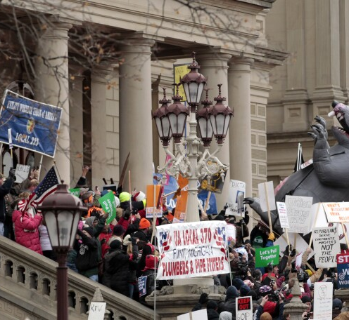
Overview
Picketing and the First Amendment
NLRA Regulation of Picketing
Common Situs Picketing
Non-Picketing Communications

Slide 3
What is Picketing?
Patrolling in front of entrances – with or without signs
Confrontational activity
“Signal” picketing – signal to union employees
  Picket sign in a snow bank at an employee entrance;
  Picket sign hung from tree at employee entrance.
NOT: Handbill or holding or wearing signs or banners.

Slide 4
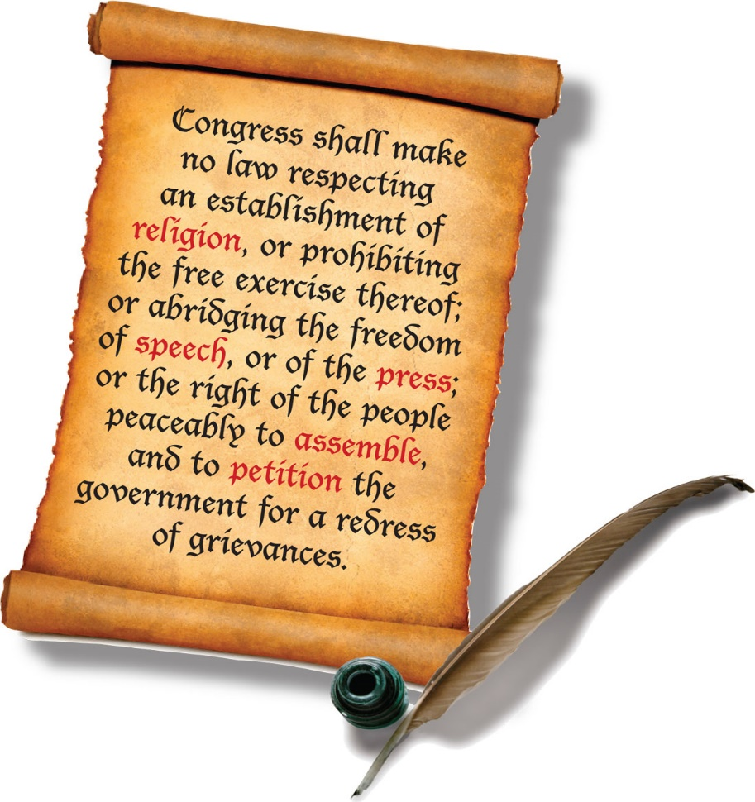

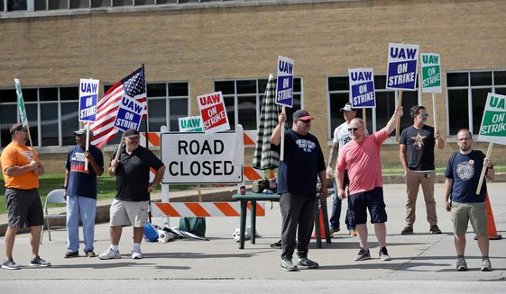

The First Amendment Right of Free Speech

Slide 5
First Amendment and Picketing
Picketing is not fully protected by the First Amendment.
Why?
  Courts consider picketing to be free speech “plus”
    Plus = physical or symbolic confrontation between union members, employers, or the public trying to enter the premises.
Picketing Regulated by the National Labor Relations Act

Slide 6
Protected Picketing Activity
Section 7 of the NLRA:
  Employees shall have the right to self-organization, to form, join, or assist labor organizations, to bargain collectively through representatives of their own choosing, and to engage in other concerted activities for the purpose of collective bargaining or other mutual aid or protection, and shall also have the right to refrain in such activities . . .”
Peaceful picketing is protected activity unless prohibited by another section of the NLRA

Slide 7
Picketing Activity
NLRA regulates:
  Secondary picketing
  Recognitional/Organizational picketing
  Informational picketing
  Area Standards picketing
  Jurisdictional picketing

Slide 8
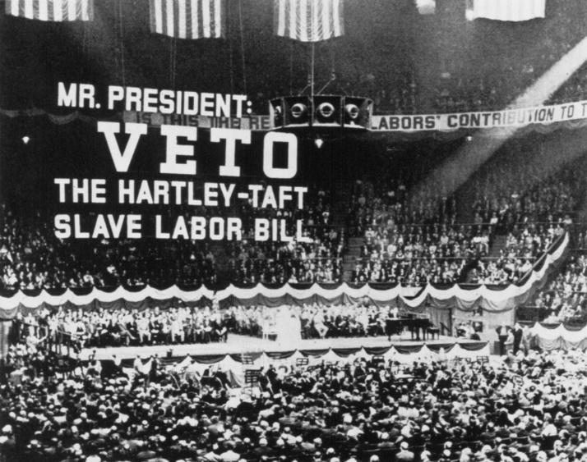
Restrictions on Secondary Picketing
Taft-Hartley outlawed picketing and other activity directed at specific objectives – Commonly Called Secondary Activity or Secondary Boycotts
Employers in labor disputes are divided between primary and secondary employers.
Restrictions designed to shield secondary/“neutral” employers from certain improper pressure related to the labor dispute.

Slide 9
NLRB V. DENVER BUILDING TRADES, 341 U.S. 675 (1951)
Facts (1948 – Just after passage of Taft-Hartley amendments)
  Large construction project in Denver
  Every contractor on the project was union except for electrical contractor
  Building Trades Council picketed the job stating: “This Job Unfair to Denver Building and Construction Trades Council”
  All union employees walked off the job and stayed off
  General Contractor replaced the electrical contractor with a union contractor
  Work resumed, and non-union electrical contractor filed 8(b)(4) charge

Slide 10
NLRB V. DENVER BUILDING TRADES, 341 U.S. 675 (1951)
8(b)(4) = “It shall be an unfair labor practice for a labor organization . . . to engage . . . in a strike . . . where an object thereof is . . . forcing or requiring . . . any employer or other person . . . to cease doing business with any other person . . . .”

Slide 11
NLRB V. DENVER BUILDING TRADES, 341 U.S. 675 (1951)
Supreme Court : 8(b)(4) violation because picketing/strike was for the purpose of having the general contractor cease doing business with the non-union subcontractor.
  Because Council’s goal was to have nonunion contractor kicked off jobsite, its object must have been to force the GC to terminate its contract with the non-union subcontractor.
Take Away: Board and Courts treat each contractor on a construction project as a separate independent entity even though the general contractor may have supervision over subcontractor.

Slide 12
Primary v. Secondary Employers
Primary:
  Organizing campaign: The ultimate entity we are trying to organize - the employer that would employ our members
  Contract dispute: The signatory employer
Secondary:
  Any entity or person other than the primary

Slide 13
Primary v. Secondary Employers
Fatal Memorial Hospital is adding a large addition in your jurisdiction
Fatal’s employees are represented by the SEIU and other unions
Fatal retains Cheap and Shoddy Construction as its General Contractor
Cheap and Shoddy subcontracts the mechanical package to Change Order Mechanical
Change Order subcontracts the insulation work to Ratboy Insulation, a non-union contractor
Who is the primary with respect to the Insulators Local Union?
Who is secondary?

Slide 14
Restrictions on Secondary Activity
Section 8(b)(4) of the NLRA Significantly Restricts Secondary Activity:
  Section 8(b)(4)(i) makes it unlawful to encourage a secondary’s employees to strike to cause the secondary to cease doing business with the primary.
  Can’t picket or otherwise encourage the SEIU-represented employees of the hospital to strike to cause the hospital to cease doing business with the GC or Ratboy.

Slide 15
Restrictions on Secondary Activity
Section 8(b)(4)(ii) makes it unlawful to threaten, coerce or restrain a secondary to cease doing business with a primary.
  Can’t threaten or coerce the hospital or the GC to cause them to cease doing business with Ratboy.
What is a threat, coercion, or restraint?
  Picketing
  Picket-like confrontational activity
  Letter threatening to picket?
    The Trump Board held that a local violated 8(b)(4) by not including certain language in a letter concerning planned primary picketing.

Slide 16
Restrictions on Secondary Activity
Cannot picket a secondary employer
  Violation requires NLRB to seek injunction.
  Section 303 gives private parties affected by violation right to sue for money damages.
NLRA also regulates various types of primary picketing.

Slide 17
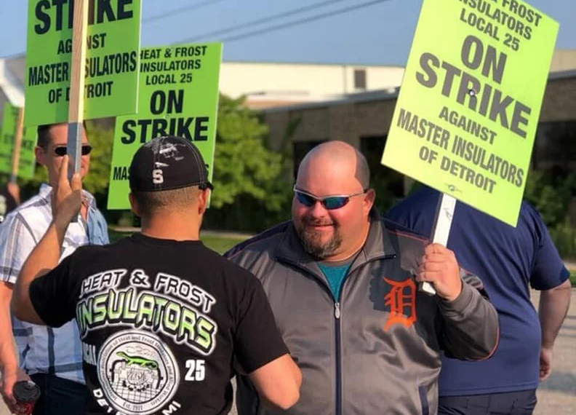
Strikes
  Peaceful picketing to support a lawful strike against a primary is protected activity.

Slide 18
OTHER REGULATED PICKETING
Recognitional/Organizational
Jurisdictional
Informational (aimed only at the public)

Slide 19
Recognitional/Organizational Picketing
Recognitional picketing is picketing where an objective of the picketing is to force an employer to recognize the union.
Organizational picketing is picketing where an objective of the picketing is to encourage employees to choose the union as their representative.
Both are limited and regulated by 8(b)(7).

Slide 20
Recognitional/Organizational Picketing
Cannot engage in recognitional/organizational picketing when:
Another union is recognized by the employer;
Representation election was held in past 12 months; or
No petition for election filed within “reasonable time” not to exceed 30 days from the start of the picketing.
    Therefore, cannot have recognitional/organizational picket for more than 30 days unless election petition filed first.
    Does not guarantee 30 days of picketing – clock may run from day one
    Picket day 1, day 5, day 80, day 85 (violation if no petition filed)

Slide 21
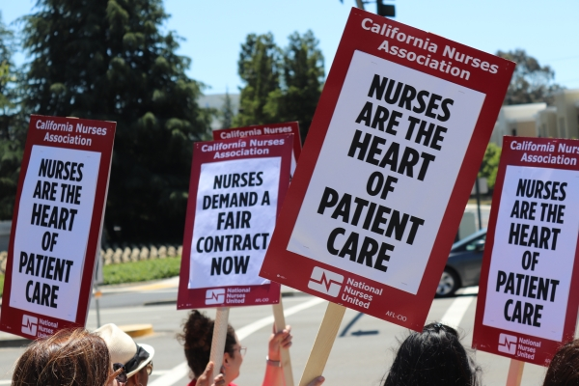
Informational Picketing
Informational Picketing is an exception to the recognitional picketing bar.
  Picketing for the purpose of truthfully advising the public (including consumers) that an employer does not employ members of, or have a contract with, a labor union.
  Exception to recognitional picketing limitations, so can picket for more than 30 days, BUT

Slide 22
Informational Picketing
Must be aimed solely at public.
  Cannot picket at employee-only entrances.
Cannot cause employees not to work or suppliers not to pick up, deliver, etc.
  The more effective the picketing is in shutting the job down, the greater the unfair labor practice.
Effective tool against primary employer with public customers (casinos, groceries, etc.), but questionable otherwise.

Slide 23
Jurisdictional Picketing
Picketing where an object is to have the contractor assign work to our union
  Cannot do it
  Prohibited by Section 8(b)(4)(ii)(D) of the Act
Ex. Mechanical subs insulation work to Ratboy Insulation, which has an agreement with the Carpenters.
  Insulators cannot picket Ratboy where an object is to get Ratboy to award work to the Insulators.
  Exception is that you can picket if Ratboy is failing to follow an order of the NLRB regarding the assignment.

Slide 24
Picketing Non-Union Contractors
Recognitional/organizational picketing is limited;
Jurisdictional picketing is unlawful;
Informational picketing either ineffective or deemed organizational picketing;
What can we do?

Slide 25
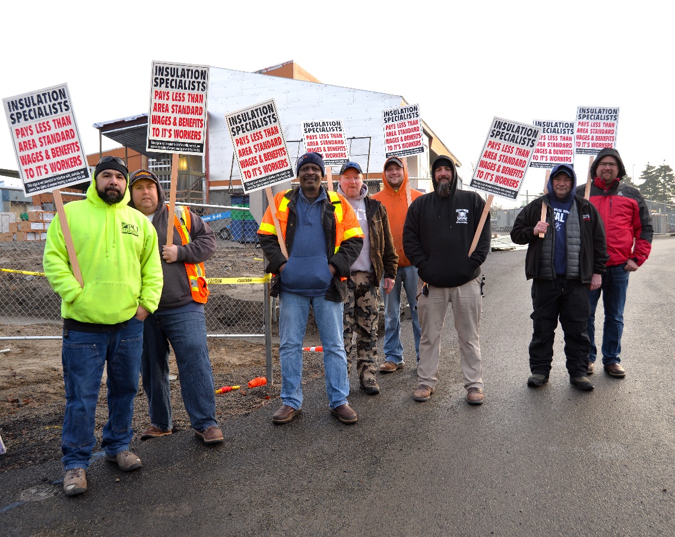
Area Standards picketing
NOTICE
RATBOY INSULATION
Is Destroying Area
Construction Industry Standard
WE PROTEST
THIS COMPANY
Not Observing Our
WAGE AND BENEFIT STANDARDS
INSULATORS LOCAL ___
We are appealing only to the public. We are not seeking to induce any person to cease work or to refuse to make deliveries.

Slide 26
Area Standards Picketing
Sole purpose is to notify public that employer pays substandard wages and benefits
  Total economic package must be substandard
Sign should state clearly that Contractor is failing to pay area standards
Not recognitional, jurisdictional, or secondary, BUT . . .

Slide 27
Area Standards Picketing
Union must investigate wages and benefits being paid prior to picketing
  Investigation must be reasonable
  Reliance on one employee’s word, for example, may not be enough
Demand letter to contractor
  Give notice of below market rates;
  Notice of picket;
  Notice that picketing is not recognitional, organizational, or jurisdictional

Slide 28
Area Standards Picketing
Area standards picket cannot immediately follow recognitional activity
  Hiatus – how long?
    No specific period – 21 days is too short
  Letter disclaiming any representational interest
Union cannot protest failure to meet both economic and non-economic standards
  Protest and demands must be limited to economic standards
    Total wage package

Slide 29
Unfair Labor Practice Picketing
Picketing to protest an unfair labor practice is protected activity
  Not subject to time limitations of recognitional picketing
  Lawful even if it causes employees of other employers not to cross picket line
Board will scrutinize object of picketing – weak ULP may lead to conclusion of unlawful objective

Slide 30
Common-Situs Picketing
8(b)(4) prohibits picketing a secondary employer.
Supreme Court carved up and separated employers on a construction project into separate primary and secondary employers.
So, how does a union take lawful action against a primary contractor/subcontractor when the primary is working on someone else’s property with multiple other employers present?

Slide 31
Common-situs picketing:
MOORE DRY DOCK, 92 NLRB 547 (1950)
Shipping industry case – not construction industry
  Ship was docked at Moore’s facility during renovations to the ship.
  Sailors Union and Ship Owner had a labor dispute.
  Pickets set up outside Moore’s main gate with signs saying, "S. S. Phopho unfair to the Sailors' Union of the Pacific, A. F. L."
  Picketing induced some of Moore’s employees to stop working on the renovations.

Slide 32
Common-situs picketing:
MOORE DRY DOCK, 92 NLRB 547 (1950)
Question before the Board: Does the right to picket follow the situs (here, the ship) while it is stationed at the premises of a secondary employer, when the only way to picket that situs is in front of the secondary employer's premises?
Board viewed issue as balancing the right of a union to picket a primary employer against the right of a secondary employer to be free from picketing.

Slide 33
Common-situs picketing:
MOORE DRY DOCK, 92 NLRB 547 (1950)
Board Ruled: Can only picket a site owned/controlled by a secondary employer under certain conditions.
Where: Picketing is done reasonably close to the primary employer,
When: Primary contractor is present and engaged in normal business, and
What: Picketing discloses that the dispute is with the primary.
What result in Moore Dry Dock?
Protected, primary picketing.

Slide 34
Common-situs picketing:
When contractor is present
Union must reasonably believe the primary employer is present on the jobsite.
If union is notified in advance that primary will be present only during certain hours, Union can only picket during those hours.
BUT: If the primary fails to observe that schedule, and is on site performing work at other hours, Union may picket then also.

Slide 35
Common-situs picketing:
Where: Must be Reasonably Close to Primary
Because picketing must be reasonably close to the primary, if a reserve gate is established for the primary contractor, picketing must be limited to that gate.
Gates for all other contractors on the site are neutral gates.
  If the reserved gate properly established, cannot picket reserve gate.

Slide 36
Common-situs picketing:
Where: Must be Reasonably Close to Primary
Gate 1 (Union)
GATE 1
STOP – READ
THIS GATE MAY NOT BE USED BY PERSONNEL, VISITORS OR SUPPLIERS OF THE CONTRACTORS LISTED BELOW:
RATBOY INSULATORS
ALL OTHERS MAY USE THIS GATE
Construction Site
Gate 2 (Non-Union)

Slide 37
Common-situs picketing:
Where: Must be Reasonably Close to Primary
Tainted Gates
If a neutral gate (the gate reserved for contractors other than the primary) is used by employees or suppliers of the primary, the gate is “tainted” and can be picketed.
  Must be significant to show “pattern of destruction of neutral gate.”
  Something more than 1 or 2 violations.
If the employer takes corrective action to restore the neutral gate, union must respect neutral gate unless it is tainted again.

Slide 38
Common-situs picketing:
Where: Must be Reasonably Close to Primary
Observers
Unions can and should put observers at neutral gates
Observers cannot carry picket signs
Should wear clothing that identifies the person as an OBSERVER and should be given instructions
Observers should note who uses the gate and when
If recording or photographing, only record suspected primary employees or suppliers

Slide 39
Ratboy Exercise
Ratboy Insulation is non-union
Wage/Benefit package is $10.00 less per hour than local insulator’s rate
Ratboy is on Stadium project
Reserved Gate established:
  Gate 1: Electrical, Painting, Drywall
  Gate 2: Ratboy
  Gate 3: Carpentry
  Gate 4: Everyone else
Ratboy’s superintendent sends a letter stating that Ratboy is on the site only from 9 pm to 5 am
All other contractors working 7 am to 3 pm
Design picket sign
Where can you picket?
When can you picket?
What else should you be doing on the site?

Slide 40
Picketing Conclusion
Cannot picket secondary employers, including other employers on job site, such as mechanical sub
Cannot picket for recognition for more than 30 days
Cannot picket to protest jurisdictional assignment
Can picket for Area Standards or to protest ULP
But picketing can be limited through reserve gate system
Is picketing an effective form of protest?
  What else could we do?

Slide 41
Picketing
QUESTIONS?

Slide 42
Non-Confrontational Publicity

Slide 43
Non-Confrontational Publicity
Truthful, peaceful, non-confrontational publicity is NOT prohibited by 8(b)(4)(ii)
Pure Speech Publicity:
Handbilling
Bannering
Websites
Facebook
Twitter/Other social media
Inflatable Animals (Scabby)
Signs
Projections

Slide 44
Non-Confrontational Publicity
8(b)(4)(i) still applies
  Cannot urge employees of secondary to strike, not make deliveries, etc.
  Therefore, message should be publicity – a message aimed at public

Slide 45
Handbilling
Peaceful handbilling with no picketing, does not violate 8(b)(4)(ii)
Handbilling need not be confined to site of dispute
Handbilling, like other forms of peaceful publicity, need not (and should not) be limited to “labor issues”

Slide 46
Handbilling
Do not block people entering or leaving site of handbilling
Keep it peaceful
May combine handbilling with bannering or other non-picketing communication

Slide 47
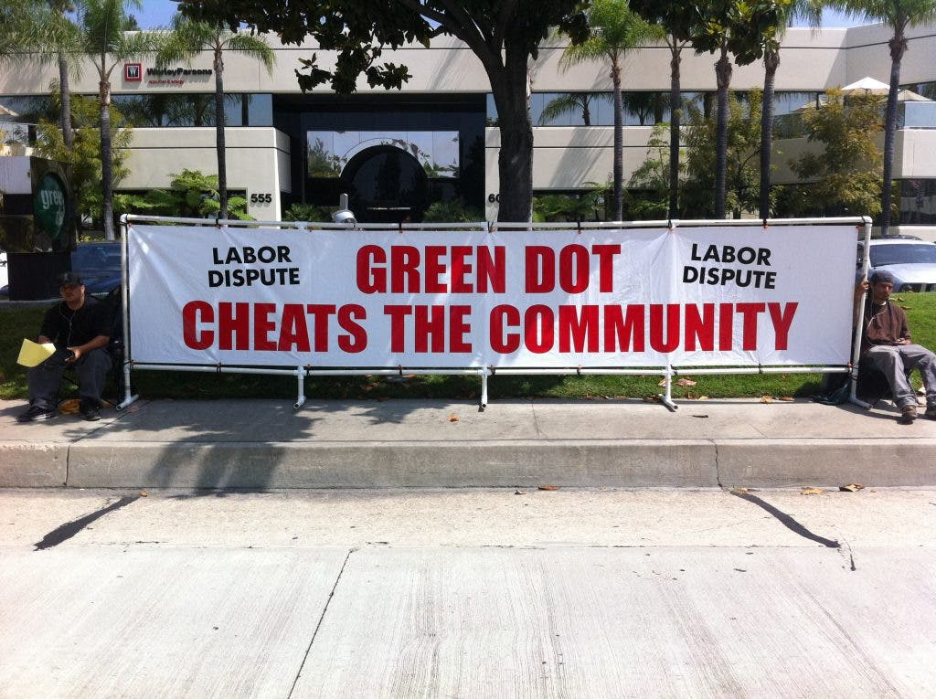
Bannering
NLRB has held that the display of a banner is noncoercive conduct that is lawful under 8(b)(4)(ii)
  Bannering not analogous to picketing
  No element of confrontation, no patrolling
  Need not be confined to reserve gate

Slide 48
Bannering
Handbillers, if any, stay with banner
No more reps than necessary
Use of drums or noise cannot disrupt building’s tenants – only used to draw attention from those outside
No confrontation
Do not create work stoppage

Slide 49
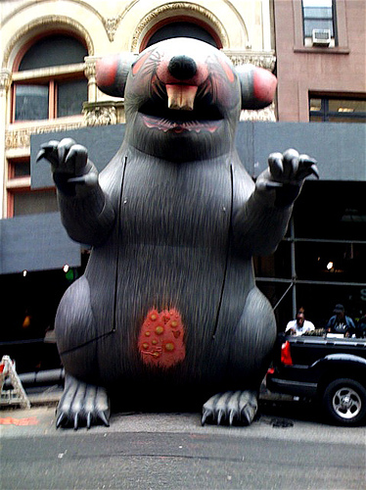
Inflatable Rats
Can you “aim” Scabby at a secondary?
NLRB has ruled that the peaceful display of rat does not violate the Act
  Stationary
    No impeding access
    No more union reps present than necessary
NLRB has re-confirmed that Scabby is lawful
  Inflatable rat and banner “achieve their effect by ‘mere persuasion, and the neutral who reacts is doing no more than what its customers honestly want it to do.’”
Notes:
49

Slide 50
Peaceful Publicity – Where?
Where can you lawfully banner, handbill, post scabby
  Public Property
    Public sidewalks, parks, street corner, etc.
  Mall/Store/Building Parking Lot?
    U.S. Supreme Court in Lechmere – Employer may prohibit nonemployee efforts to communicate with employees on the employer’s property.
    Employer’s rule must be nondiscriminatory – can’t allow Girl Scouts, but bar Union Organizers
Notes:
50

Slide 51
Peaceful Publicity - What Can You Say?
Only limitation is truth
Does not need to – and probably should not – be limited to labor issues
Can and should be aimed at secondary
Can call for a complete boycott of secondary
Can and should expose secondary’s problems
Notes:
51

Slide 52
Peaceful Publicity - What Can You Say?
Research and Uncover Facts
Provide truthful information that is important to the public, not just to the labor movement
    Health Board violations – unsanitary conditions
    Workforce issues
    Financial practices
    Health and Safety problems
Notes:
52

Slide 53
Peaceful Publicity - What CAN’T You Say?
  Do NOT include false information in a handbill, on a banner, on a website, or in any other publicity
Notes:
53

Slide 54
Defamation
Definition:
  Publication of
  a false statement
  about a person
  that tends to harm the reputation of the person,
  and causes that person harm (note: harm is sometimes assumed).

Slide 55
Defamation
Libel and Slander
  Subsets of defamation
    Libel – written defamatory statement
    Slander – oral defamatory statement

Slide 56

Defamation
A true statement cannot be defamatory
  No matter how harmful
  No matter how much the reputation of another is damaged

Slide 57
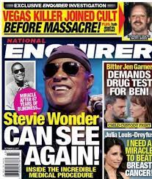
Assuring the truth
What is the source of your information?
  Reputable?
  Person’s own words?
  Private vs. public?
  Government?
  First-hand?
  Verifiable?
Double source and fact check
  Keep file
  Demonstrate fact check and verification

Slide 58
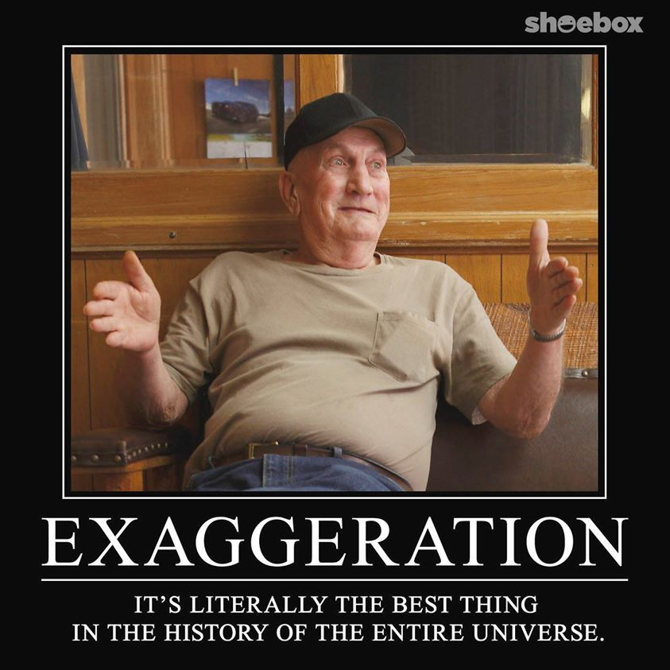
No Hyperbole
Exaggerating the facts can transform a true statement of fact into a defamatory statement
Let the facts speak for themselves
Don’t interpret the facts
    Let the audience interpret

Slide 59


Don’t Play Jeopardy
Putting a defamatory statement in the form of a question does not make it less defamatory
Still an assertion of verifiable fact

Slide 60
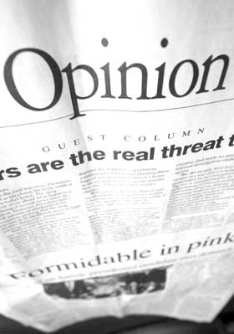
Opinion
A defamatory statement is a false statement of fact that damages another person’s reputation
  Pure opinion that is not an assertion of a verifiable fact is generally not actionable
  “In my opinion” will not save an otherwise defamatory statement

Slide 61
Defamation Takeaways
Stick to the facts
Know that the facts are true
Leave the facts alone

Slide 62
Example
J. Maki Construction Co. builds single family homes in Lake County, Illinois outside of Chicago
Research uncovers newspaper article in which Maki homeowners complained about their leaky windows caused by improper installation
Customers complain that leaky windows installed by Maki caused ice build up and water damage

Slide 63
Example
"ACCORDING TO THE NORTHWEST HERALD PAPER CONSIDER THIS BEFORE YOU BUY:
THERE ONCE WAS A MAN NAMED MAKI, WHO DIDN'T WANT YOU TO KNOW HIS HOUSES WERE CRAPPY.
`IF MY HOMEBUYER HAS WINDOWS THAT LEAK, THEY WON'T TAKE A PEEK, AND SEE THE WHOLE HOUSE IS CRAPPY.'
SO SAID A MAN NAMED MAKI!
ONE `LUCKY' HOMEBUYER IN JOHNSBURG IS QUOTED; [sic] `THERE'S JUST THE ONE ISSUE: THE WINDOWS WERE INSTALLED INCORRECTLY.' [internet web address for Northwest Herald article]
AN INFORMED HOMEBUYER IS A SMARTER HOMEBUYER."

Slide 64
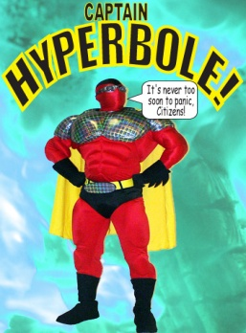
J. Maki Construction Co. v. Chicago Regional Council of Carpenters
Case proceeded to jury:
  Jury awarded $2,353,000 in damages to Maki and against Union and three organizers, who were named individually
  On appeal, judgment was reversed, but case cost thousands to litigate and try

Slide 67
Non-picketing communication
QUESTIONS?

Slide 68
Picketing and Handbilling
QUESTIONS?
Sherman Dunn, P.C.
900 7th Street, N.W., Suite 1000
Washington, D.C. 20001

