Slide 1
Robert’s Rules of Order
Notes:
Well, here we are again. And you have me for the rest of the day. I am not a parliamentarian. Though, really, I think that’s another way to make a few bucks. There is a National Association of Parliamentarians that has a test that costs money. You pass the test and pay your money; you’re a parliamentarian.
I was, however, President at Local 24 for 15 years and chaired my share of meetings and hearings.
I am currently the Maryland State Chair of Apprenticeship. I have had that position for 5 years. We meet bimonthly. Later this month will be my 31st meeting as chair of that council.
With this experience, I have been given the task of presenting the information you need to help you chair meetings and produce the minutes at your local union.

Slide 2
Training Objectives:
To provide insight about the history of Robert’s Rules of Order and parliamentary law.
To address the roles and responsibilities of the officers.
To review the meeting process and provide guidance on how to conduct an effective meeting.
Notes:
The purpose of this training is to achieve the following: (1) to provide insight about the history of Robert’s Rules of Order and parliamentary law; (2) to address the roles and responsibilities of the officers and (3) to review the meeting process and provide guidance on how to conduct an effective meeting.

Slide 3
Parliamentary Law
The rules and precedence governing the proceedings of deliberative assemblies and other organizations.
Notes:
According to Webster’s Dictionary, Parliamentary Law is the rules and precedence governing the proceedings of deliberative assemblies and other organizations. Parliamentary law is necessary when conducting meetings. It allows for productive and efficient meetings when officers and members abide by the rules. Without parliamentary law, meetings could last for extended periods of time, and it may be difficult to accomplish the tasks at hand.
Let’s face it, long, drawn-out meetings suck! While it takes time to conduct business, it shouldn’t take longer than needed. An efficient, well-run meeting will hopefully mean better participation by your members.

Slide 4
History of Robert’s Rules of Order
Henry Martyn Robert
  Author of Robert’s Rules of Order published in 1876
  Engineer
  United States Army General -1901
  Country’s Leading Parliamentarian
Designing The Rules…
    “Based, in its general principles, upon rules and practices of Congress, and adapted in its details of the use of ordinary societies”
Notes:
Thomas Jefferson drafted The Manual of Parliamentary Practice. The purpose was for a uniform system of rules. His desire was to prevent needless haggling over government procedures and to help assist government decision-making. His system, while it had a great purpose, was too complex for the everyday citizen when attempting to conduct business in non-legislative settings.
Henry Martyn Robert was the country’s leading Parliamentarian. Mr. Robert was an engineer in the Army and later rose to the rank of Army Brigadier General. Frustrated by attending meetings where there were several interruptions and off-topic conversations, he felt the need to design a tool for non-legislative organizations where the meetings would be conducted more efficiently and effectively.
The first publication of Robert’s Rules of Order was in 1876. He decided to author this document after being asked to preside over a meeting and experiencing embarrassment because he was unsure of how to conduct the meeting. Additionally, he observed that wherever he went in the country, there was a different method of presiding over a meeting, leaving organizations more focused on procedure than on the substance of the meeting. He decided at this point to design a set of rules for the use of “ordinary societies.” People could belong to more than one organization without needing to learn new procedural rules. Since the creation of his book, there have been many editions which deal with current topics and issues. The latest edition is Robert’s Rules of Order Newly Revised 12th Edition, which was published in 2020. What we have provided you is Roberts Rules of Order In Brief; it’s the Cliff’s Notes of Roberts Rules, a good reference manual should you need it. We also have some handouts for you to use in the future as well.

Slide 5
Purpose of Robert’s Rules of Order
Parliamentary Rules Protect:
  The right of the majority to decide;
  The right of the minority to be heard;
  The right of the individual member; and
  The right of absentees.
Notes:
Robert’s Rules of Order protects the majority, the minority, individuals, and absentees. Let’s take a look in more detail at these individual categories. The majority is the number greater than half the total. While everyone may not agree, it is essential for more than half of the individuals who are a part of the organization to agree. The minority is the smaller part of group opposed to the majority. Sometimes, when a viewpoint is different from everyone else, it is difficult to be heard. Nevertheless, Robert’s Rules of Order gives everyone a voice.
An individual member of the Local would be the Business Manager, a member of the E-Board, a mechanic, or an apprentice, among others, as classified by our Union’s bylaws. These individuals collectively make up the voice of the individuals who are a part of the organization. Lastly, an absentee is an individual member who, for some unforeseen or foreseeable reason, will not be present at the meeting. Members still have rights even if they are absent. Even so, I can’t stress enough how important it is to attend and participate!

Slide 6
True / False
The latest version of Robert’s Rules of Order is the 10th Edition.

Slide 7
Answer:
False. It is the Robert’s Rules of Order Newly Revised, 12th Edition which was published in 2020.

Slide 8
The Roles and Responsibilities of the Officers
Notes:
Let’s talk about the officers as it pertains to a Local Union’s meetings

Slide 9
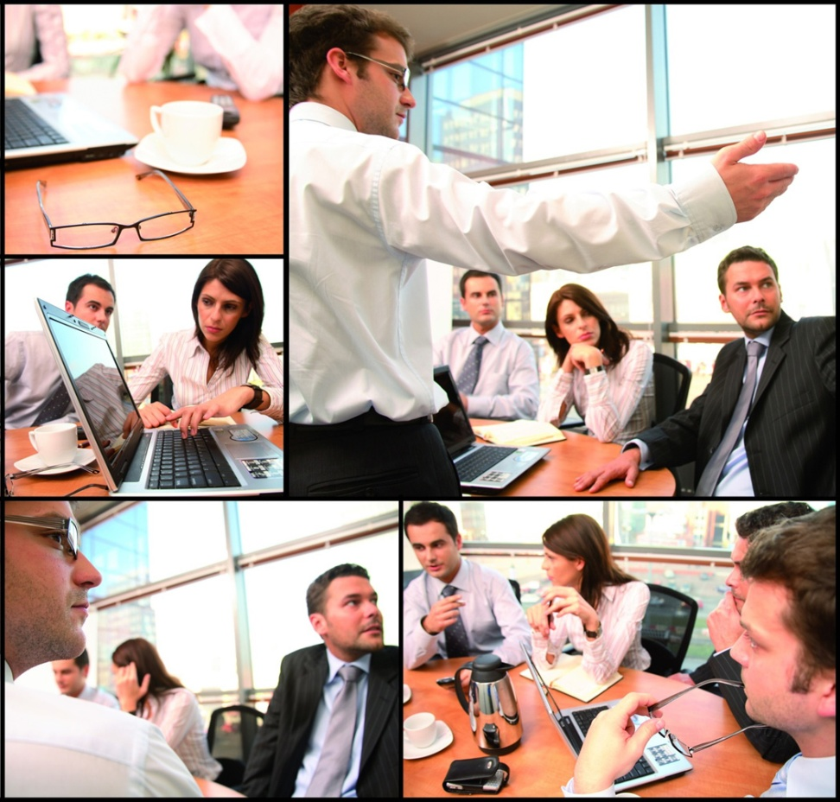
Who are the Local Officers?
President
Vice President
Recording Secretary
Notes:
The International constitution and by-laws provide guidance on the roles and responsibilities of the officers. Throughout this training, I will address the roles and responsibilities of the Local Union President, Vice President, and Recording Secretary. I know Vice Presidents are not in this training, but it's important for them to get the basics of these rules as well; they are the chair of the Executive Board meetings and possibly the next President. I also understand the Recording Secretaries are probably not here either. They provide the minutes. It is imperative that they understand their responsibilities. Please share the knowledge you gain here with the VP and Recording Secretary.
The duties of the Local Union President can be found in the International Constitution and Bylaws Article XXI, Section 1.
The duties of the Local Union Vice President can be found in the International Constitution and Bylaws Article XXI, Section 2.
The duties of the Local Union Recording Secretary can be found in the International Constitution and Bylaws Article XXI, Section 4
Section 3 of that Article states that in the absence of both the President and Vice President, a chairman to preside over the meeting shall be chosen by the membership. That should make for an interesting meeting!

Slide 10
Chairman’s Demeanor
Impartial
Fair
Objective
Calm
Notes:
The role of the Local Union President is very important because one of his/her main responsibilities is to Chair the Local’s meetings. In doing so, he/she must make sure to exhibit the following qualities: They should be calm, objective, fair, and impartial. In serving in a leadership role, it is the responsibility of the Chairman to refrain from dominating the meeting and to operate in a diplomatic fashion. The Chairman must ensure that the concerns of the officers and members are heard and that the group is able to address the issues before the organization.

Slide 11
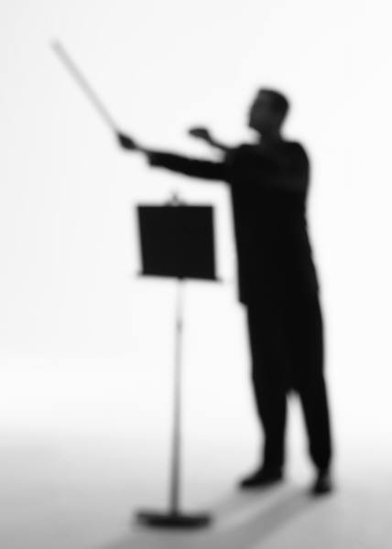
Chairman’s Role
  Maintain order
  Enforce the rules
  Operate in an expedient and impartial manner
  Conduct business in a calm and objective manner
  Focus the group and not allow irrelevant discussion
  Provide clarification when needed
Notes:
When serving as the overseer of the meeting, the Chairman is like a conductor. His or her role is to ensure that there is order in the meeting. Some of the responsibilities include enforcing the rules and conducting business in a professional, expedient, and impartial manner.
Additionally, he is to ensure that the group is focused and that there are no irrelevant conversations during the meeting. Throughout the meeting, he/she clarifies motions and votes to ensure that members conduct the business of the organization.

Slide 12
Chairman’s Responsibilities
Arrive early and start meetings on time
Develop a well-prepared agenda and stick to it
Contact those with reports prior to the meeting
To be familiar with procedural rules of the by-laws, the standing rules, and the customs of the group and parliamentary procedure
Clarify motions and votes
Notes:
Here is a list are tasks that the Chairman can complete in preparation for an organized and effective meeting. These tasks include:
Arrive early and start meetings on time;
develop a well-prepared agenda and stick to it;
contact those members or committee chairs who have reports prior to the meeting;
be familiar with procedural aspects of the by-laws, the standing rules, and the customs of the group and parliamentary procedure; and
clarify motions and votes.

Slide 13
Co-Chair’s Role
Serves in the absence of the Chair
Completes any reports he/she is assigned
Notes:
The next role we will discuss is the role of the Co-Chairman. The Co-Chair serves in the absence of the Chair. Therefore, he/she needs to be prepared to develop the agenda, manage the meeting, and even direct the other members. In our organization, the Co-Chair would be the Vice President. The Vice President, according to our by-laws, is chair of the Executive Board meeting. While on a smaller scale, same rules apply to E-Board meetings.
In the absence of the Chairperson, someone must be prepared to continue with the business of the organization. Generally, the Co-Chairperson serves in the absence of the Chair. If the Chairperson is unable to oversee the meeting, create the agenda, or attend the meeting, the Co-Chair should be prepared to handle the Chair’s duties and responsibilities. Additionally, all members need to be aware of the roles of the officers and be prepared to contribute to the effectiveness of the organization. It is a good idea to have some basic training about meetings and rules of order during apprenticeship training.

Slide 14
Role of the Secretary
Responsible for minutes of the meeting and executive board
  Recording
  Reviewing
  Revising
  Returning
Assisting with the preparation and dissemination of the agenda
Keeping records
  Minutes
  Duties
  Special Assignments
Notes:
The Secretary is the record keeper. He/she has three main responsibilities, which include: minutes, agenda, and record keeping. As it relates to the minutes, the secretary is responsible for the 4 R’s, which include recording the minutes at the meeting, reviewing the minutes after the meeting, and making the necessary revisions to the minutes prior to returning the minutes to the members for approval. The secretary is also responsible for assisting the Manager, the Chair, and the Co-Chair with preparing the agenda for the upcoming meetings. Lastly, the Secretary is responsible for keeping the organization’s records. These records include the minutes, duties of the officers, and any special assignments of the members and officers of the organization. I know most locals will keep materials and documents at the union hall for the Recording Secretary; it is important for the Recording Secretary to understand their responsibilities. I also agree that it is best to keep these materials on file at the Union Hall for safekeeping and security.
A good practice for the Recording secretary is to take notes during the meeting, keep the notes after the meeting, create a rough draft of the minutes from the notes, and meet with the manager and president (and whoever else at the Local Union) to finalize the minutes before the next meeting for approval

Slide 15
The Importance of Minutes
They constitute the permanent record of proposals, decisions and reports of members of the executive board
Legal record of the meeting
May be subpoenaed
Not in the Minutes
  It didn’t happen!
Notes:
So, Why are minutes important?
Minutes are important because they are the permanent record of the organization. The minutes are the method by which proposals, decisions, and reports are recorded. They serve as the legal record of the meeting and may be subpoenaed at any time. By recording what occurs in the minutes, the organization has legal protection of what has been accomplished and who is accountable for performing assigned and required duties. Legal experts will maintain that if an action isn’t in the minutes, it did not happen.

Slide 16

Contents of Meeting Minutes
Kind of Meeting
Name of the organization
Date and place of meeting
Presence of the chairman and secretary
Presence of the quorum
Time the meeting was called to order
Whether the minutes of the previous meeting were approved or corrected
Notes:
There are different types of meetings. These types include regular, special, adjourned regular, and adjourned special. When recording the minutes of any of these types of meetings, the contents of the meeting minutes should include the following:
type of meeting, name of the organization, date and place of meeting, presence of officers and members, the presence of the quorum, the time the meeting was called to order, and whether the minutes of the previous meeting were approved or corrected.

Slide 17
What to Record in the Minutes
All adopted or defeated motions
Names of all members reporting
Names of all those elected or appointed
Number of votes on each side in a ballot or counted vote
Notes:
Some may feel compelled to write down every single word that is spoken in the meeting. Writing every spoken word is a transcript and not minutes. While this may be helpful when it comes to drafting the minutes, it is very difficult to keep up as the meeting progresses. There is specific information that should be provided in the meeting minutes. The secretary should record (1) all adopted or defeated motions, (2) names of all members reporting to the meeting, (3) Names of the members who have been elected or appointed to an office, and (4) the number of votes on each side in a ballot or counted vote.

Slide 18
What Not to Record
Discussion or personal opinion
Name of the seconder of the motion
Motions withdrawn
Entire reports
  Attach to the original of the minutes
Note: Corrections to minutes may be made at any time but requires two thirds vote if the minutes are already adopted.
Notes:
While the secretary is responsible for including pertinent information in the minutes for the effective operation of the organization, there are some things that should not be recorded in the minutes. The information that should not be recorded in the minutes includes the following: discussion or personal opinion, name of the seconder of the motion, motions withdrawn, and entire reports. Nevertheless, reports that are provided by members or committee chairs could be attached to the minutes and should be kept on file.
Throughout meetings, members may feel inclined to engage in discussion and provide their personal opinions about various subjects. When a discussion is relevant and centered on the topic at hand, the discussion does not become a part of the minutes. Once the discussion is over, any vote that is taken on behalf of the information discussed should be recorded in the minutes. Before a vote is taken, a member of the organization must make a motion to act upon the request.

Slide 19

Drafting Minutes
Minutes do not have to be verbatim.
Minutes are supposed to be a short and to the point.
The body ultimately decides what should and should not be in the minutes by a vote.
Minutes are not official until voted on (or even changed) at the following meeting.
Notes:
Minutes do not have to be verbatim. In cases where they are verbatim, as I mentioned before, that is a transcript, not notes. Minutes are supposed to be short, to-the-point accounts of business transacted so that readers can quickly determine what was done. The ultimate decider of what should and should not be done in the minutes is the body as a whole. Draft minutes do not become official until voted on (or even changed) at the following meeting.
A good idea for a meeting template would be to take a basic agenda for the organization and leave space for each topic for the notes of that portion of the meeting.

Slide 20
Drafting Minutes
Minutes are formulaic; therefore, it is advantageous to prepare a template in advance to save time.
Call to Order: time_____
Moment of silence: names______________
Minutes of previous meeting. Approved or corrected?
Report of E-Board. Approved?
Etc. through the entire agenda
Notes:
If you are the keeper of the minutes, prepare the minutes template in advance because they will look very similar from meeting to meeting. This will save time and provide consistency in providing the minutes to the body.
It is preferred that the written minutes be in a bound notebook so that pages can not be removed. Then, minutes can be typed up from those notes and submitted for approval by the membership at the next meeting. The book of written minutes is the notes of the meetings. The typed minutes are what is submitted for approval and, therefore, become the official record.

Slide 21
True / False
The secretary shall transcribe the minutes verbatim for the members to review at the next meeting.

Slide 22
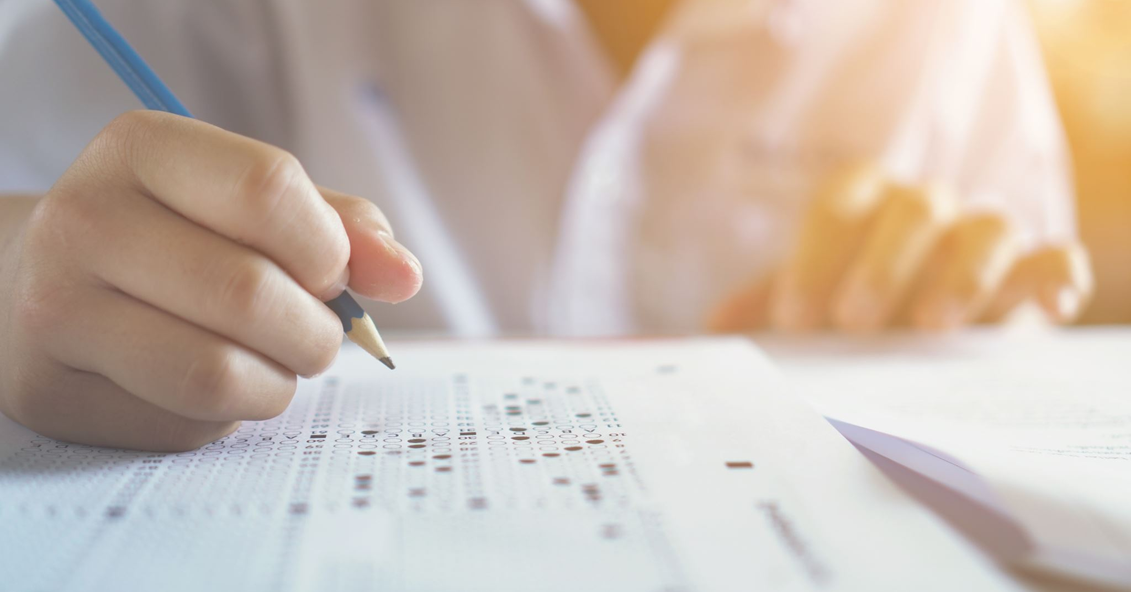
Answer:
False. In cases where minutes are verbatim, that is considered a transcript, not notes. Minutes are supposed to be a short, to-the- point account of business transacted so that readers can quickly determine what was done.
Notes:
When I was new to chairing a meeting, I looked all over the place for any kind of resource to help me be efficient, correct, and probably most importantly, confident in chairing a meeting. Recently, I found a set of training videos done by Susan Leahy, a Roberts Rules expert. They are free on YouTube. I decided to use some of them to help me wrap up certain sections of this training. The first is about minutes.

Slide 23
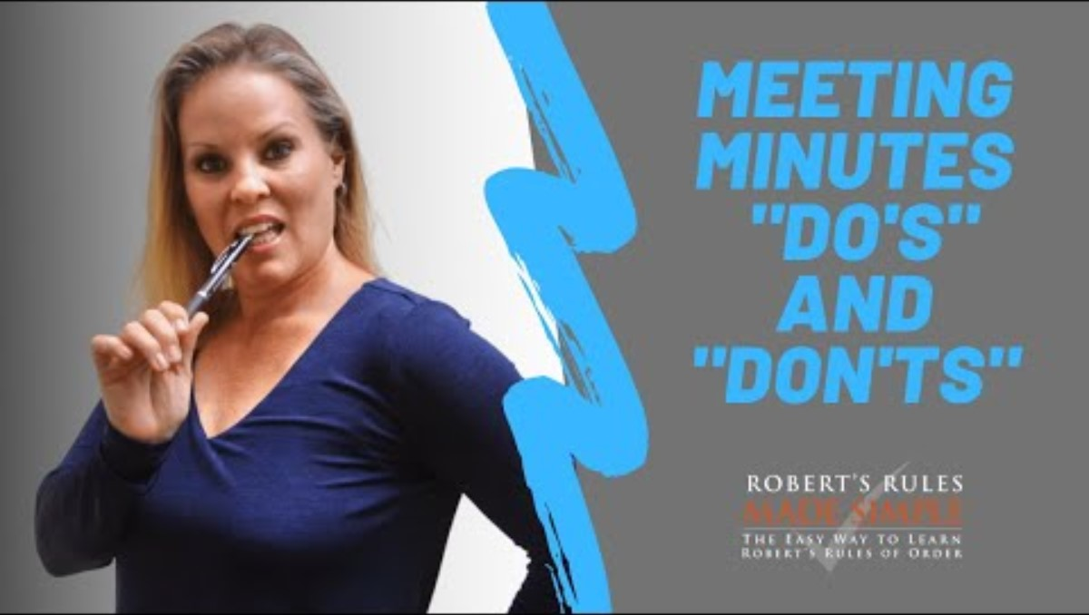

Slide 24

Notes:
Let’s take a quick break.
10 minutes and we will then get started on our next topic – “The Meeting”

Slide 25
The Meeting

Slide 26

Before the Meeting
Secure Meeting Location
  Arrive early to set up meeting location
Prepare an Agenda
Prepare a script (if necessary)
Post Notice of Meeting
  Three days prior to meeting with agenda if the individual members will address an issue that requires a vote
Make sure minutes are ready for approval by members
Notes:
Preparation is the key to an organized meeting. There are certain logistical items that may be addressed before the meeting, which will minimize issues throughout the meeting.
The most important action is to secure a location for the meeting. Should the location not be at the Local Union office, this would generally handled by the Business Manager, as the chief administrative officer of the Local. Nevertheless, it is always good protocol to check with the Manager to make sure that the room is available. Upon determining that the meeting location is available, arrive early to set up the meeting location. At this point, you may decide if the agenda will be in a location for everyone to access or if you will distribute it at the time of the meeting. Frankly, a basic agenda for a Local Union meeting is in the back of the International Constitution and Bylaws and should not need to be distributed but you can if you like.
Additionally, prepare a script if necessary. A script is provided for you as a handout. (distribute and go over the script)
Meetings should be very consistent; therefore, once a script is developed for the meeting, then it stands that this is a document that may be used and revised for all meetings. At any time, a member's rights may be taken away, or if there is an issue that requires a vote, notice of the meeting should be provided. There are two mentions of notification in the International Constitution and Bylaws. The first is in Article XIX, Section 12 where it states Special local union meeting called with reasonable advance notice given to all members with time, place and purpose of said special meeting. The second is Article XX, Section 11(b) where it states local union nomination and election notice must be 15 days and 25 days respectively and further that both notices can be sent together if they are sent at least 15 days prior to date of the nomination. A good rule of thumb would be to use the 15 days of notice whenever possible and consult your local union attorney should something come up, that is so critical that it might not allow for 15 days of notice.
Remember, if you are the recorder or minutes, make sure that the minutes are ready for approval by the members at the time of the next meeting.

Slide 27
Meeting Location
Arrive early to determine logistics and comfort level of the room
Set up room
  Sign in Sheet / Roster
  Tables & Chairs
  Tent Cards with Member Names
  Speaker Cards (for the general public)
  Snacks (optional)
Notes:
When you arrive for the meeting, make sure to determine the logistics and comfort level of the room. Set the room up by placing the sign-in sheet /roster in a location for everyone to access. Also, make sure there are enough tables and chairs for all of the members.
Again, it is a good idea to have a bound book to use for sign-in. You want to remove any doubt that the record is original. At 24, we always used two sign-in books: one for mechanics and one for apprentices though this is not required. It makes it easy when calling for mechanics when a counted vote is required. Many locals have the Sergeant at arms “watch over” the sign-in books.

Slide 28

Agenda
Purpose:
To follow fixed
order of business
This Photo by Unknown Author is licensed under CC BY
Notes:
The purpose of the agenda is to allow for organization and structure in the meeting. It provides for a fixed order of business. The agenda should be created before the meeting. The Chairman, Co-Chair, and Secretary are responsible for the agenda. However, all members of the organization may propose items for discussion. The following slides will provide examples of information that should be included in the agenda.

Slide 29
Agenda Example
Meeting Call to Order / Determination of a Quorum
Adoption of Agenda
Introduction & Welcome
  Pledge of Allegiance
  Moments of Silence
  Any guests
Notes:
The Chairman will call the meeting to order. To call the meeting to order, he/she may simply state, “The meeting will please come to order” or, “The meeting is now convened.” The Chairman then says, “The Secretary will call the Roll.” This helps to determine if there is a quorum to conduct business. If there is a sign in book, you may rely on that for the roll but there must be a determination that a quorum is present.
The agenda is simply a plan of action on how to efficiently and effectively run the meeting. Adopting the agenda makes the meeting binding. When the members of the body adopt the agenda, this signifies that everybody is in agreement with the plan and is seeking to move forward in a productive manner. After adopting the agenda, if there are any introductions of guest speakers, dignitaries, etc, the Chairman will recognize and welcome them to the meeting.
Because we have a “regular” or “normal” agenda within our International Constitution and Bylaws, there is no need to have the agenda approved at every regular union meeting. An agenda, however, for a special meeting with limited items of discussion or a regular meeting with a modified agenda should be approved before moving forward.
Examples:
A specially called meeting to discuss terms and vote on a new contract would be called to discuss the contract only, and that is the only item on the agenda. The chair should state after calling the meeting to order that the only item on the agenda is the proposed contract and ask for approval.
Another example in my experience was during the December meeting; we had a shortened agenda that only discussed required items of the month, and the rest of the agenda was postponed to hear from guests, distribute annual awards, and have a holiday party. I always asked for approval of the “suspension of the regular order of business”.

Slide 30
Agenda Example (continued)
Reading / Adoption of the Minutes
Old Business / Unfinished Business
    Open positions
    Prior discussions
New Business
Notes:
The minutes should be read aloud to the body. The Chair will say, “The Secretary will read the minutes of the last meeting.” After the minutes have been read and reviewed, the Chair will ask, “Are there any additions or corrections to the minutes?” If not, the minutes stand approved as read. If a change or addition is objected to by a member of the body, then there must be a motion to make that change. Once the minutes have been read and following any corrections or additions, the minutes should be approved by the body. Approval of the minutes requires a vote by the body.
Many organizations refer to unfinished business as “old business.” Unfinished business is items or topics of discussion that were carried over from the previous meeting. Some items to consider when discussing Unfinished Business is open positions and other item discussed prior and needed research to find answers. The Chair would say, “We have some unfinished business to take care of…”Just as there is “Unfinished Business,” there is also “New Business.” The members of the body can introduce new items of business during this part of the meeting. To open this part of the meeting, the Chair would say: “Is there any new Business?”

Slide 31
Agenda Example (continued)
Reports
  E-Board
  Officers
  Committees
  Etc.
Other pertinent information
  Good and Welfare
  Receipts and expenditures
  Etc.
Adjournment
Notes:
Reports are sometimes made by the Officers, the Principal, Faculty and even Students. These reports can range from issues affecting the members to recommendations for how funds are spent for the organization.
Again, the open agenda will serve as the public comment. Please note that during public comment, the member of the public only receives three minutes to speak during this time. Lastly, upon completing all of the business at hand, a motion must be made to adjourn the meeting. If no one makes a motion to adjourn, the Chair should ask for one by saying: “Do I hear a motion to adjourn?” It must be seconded and is then voted on without debate.

Slide 32

Meeting Notice
Removal of rights of a member
Topics requiring a vote
Practice v. Protocol
Notes:
When is meeting notice required? Our regularly scheduled meeting should be known by every member. Ot is posted in the Journal for each Local. So notice of a regular meeting isn’t necessarily required, though if you send a regular newsletter, dates of upcoming meetings aren’t a bad idea. Little CYA.
But, specifically, whenever the rights of a member will be taken or if an item requires a vote, a meeting notice must be posted and sent to the membership prior to the meeting. Refer to the examples I provided earlier from the Constitution and Bylaws in Articles XIX and XX.

Slide 33

During the Meeting
Follow the Agenda / Script
Adhere to Parliamentary Procedure
  Members must be recognized by the Chair
  One question at a time, one speaker at a time
Confirm that a Quorum is Present
  Majority must be present to conduct business
Vote on items before the assembly
Notes:
During the meeting, it is important to follow the agenda and even the script if there is one. Everyone must adhere to parliamentary procedure by asking one person at a time and speaking one person at a time. The Chair will recognize the speakers by saying, “The Chair recognizes….” if a quorum is present and an item requires a vote, then there are procedures which must be followed to vote when taking a vote. First, the member will state the question by stating, “I motion that…” or “I move that….” and upon making a motion, the item must receive a second, or it dies. After the motion, the Chair will state, “ It is moved and seconded that…. Are there questions or discussion?” Then the debate will begin. Once the debate has ended, if no one objects, then the chair will proceed with the vote. He will ask, “Are you ready for the question?” He will then state the question or ask the secretary to read the motion. “The question is on the adoption of …” or “There is a motion to…..”
“All those in favor of the motion signify by saying AYE.” “Those opposed say NO.” The Chair will determine and announce the vote. For example, “The AYEs have it, and the motion is adopted.” or “The NOs have it, and the motion is lost.”
Should the outcome of the voice vote be in question, the chair may state, “I have doubt about the outcome; I would like a hand count or a standing count,” OR a member can ask for the same by stating a motion in a similar way. This is called the Division of the Assembly. It does not need a second and is not debatable. The vote is then taken by either hand or standing count. The chair can determine which they prefer
The chair would then say, “All those in favor of the motion will raise their right hand.” Then the hands will be counted. “Those opposed will raise their right hand.” Then the hands will be counted. The Chair will then announce the vote. For example, “There are 5 in the affirmative and 3 in the negative. The affirmative has it, and the motion is adopted.” or “There are 3 in the affirmative and 5 in the negative. The negative has it, and the motion is lost.”

Slide 34
Quorum Defined
The number of people who must be present to legally transact business.
International Constitution and Bylaws Article XIX, Section 19
  Seven (7) members shall constitute a quorum at local union meetings
7
Notes:
To take a vote, a quorum must be present. A quorum is defined as the number of people who must be present to legally conduct business. Our International Constitution and Bylaws Article XIX, Section 19 states that Seven (7) members shall constitute a quorum at local union meetings

Slide 35
Quorum
No quorum, no action taken!
Two thirds vote is necessary whenever you are taking away the rights of members or whenever you are changing something that has already been decided.
Notes:
The Officers and Members must be cognizant of the fact that if there is no quorum, then there is no vote. Again, I stress the importance of our members to attend and participate. No vote should be taken without a quorum. Two thirds vote is necessary when the rights of a member are taken away and when there is a change in something that has already been decided.
As we conclude this part of the presentation, I found another video from Ms Laehy that discusses the confidence needed to chair a meeting and “What to say…when”

Slide 36
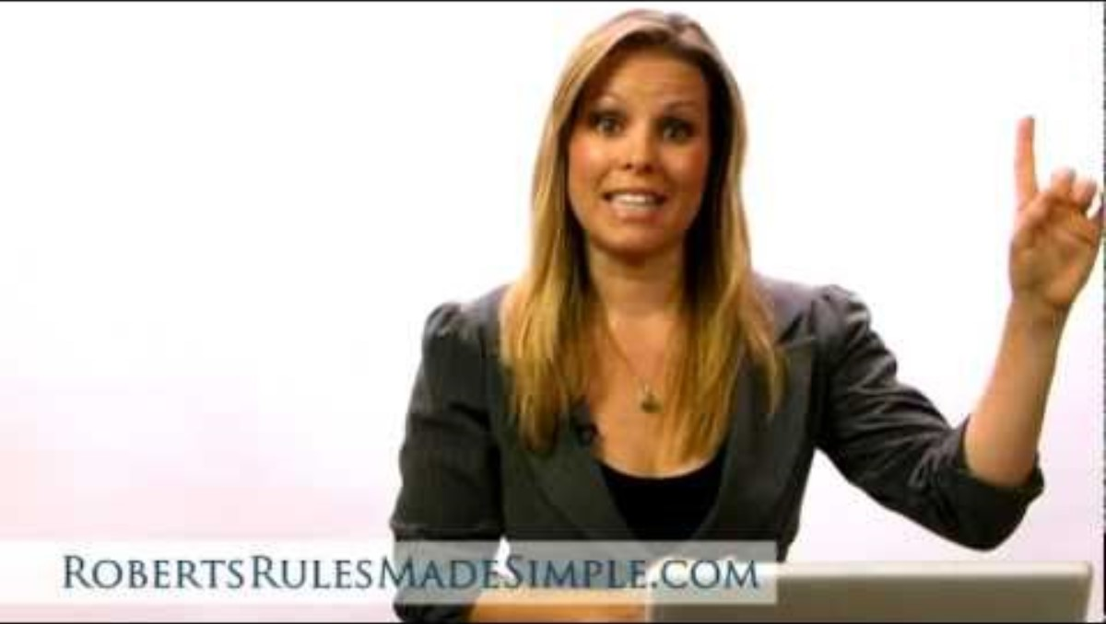

Slide 37

Notes:
How about we take another break before we get into MOTIONS?
See you in 10 minutes

Slide 38
Types of Motions
Main Motions
Secondary Motions
A proposal that certain action be taken or an opinion be expressed by the group.
Allows the group to do work
“I move…”
May be used while the main motion is on the floor
Various types
  Subsidiary Motions
  Privilege Motions
  Incidental Motions
Notes:
There are several types of motions. There are main motions and there are secondary motions. A main motion allows the group to do work, while secondary motions are used while the main motion is on the floor.

Slide 39

Standard Characteristics of a Motion
Are Debatable
May be Amended
Adopted
Notes:
Motions have several characteristics. Motions may be debated, amended, and adopted. If a motion is debatable, this means that there may be a discussion of the motion. If it may be amended, it may be changed to another motion. If the motion is adopted, then it has been voted on and agreed upon by the members of the organization.

Slide 40
 | Rank/Priority | Need Second? | Debatable? | Amendable? | Vote?
MAIN MOTION | 1 | Yes | Yes | Yes | Majority
SUBSIDIARY MOTIONS
Amendment* | 3 | Yes | Yes | Yes | Majority
Primary Amendment |  | Yes | Yes | No | Majority
Secondary Amendment |  | Yes | Yes | Yes | Majority
Refer to committee | 4 | Yes | Yes | Yes | Majority
Postpone to a certain time | 5 | Yes | Yes | Yes | Majority
Limit or extend limits of debate | 6 | Yes | No | Yes | Two-thirds
Previous question or call the question* | 7 | Yes | No | No | Two-thirds
Table | 8 | Yes | No | No | Majority
PRIVILEGED MOTIONS
Call for orders of the day | 9 | No | No | No | request of a member
Raise a question of privilege | 10 | No | No | No | Chair Decides
Recess | 11 | Yes | No | Yes | Majority
Adjourn | 12 | Yes | No | No | Majority
Fix time to which to adjourn | 13 | Yes | No | Yes | Majority
* Amendment and Previous/call the question can be applied to motions higher in rank
Incidental Motions
Request for Information |  | No | No | No | Chair repsonds
Point of Order |  | No | No | No | Chair Rules
Appeal |  | Yes | It Depends | No | Negative
Bring Back Motions
Reconsider |  | Yes | It Depends | No | Majority
Rescind |  | Yes | Yes | Yes | **
Amend something previously adopted |  | Yes | Yes | Yes | **
Take from the Table |  | Yes | No | No | Majority
** Majority with prior notice; two-thirds with no notice (or majority of the entire membership)
Notes:
Let’s look at the Motion Chart. And talk about the ranking of motions and working through situations that might arise.
Remember that a motion must be made and receive a second before the discussion starts. Any motion that does not receive a second dies. The thought is that if there isn’t enough interest to even receive a second from one other member, there isn’t enough interest to approve the motion, and there is no need to move forward. During the discussion, subsidiary or secondary motions can arise to help the body determine the outcome of the motion. These motions have an order or ranking. Once a subsidiary motion is made, any motion below it in the chart can not be made and would be “out of order”. So, let’s start at the bottom of the subsidiary motion list.
NOTE* #2 is missing. I blew it when I made the list and didn’t notice until Friday when I was finalizing this [presentation and after the sheet was sent for copies to be made.
Lowest in the rank in TABLE the motion. Also known as “postpone indefinitely”. Frankly, this is a way to kill the motion. Any motion that is tabled or postponed indefinitely will need a vote from the body to bring it back. It is the lowest because it gives members the ability to have other options to have a motion more likely to have further discussion and be adopted.
Next is the motion PREVIOUS QUESTION or CALL THE QUESTION. This motion requires the vote on the motion to happen now which means effectively limiting the debate on the motion. Therefore, it would need a two-thirds majority to be adopted. NOTE* this motion can be made at any time during the discussion of any motion in this list.
Next in the ranking list is to limit or to extend limits in debate. Some discussions are likely to have a long debate. Contract ratification, for example, would be prudent to set a time limit on debate to give every member the ability to have their voice heard. Once a limit is set, changes in that limit, higher or lower would also require a motion and vote. These require two-thirds as well.
Moving up the list is Postpone to a Certain Time (used to be called Table to a later date) but at some point, in a version of Roberts Rules, it was considered to close and confusing with Table indefinitely. This motion sets a certain time for a motion to be reconsidered. Perhaps there is some research that is requested during discussion; funding possibilities, logistics to adoption, etc. legitimate reasons to delay until answers can be researched and presented to the body.
The body can choose to Refer to Committee. Perhaps it’s a little more than just researching an answer, but there needs to be further discussion by a group of members. The bylaws determine how a committee is created. Our Constitution and Bylaws say it is the President’s responsibility to create and appoint members of a committee.
A motion can be amended. That is it can be changed. I will use one of the favorite motions that comes up every couple of years, the union vehicles. There is a motion that has been seconded to buy a new vehicle for the Business Manager. During the discussion, a member might want to limit the amount spent on a vehicle and could make an amendment to the motion to limit the amount to $30,000. then the discussion would start on the amendment. When that discussion ends, a vote is in order on the amendment. If it passes, the motion has been amended, and now the motion would be to Buy the business manager a new vehicle with a price limit of $30,000. The original motion was to buy the vehicle the amendment added the price limit. A primary amendment can have amendments as well. Use your imagination. If discussion is ongoing, changes will be presented, and some of them may be worthy of a motion to amend.
Now let’s talk about the Incidental Motions
Request for Information – in order to responsibly vote on a motion, members might request information. The chair determines how the request is handled. They may have the information readily available. But, in the case that the information isn’t available, this could lead to the request for a motion to postpone to a certain time. IE the next meeting
Point of Order – I haven’t heard it as much, but when I was young, a few, dare I say, slightly unruly members would use Point of Order to interrupt the discussion and try to get their point heard instead of waiting to be called upon like everyone else. Point of Order is a legitimate item to be brought up when it is in order. Perhaps the chair skips an item on the agenda or forgets to hear a report from a committee. These are legit Points of Order that should be heard by the chair. A member would then interrupt discussion by claiming a Point of Order and the chair would rule and the decision is final. There is no vote on a point of order.
That brings us to an Appeal. Members may disagree with the decision of the chair. They can call for an appeal. An appeal needs a second and majority to prevail. An example would be that a member makes a motion that the chair considers out of order. An appeal would determine if the chair’s decision is sustained or not. Decisions of the chair that are codified in bylaws may not be appealed. For example, a Local Union nomination, as stated in their bylaws, is the first Thursday in September. A motion to move the nomination to another date is not in order. As a side note the proper way to change that nomination date would be through a change in Local Bylaws to included proper notification and secret ballot vote.
The bring-back motions are rare and pretty self-explanatory. They are…
Reconsider, Rescind, Amend a previously adopted and to take from the table.
A motion that has previously been discussed and maybe even voted on will need a motion, second, and vote to be brought up again.
Two of them would need notification or otherwise require two-thirds to be adopted.

Slide 41
Steps to Making a Motion
1. Member rises and addresses Chair
2. Chair recognizes a member by nodding at the member and stating his or her name
3. Member states the motion
  “I move to…”
4. Another member seconds the motion by raising a hand and calling out “Second”

Slide 42
Steps to Making a Motion
Chair states motion and places it before the assembly
  “It is moved and seconded that….”
  “Is there any discussion?”
6. Members are recognized and debate the motion (subsidiary motions may be introduced during this time)

Slide 43

Steps to Making a Motion
Chair puts question to a vote
  “Are you ready for the question?”
  “The question is on the adoption of the motion…”
  “Those in favor raise your hand…”
  “Those opposed raise your hand…”
  “Secretary please take roll…”

Slide 44
Steps to Making a Motion
8. Chair announces the results of the vote
  “Those in favor have it, the motion has been adopted to…”
      “Those opposed have it; the motion is lost, we will not…”
      “The next order of business is…”

Slide 45
When the Meeting is Out of Order
Individual members making personal remarks
Members bringing up the same motion or essentially one like it
Putting a debatable issue to vote before the full debate is complete
Debates are not directed to motions but to motives, principles and personalities.
Members yelling out in opposition
Members not being in recognized by the Chair
Notes:
Individual members making personal remarks – The chair would declare those members out of order and must restore order which can be difficult at times.
Members bringing up the same motion or essentially one like it – require a motion to reconsider
Putting a debatable issue to vote before the full debate is complete – if the chair calls for a vote and there is still people wanting to discuss the issue, a point of order could be used here.
Debates are not directed to motions but to motives, principles, and personalities. The members must always address the chair. Debate and discussion is not personal. The chair must keep the debate focused on the business at hand.
Members yelling out in opposition or Members not being recognized by the Chair
– again, the chair is responsible for keeping order. Confidence comes with experience.

Slide 46
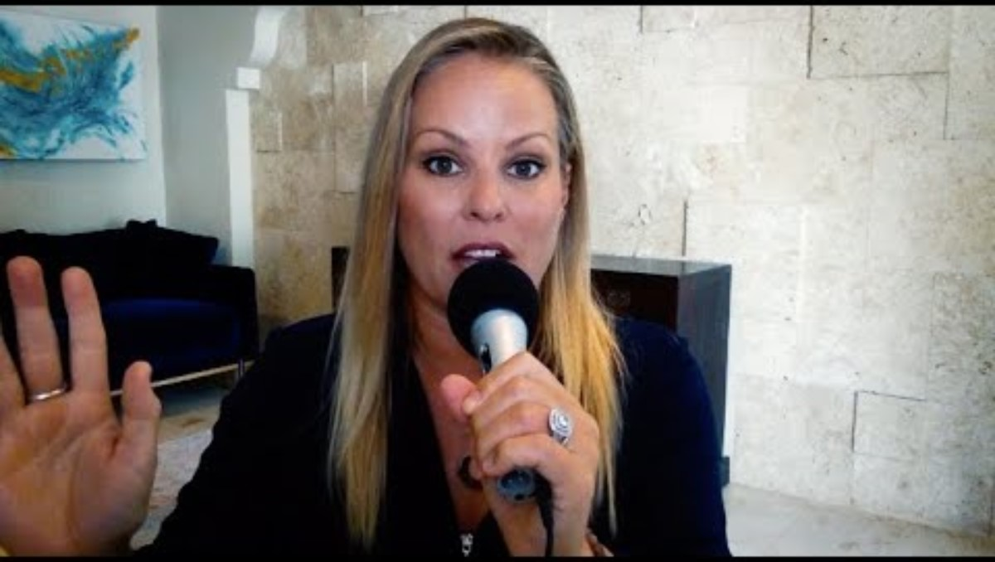

Slide 47
True / False
Every time some one seconds a motion, it should be recorded in the minutes.

Slide 48
Answer:
False. The information that should not be recorded in the minutes includes the following: discussion or personal opinion, name of the seconder of the motion, motions withdrawn and entire reports. Nevertheless, reports that are provided by members or committee chairs should be attached to the minutes.

Slide 49
True / False
A quorum is the number of people who must be present to legally transact business.

Slide 50
Answer:
True. The number of people who must be present to legally transact business is a quorum.
What’s that number for us?

Slide 51
After the Meeting
Identify any unfinished business
Type minutes and send out for review
Develop an agenda for next meeting
Complete any reports that are assigned
Contact respective persons if you are not going to attend the upcoming meeting

Slide 52
Resources
Webster’s
  ROBERT’S RULES OF ORDER
    SIMPLIFIED AND APPLIED
World’s #1 Quick Reference Guide
  ROBERT’S RULES OF ORDER QUICK STUDY
Notes:
I these to resources with me at every meeting I chair along with our International Constitution and Bylaws as well as Local Bylaws.
You can’t always count on legal counsel for advice about rules of order. As I mentioned earlier, I chair the MD State Apprenticeship Council. We have an assistant state attorney at every meeting. When it comes to rules of order, she is clueless and counts on me to know procedure a determine order. She readily points out that she is an attorney not a parliamentarian.

Slide 53

Any Questions?
Notes:
Are you ready to go to the National Association of Parliamentarians and take the test??

